Slide 1

Introduction on Microsoft Power BI
Nguyen Van Vien
Email: viennv@ueh.edu.vn
Mobile: 0973 225 589

Slide 2
The goal is to turn data into information, and information into insight.
―Carly Fiorina

Slide 3
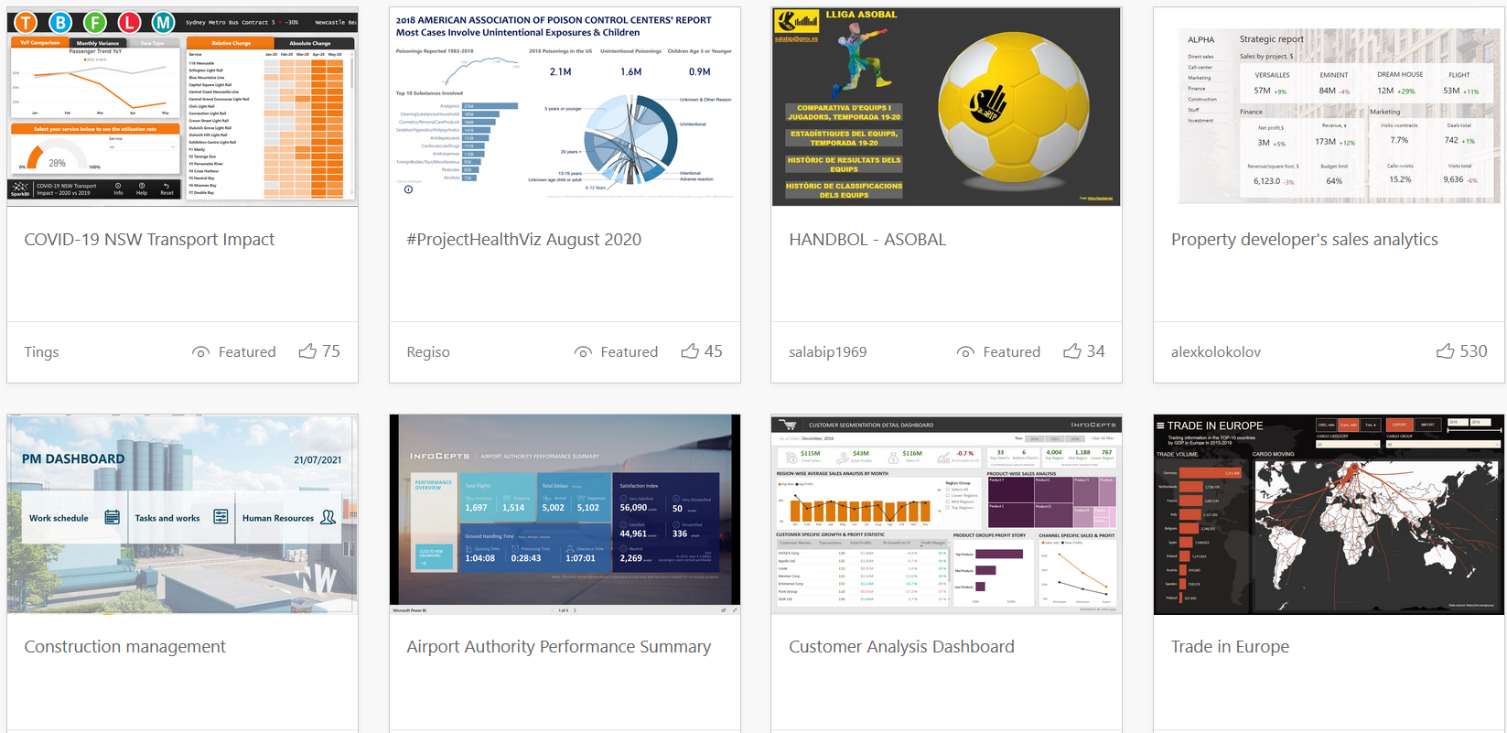
Data Stories Gallery

Slide 4
Exploring key concepts of business intelligence
Domain
Data
Model
Analysis
Visualization

Slide 5
Domain
A domain is simply the context where business intelligence is applied. Most businesses are composed of relatively standard business functions or departments, such as the following:
Sales
Marketing
Manufacturing/production
Supply chain/operations
Research and development
Human resources
Accounting/finance
Source: Deckler (2022)

Slide 6
Data (1)
Once a domain has been decided upon, the next step is identifying and acquiring the data that's pertinent to that domain. This means identifying the sources of relevant data. These sources may be internal or external to an organization and may be structured, unstructured, or semi-structured in nature.
Internal and external data
Internal data is data that is generated within an organization by its business processes and operations.
External data is data that is generated outside the boundaries of an organization's operations.
Source: Deckler (2022)

Slide 7
Data (2)
Structured, unstructured, and semi-structured data
Structured data is data that conforms to a rather formal specification of tables with rows and columns: Open Database Connectivity (ODBC) and Object Linking and Embedding Database (OLE DB)
Unstructured data is effectively the opposite of structured data. Unstructured data cannot be organized into simple tables with rows and columns. Such data includes things such as video, audio, images, and text. This type of data is either stored as Binary Large Objects (BLOBSs), online files or posts, or as files in a file system, such as the New Technology File System (NTFS) or the Hadoop Distributed File System (HDFS).
Semi-structured data has a structure but does not conform to the formal definition of structured data, that is, tables with rows and columns. Examples of semi-structured data include tab and delimited text files, XML, other markup languages such as HTML and XSL, JavaScript Object Notation (JSON), and Electronic Data Interchange (EDI).
Source: Deckler (2022)

Slide 8
Model
A model, or data model, refers to the way in which one or more data sources are organized to support analysis and visualization. Models are built by transforming and cleansing data, helping to define the types of data within those sources, as well as the definition of data categories for specific data types. Building a model generally involves three elements:
Organizing
Transforming and cleansing
Defining and categorizing
Source: Deckler (2022)

Slide 9
Organizing
The model becomes more complex as the various sources and tables of data must be combined into a cohesive whole. This is done by defining how each of the disparate sources of data relates to one another.
As an example, let's say you have one data source that represents a customer’s name, contact information, and perhaps the size of the business by revenue and/or the number of employees. This information might come from an organization's Customer Relationship Management (CRM) system. The second source of data might be order information, which includes the customer's name, units purchased, and the price that was paid. This second source of data comes from the organization's Enterprise Resource Planning (ERP) system. These two sources of data can be related to one another based on the unique name or ID of the customer.
Source: Deckler (2022)

Slide 10
Transforming and cleansing
Data is never clean – it must always be massaged for bad data to be removed or resolved.
In addition, data may have errors, missing data, inconsistent formatting, or even have something as seemingly simple as trailing spaces.
Business intelligence tools such as Power BI provide mechanisms for cleansing and reshaping the data to support analysis. This might involve replacing or removing errors in the data, pivoting, unpivoting, or transposing rows and columns, removing trailing spaces, or other types of transformation operations.
Source: Deckler (2022)

Slide 11
Defining and categorizing
Data models also formally define the types of data within each table. Data types generally include formats such as text, decimal number, whole number, percentage, date, time, date and time, duration, true/false, and binary. The definition of these data types is important as it defines what kind of analysis can be performed on the data.
Data models also define the data category of data types. While a data type such as a postal code might be numeric or text, it is important for the model to define that the numeric data type represents a postal code. This further defines the type of analysis that can be performed upon this data, such as plotting the data on a map. Similarly, it might be important for the data model to define that a text data type represents a web or image Uniform Resource Locator (URL). Typical data categories include such things as address, city, state, province, continent, country, region, place, county, longitude, latitude, postal code, web URL, image URL, and barcode.
Source: Deckler (2022)

Slide 12
Analysis
This is a key process within business intelligence as this is when you attempt to answer questions that are relevant to the business using internal and external data. Simply having data about sales is not immediately useful to a business.
Many times, organizations have, or wish to have, Key Performance Indicators (KPIs), which are tracked by the business to help determine the organization's health or performance. KPIs might include such things as employee retention rate, net promoter score, new customer acquisitions per month, gross margin, and Earnings Before Interest, Tax, Depreciation, and Amortization (EBITDA). Such KPIs generally require that the data is aggregated, has calculations performed on it, or both. These aggregations and calculations are called metrics or measures and are used to identify trends or patterns that can inform business decision-making.
Source: Deckler (2022)

Slide 13
Visualization
Humans are visually oriented and thus it is advantageous to view the results of the analysis in the form of charts, reports, and dashboards.
In the same way that a picture is worth a thousand words, visualizations allow thousands, millions, or even trillions of individual data points to be presented in a concise manner that is easily consumed and understandable.
Visualization allows the analyst or report author to let the data tell a story. This story answers the questions that are originally posed by the business and thus delivers the insights that allow organizations to make better decisions.
Source: Deckler (2022)

Slide 14
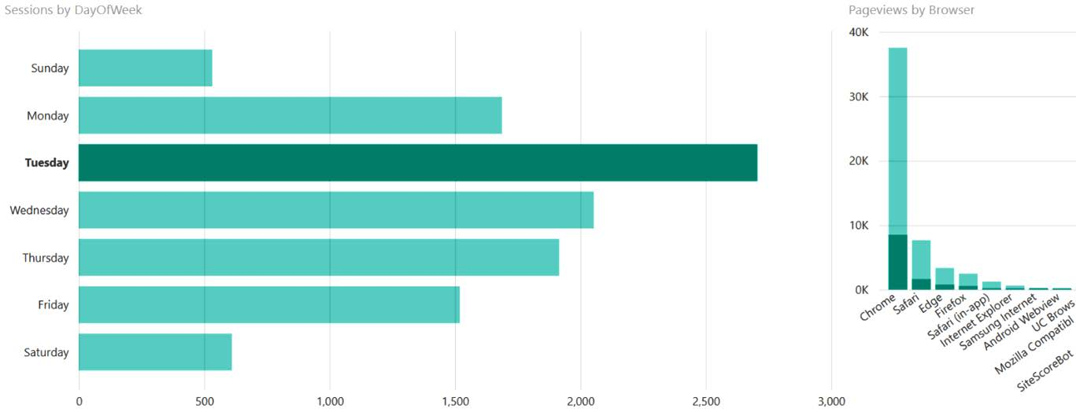
Source: Deckler (2022)

Slide 15
Power BI Desktop: Process
Getting data
Creating a data model
Analyzing data
Creating and publishing reports
Source: Deckler (2022)

Slide 16
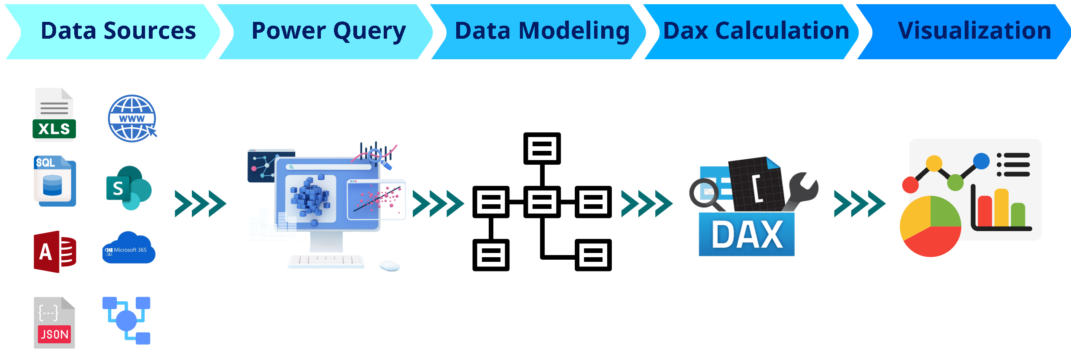

Slide 17
The Power BI service
Viewing and editing reports
Creating dashboards
Sharing and collaborating with others
Accessing and creating apps
Refreshing data
Source: Deckler (2022)

Slide 18
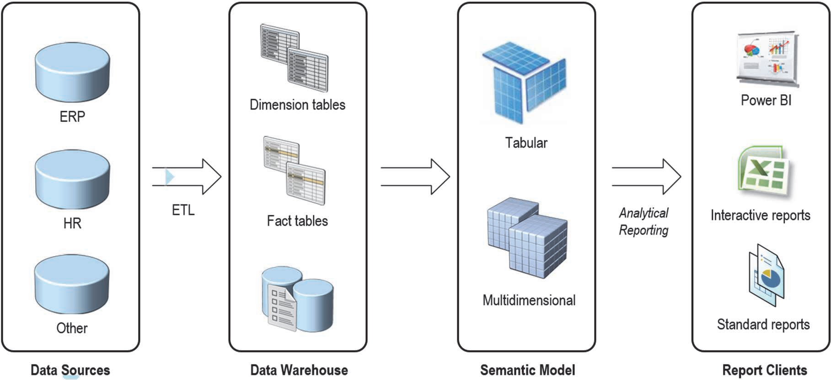
Classic organizational BI architecture
Figure. Organizational BI typically includes ETL processes, data warehousing, and a semantic layer.
Source: Lachev & Price (2018)

Slide 19
Understanding organizational BI challenges
Upfront planning and implementation effort - Depending on the data integration effort required, implementing an organizational BI solution might not be a simple task. Business users and IT pros must work together to derive requirements. Most of the implementation effort goes into data logistics processes to clean, verify, and load data.
Highly specialized skillset - Organizational BI requires specialized talent, such as someone experienced in ETL, Analysis Services, and data warehousing. System engineers and developers must work together to plan the security, which sometimes might be more complicated than the actual BI solution.
Less flexibility - Organization BI might not be flexible enough to react quickly to new or changing business requirements.
Source: Lachev & Price (2018)

Slide 20
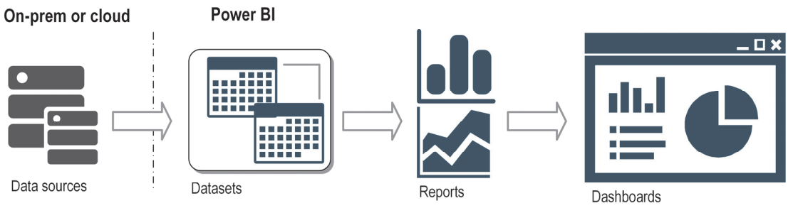
Understanding Power BI Content Items
Figure. The Power BI main items are datasets, reports, and dashboards.
Source: Lachev & Price (2018)

Slide 21
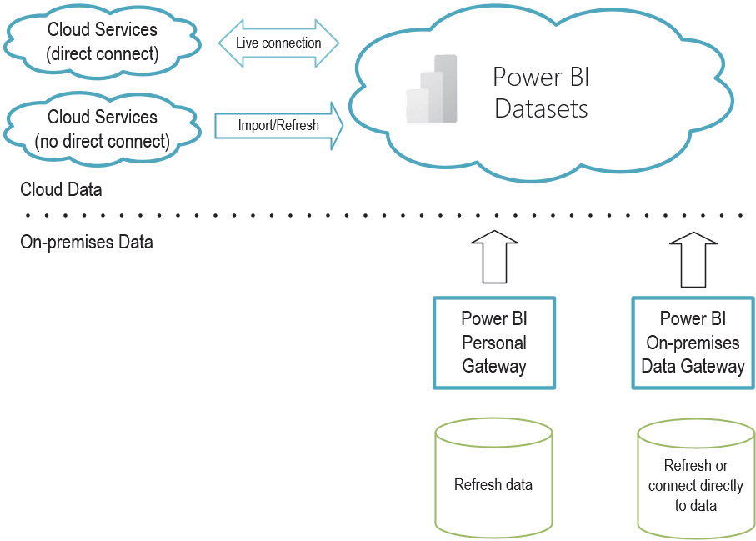
Understanding cloud and on-prem data sources
Figure. Power BI can import data or create live connections to some data sources.
Source: Lachev & Price (2018)

Slide 22
Understanding cloud and on-prem data sources
Cloud (SaaS) services – These data sources are hosted in the cloud and available as online services. Examples of Microsoft cloud data sources that Power BI supports include OneDrive, Dynamics CRM, Azure SQL Database, Azure Synapse Analytics, and Spark on Azure HDInsight. Power BI can also access many popular cloud data sources from other vendors, such as Salesforce, Google Analytics, Marketo, and many others (the list is growing every month!).
On-premises data sources – This category encompasses all other data sources that are internal to your organization, such as databases, cubes, Excel, and other files. For Power BI to access onpremises data sources, it needs a special connectivity software called a gateway.
Source: Lachev & Price (2018)

Slide 23
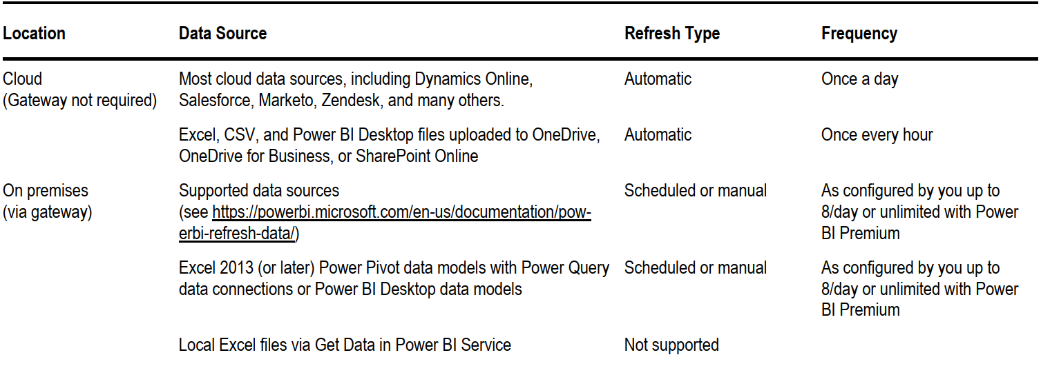
Table. This table summarizes data refresh options when data is imported from cloud and on-premises data sources.
Source: Lachev & Price (2018)

Slide 24
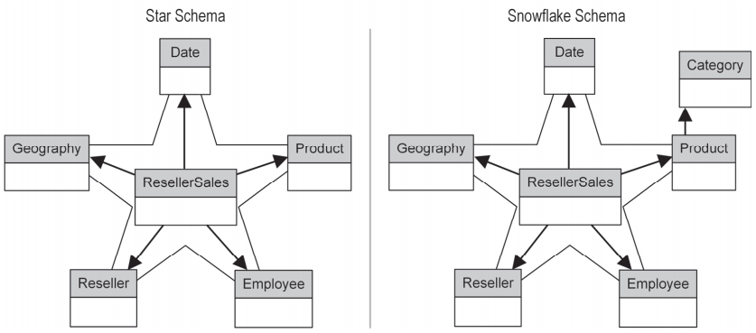
Understanding star schemas
Figure. Power BI models support both star and snowflake schema types.
Source: Lachev & Price (2018)
Notes:
Lachev, T., & Price, E. (2018). Applied Microsoft Power BI Bring your data to life!. Prologika Press.

Slide 25
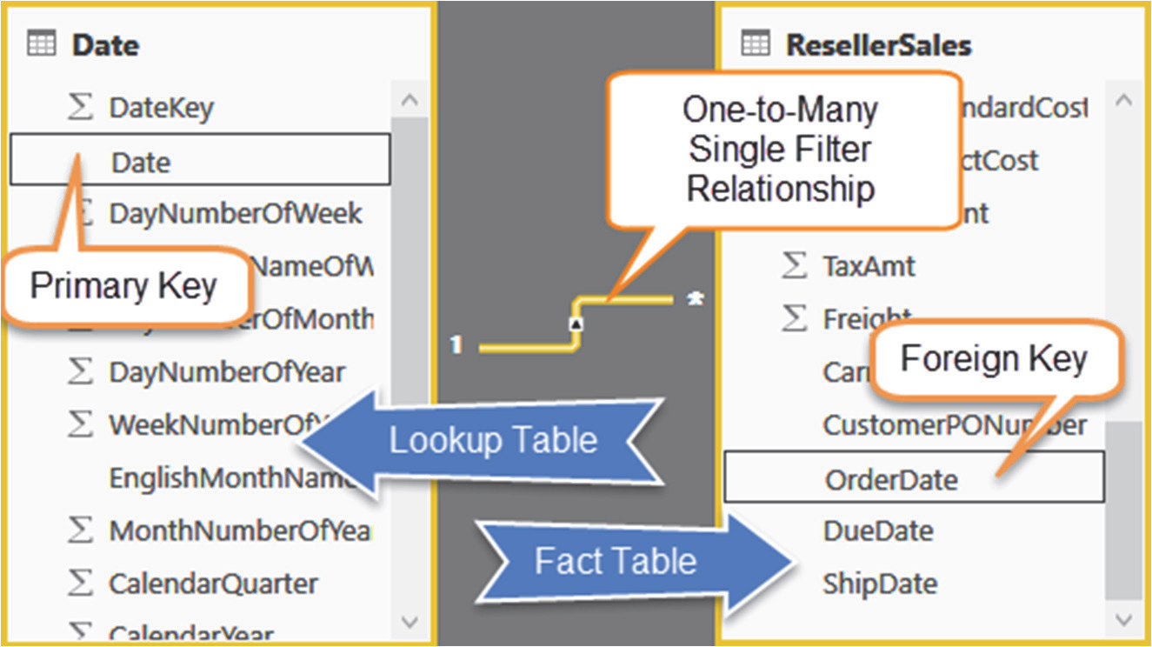
Introducing Relationships
Figure. The Date column (primary key) in the Date table is related to the matching OrderDate column (foreign key) in the ResellerSales table.
Source: Lachev & Price (2018)

Slide 26
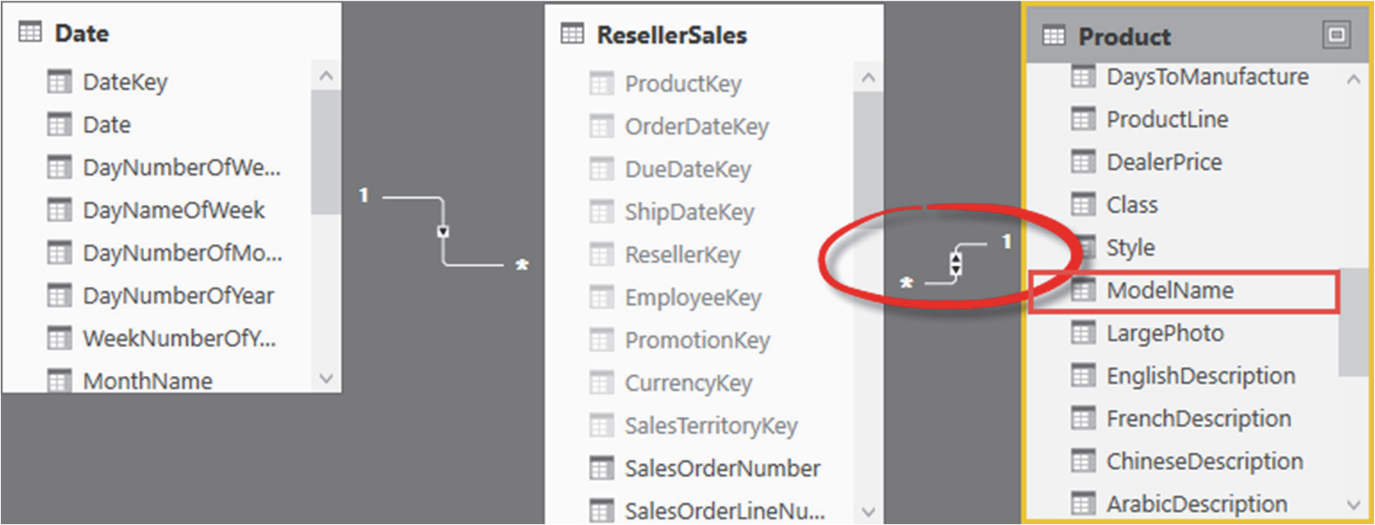
About relationship cross filter direction
Figure. The relationship between the ResellerSales and Product table has a cross filtering direction set to Both.
Source: Lachev & Price (2018)

Slide 27
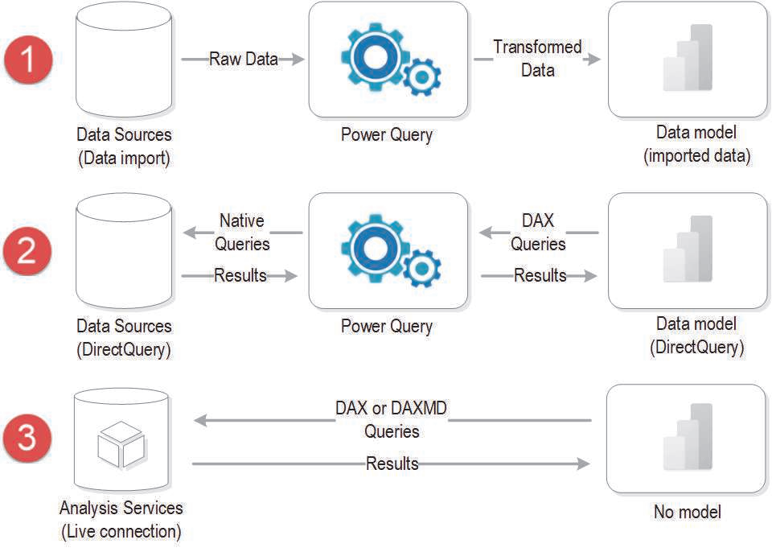
Understanding Data Connectivity
Figure. Power BI supports three main connectivity options: import, DirectQuery, and live connections.
Source: Lachev & Price (2018)

Slide 28
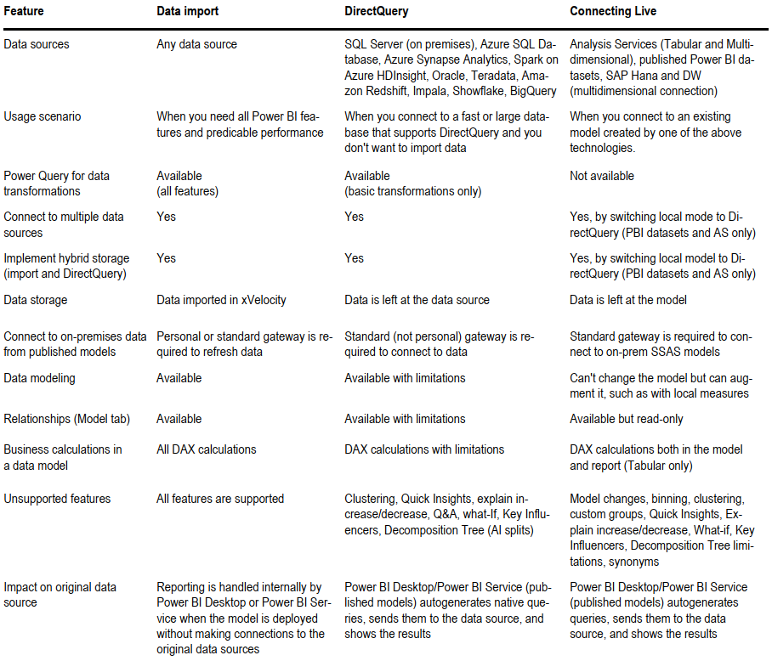
Source: Lachev & Price (2018)

Slide 29
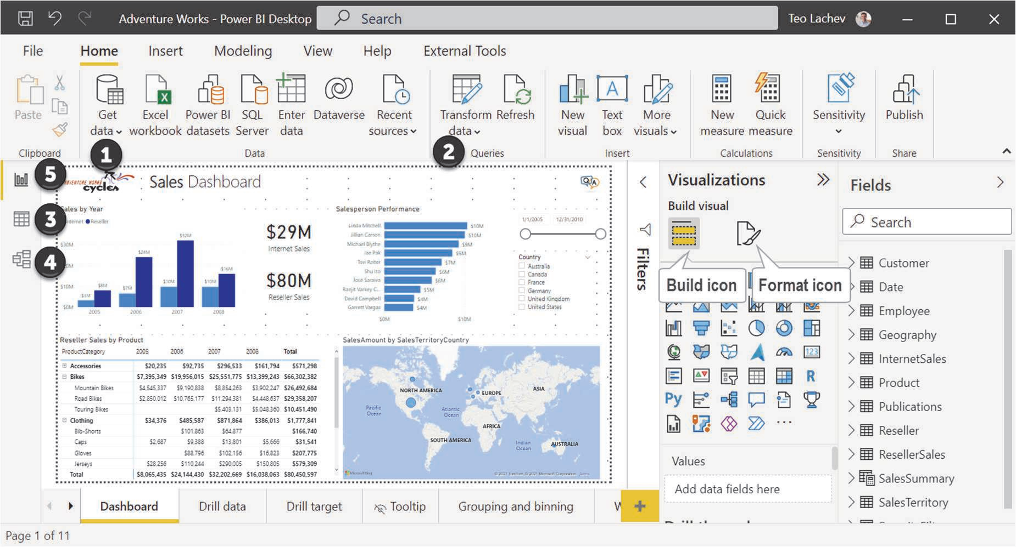
Understanding Design Environment
Source: Lachev & Price (2018)

Slide 30
Understanding data modeling steps
Get data – As in Power BI Service, the process starts with connecting to your data (the Get Data button).
Transform data – Remember that when you import the data or use DirectQuery, Power BI Desktop creates a query for each table you import (except when you connect live to certain data sources, in which case there is no underlying query). If the data requires cleansing or transformations, click "Transform data" to open Power Query Editor and perform data transformation tasks, such as replacing column values.
Explore and refine data – Switch to the Data tab to explore and refine the imported data, such as to see what data is loaded in a table and to change column data types. The Data tab isn't available with DirectQuery and live connections. However, in the case of DirectQuery data sources, you can still use the Power Query Editor to shape and transform the data, although not all transformations are available.
Create relationships – As a part of refining the data model, if you import multiple tables, you need to relate them either using the Model tab or the Manage Relationships button in the ribbon's Modeling tab.
Visualize data – Finally, you build reports to visualize your data and get insights by switching to the Report tab, which is available with all the data connectivity options.
Source: Lachev & Price (2018)

Slide 31
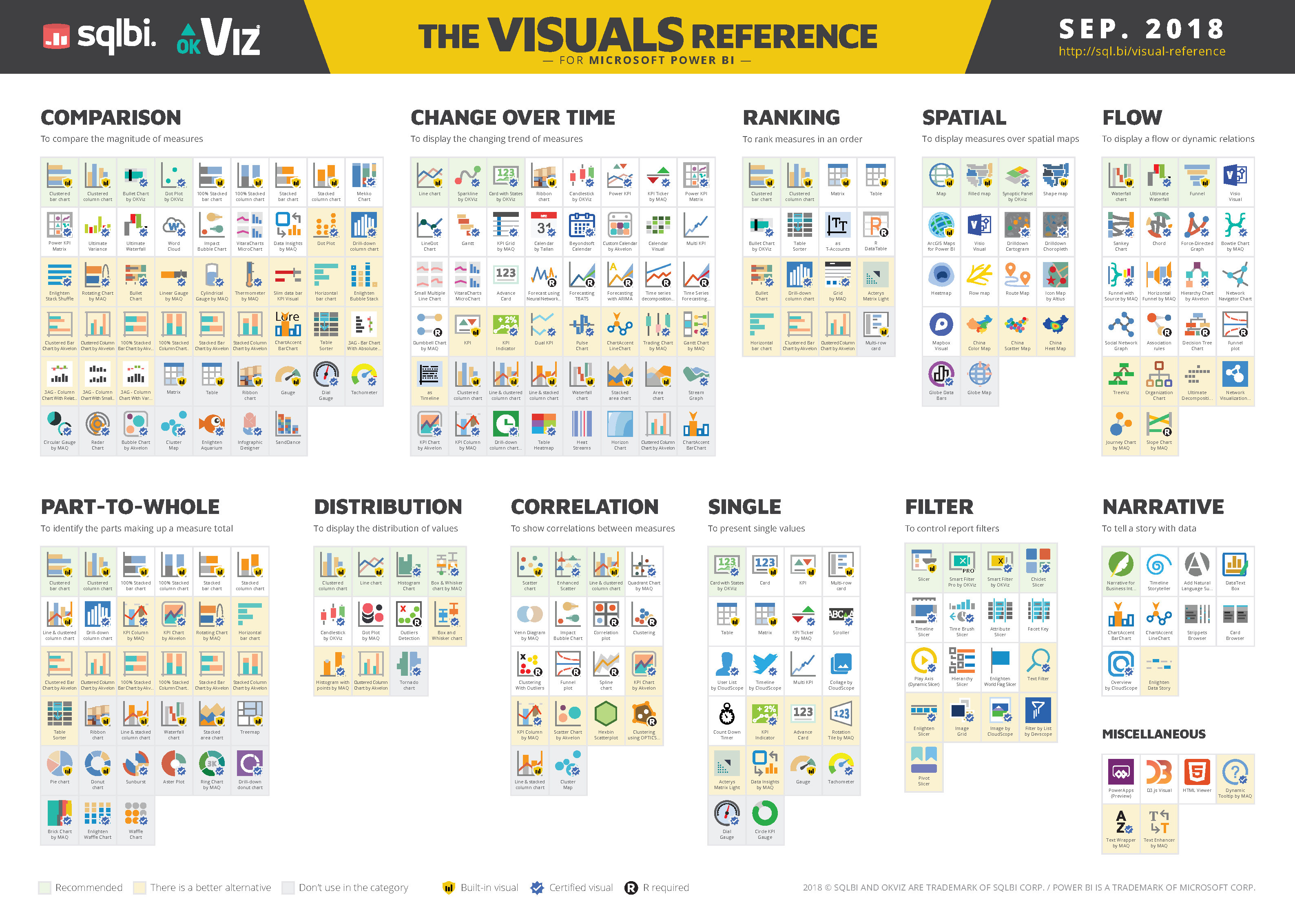
Notes:
https://www.sqlbi.com/ref/power-bi-visuals-reference/

Slide 32
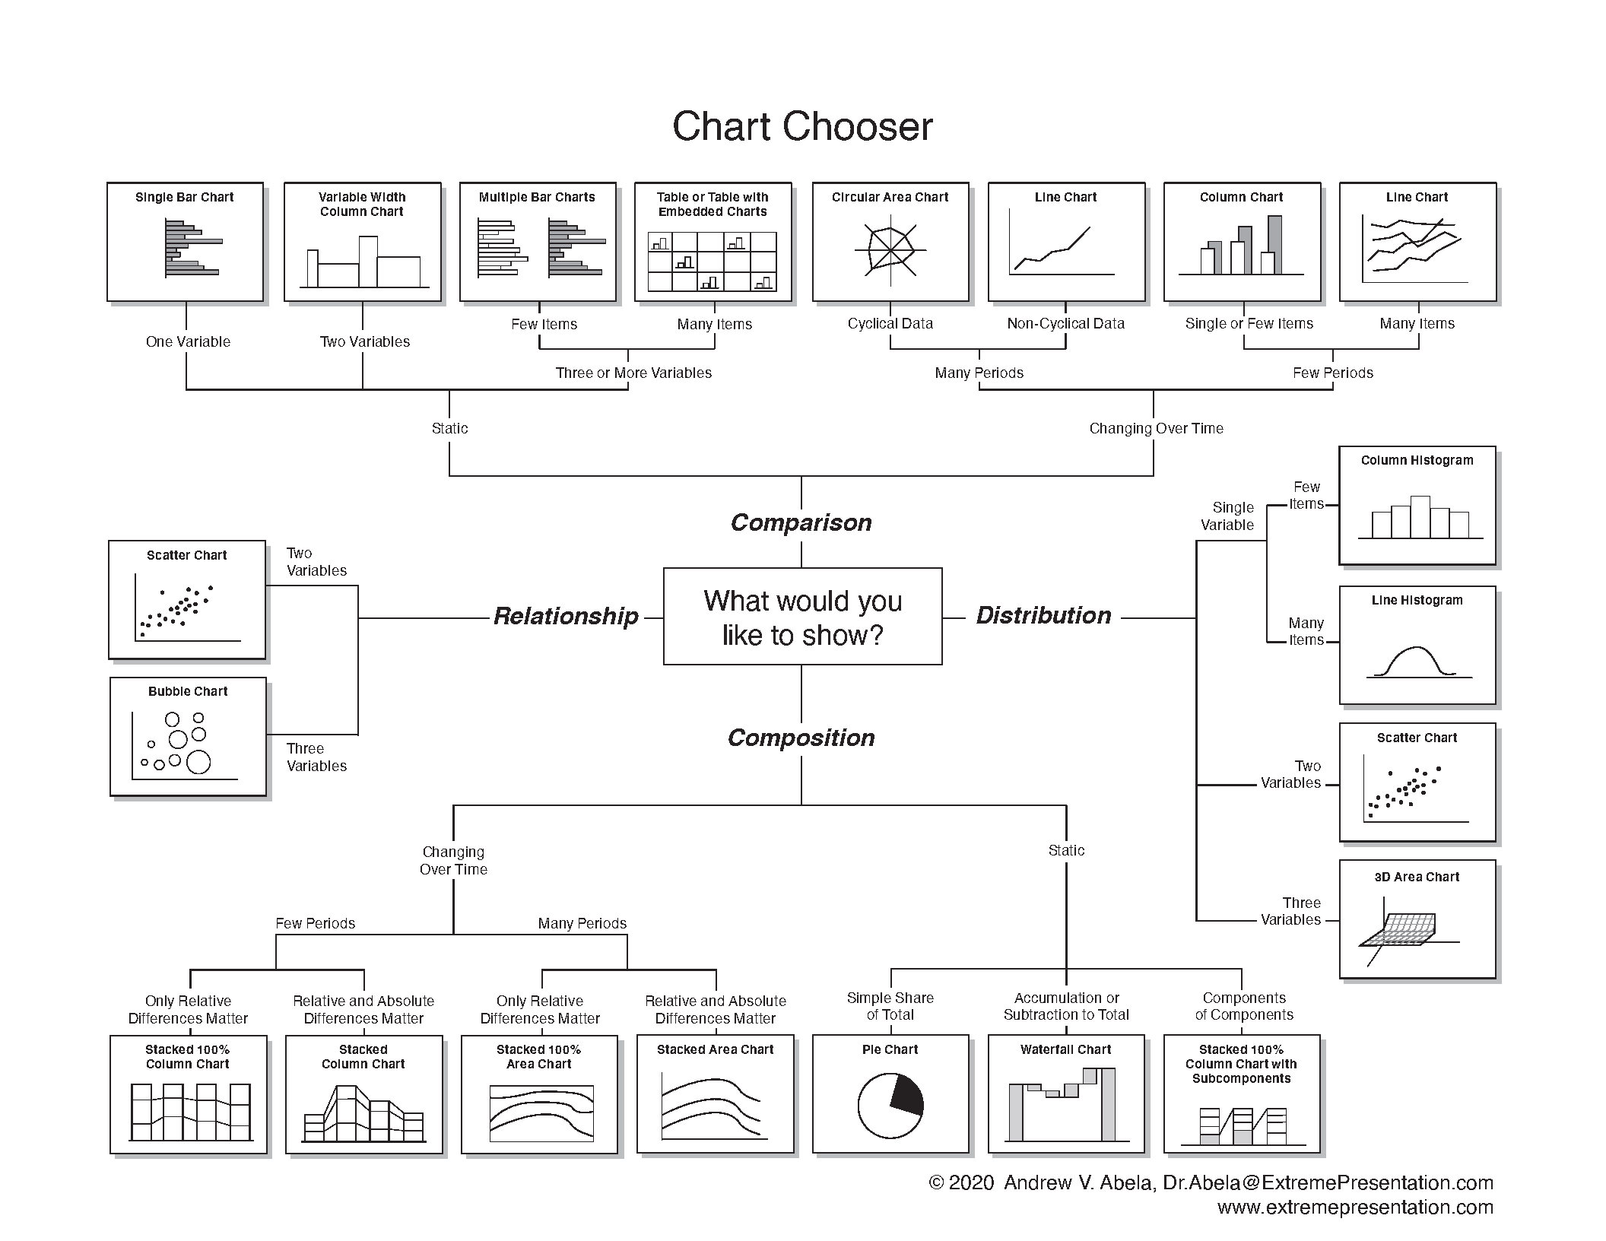

Slide 33
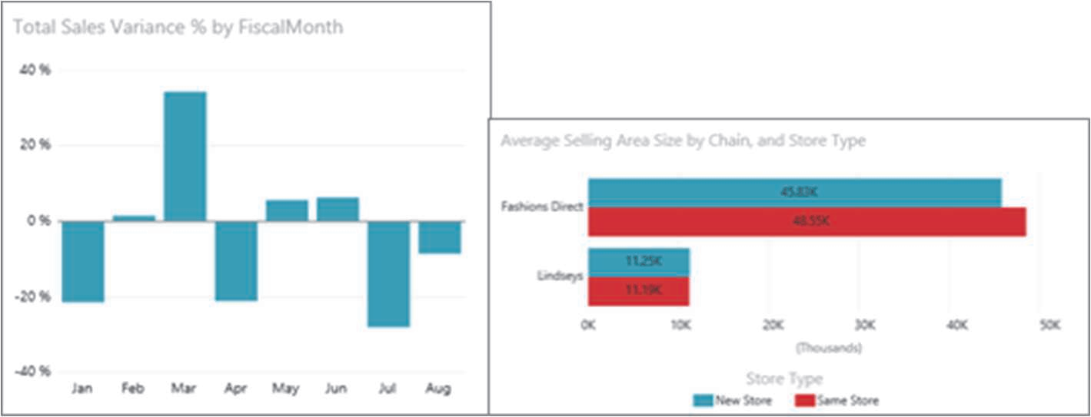
Column and Bar charts
Figure. Column and bar charts display data points as bars.
Source: Lachev & Price (2018)

Slide 34
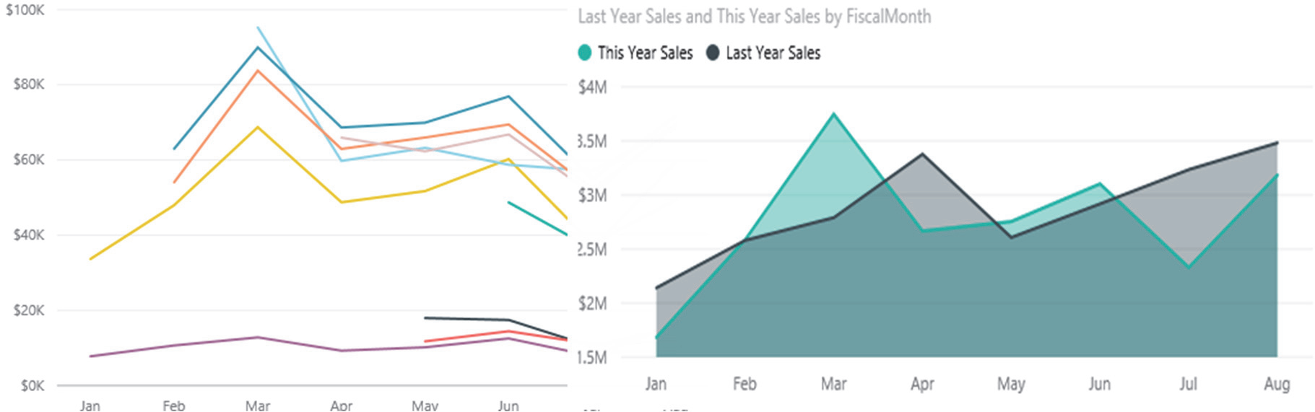
Line charts
Figure. Power BI supports line charts and area charts.
Source: Lachev & Price (2018)

Slide 35
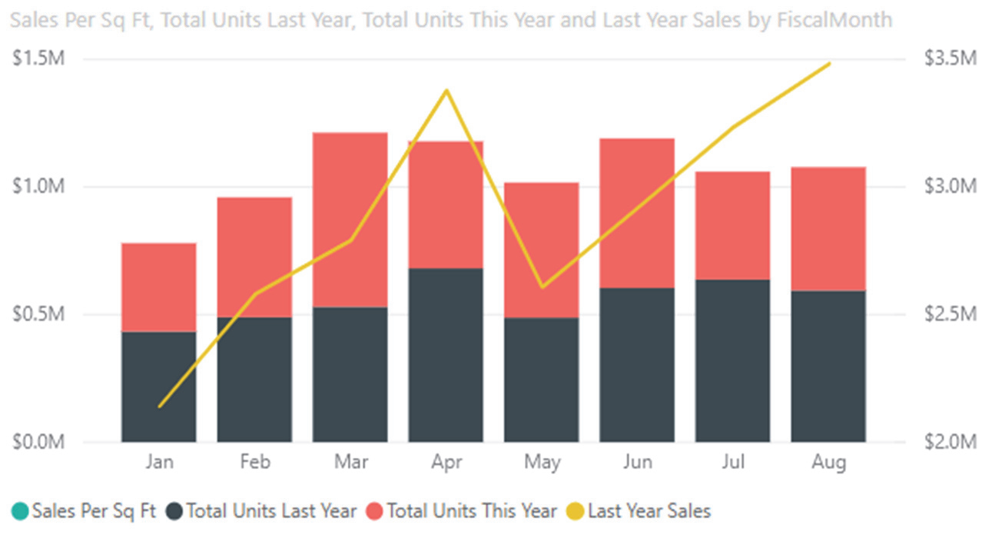
Combination Chart
Figure. A Combo Chart allows you to plot measures on different axes. In this example, the This Year Sales and Last Year Sales measures are plotted on the left Y-axis, while Store Count is plotted on the right Y-axis.
Source: Lachev & Price (2018)

Slide 36
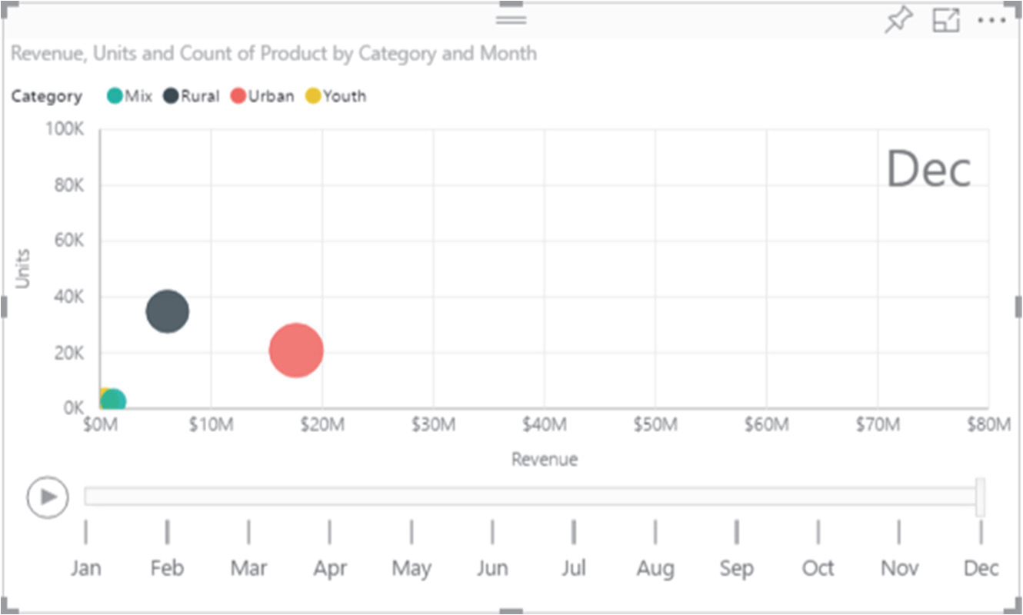
Scatter Chart
Figure. Use a Scatter Chart to analyze correlation between two variables.
Source: Lachev & Price (2018)

Slide 37
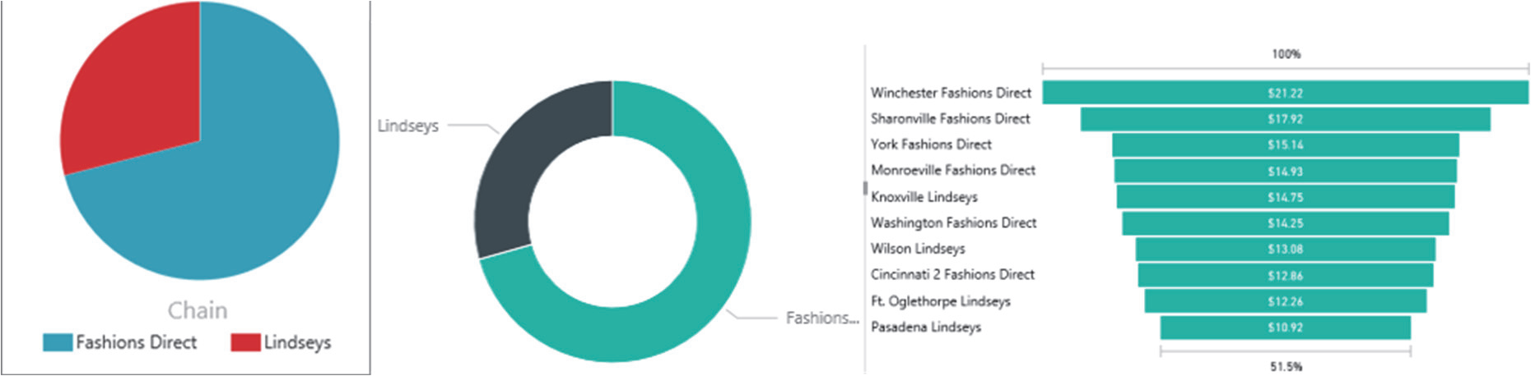
Shape charts
Figure. Pie, Doughnut, and Funnel charts can be used to display values as percentages of a whole.
Source: Lachev & Price (2018)

Slide 38
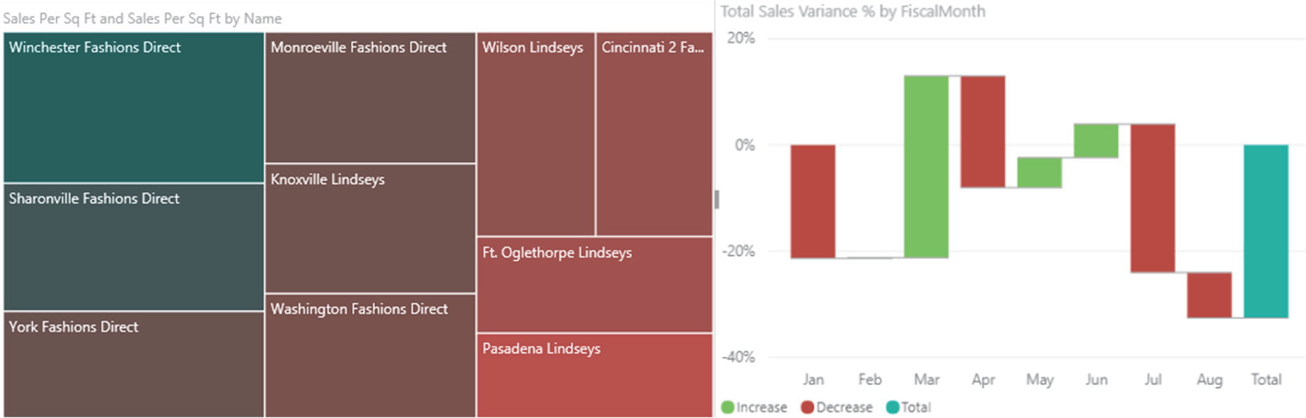
Treemap and Waterfall charts
Figure. Consider a Treemap Chart to analyze contribution across many data points and a Waterfall Chart to show a running total as values are added or subtracted.
Source: Lachev & Price (2018)

Slide 39
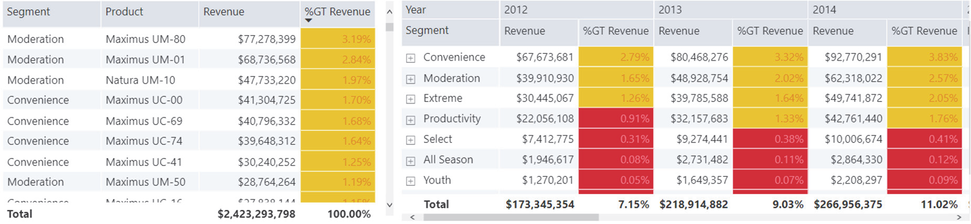
Table and Matrix visualizations
Figure. Use Table and Matrix visualizations for tabular and crosstab text reports.
Source: Lachev & Price (2018)

Slide 40
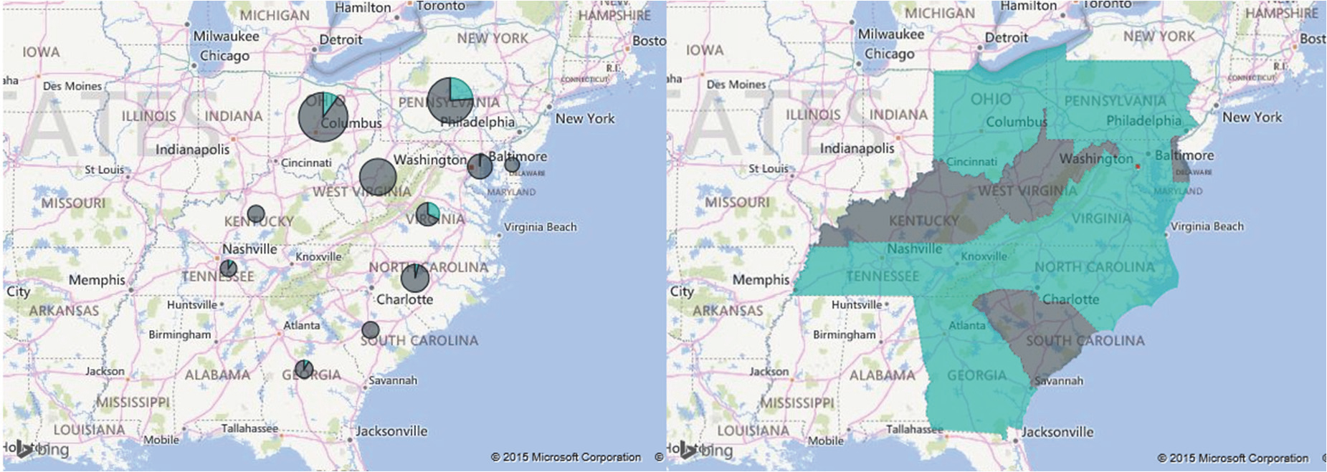
Map visualizations
Figure. Examples of a Basic Map and Filled Map.
Source: Lachev & Price (2018)

Slide 41
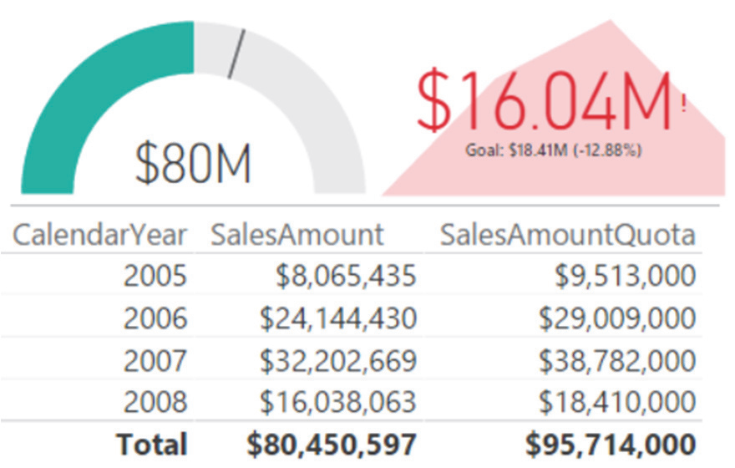
Gauge visualizations
Figure. The Gauge and KPI visuals display progress toward a goal.
Source: Lachev & Price (2018)

Slide 42
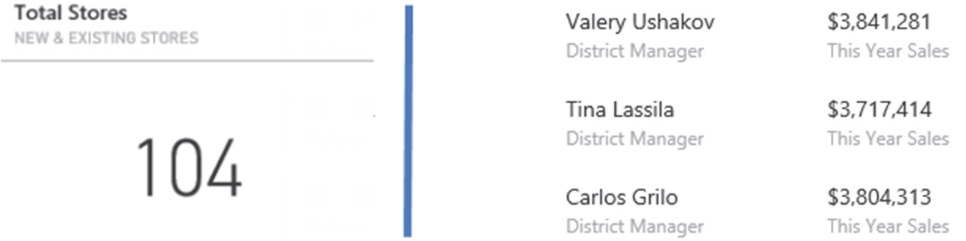
Card visualizations
Figure. The Single Card on the left displays a single value (total stores) while the Multi Row Card displays managers and their sales.
Source: Lachev & Price (2018)

Slide 43
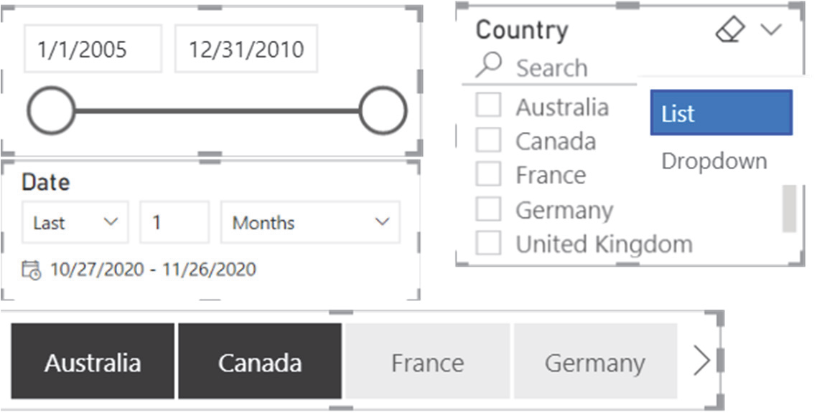
Slicer
Figure. Use the Slicer visualization to create a filter that filters all visualizations on the report page.
Source: Lachev & Price (2018)

Slide 44
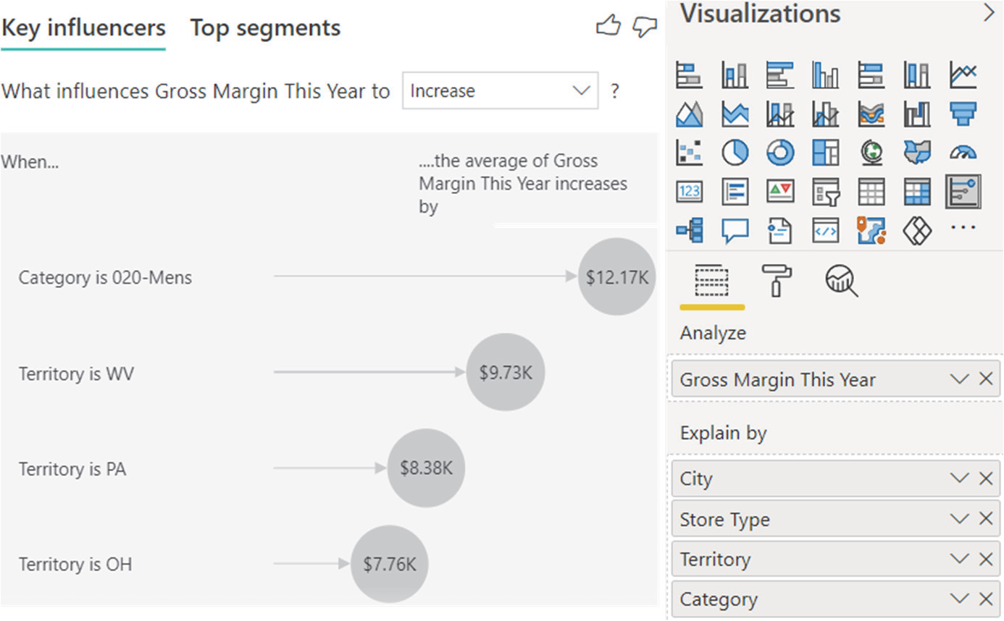
Key influencers
Figure. Use the Key Influencers visual to identify the most important factors for increasing or decreasing a measure.
Source: Lachev & Price (2018)

Slide 45
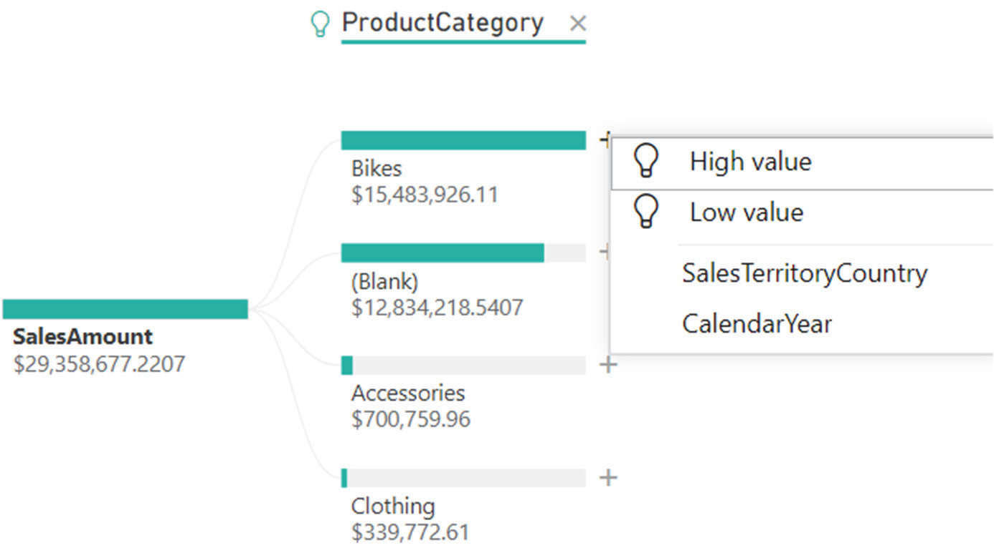
Decomposition Tree
Figure. Use the Decomposition Tree to find which category contributes the most to higher sales.
Source: Lachev & Price (2018)

Slide 46
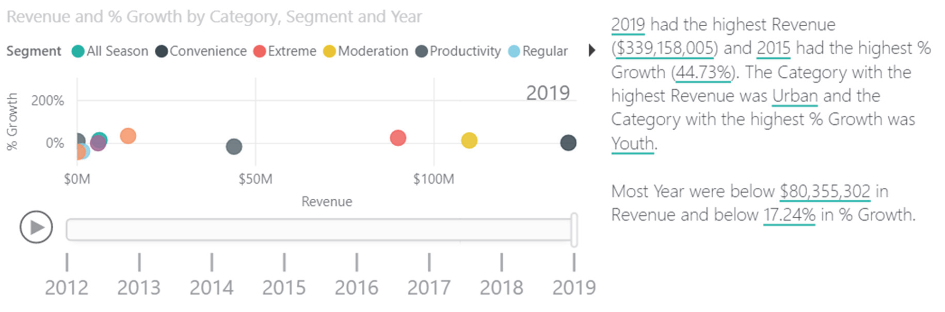
Smart narrative
Figure. You can right-click a visual and click Summarize to get a narrative explaining the data behind the visual.
Source: Lachev & Price (2018)

Slide 47


Slide 48
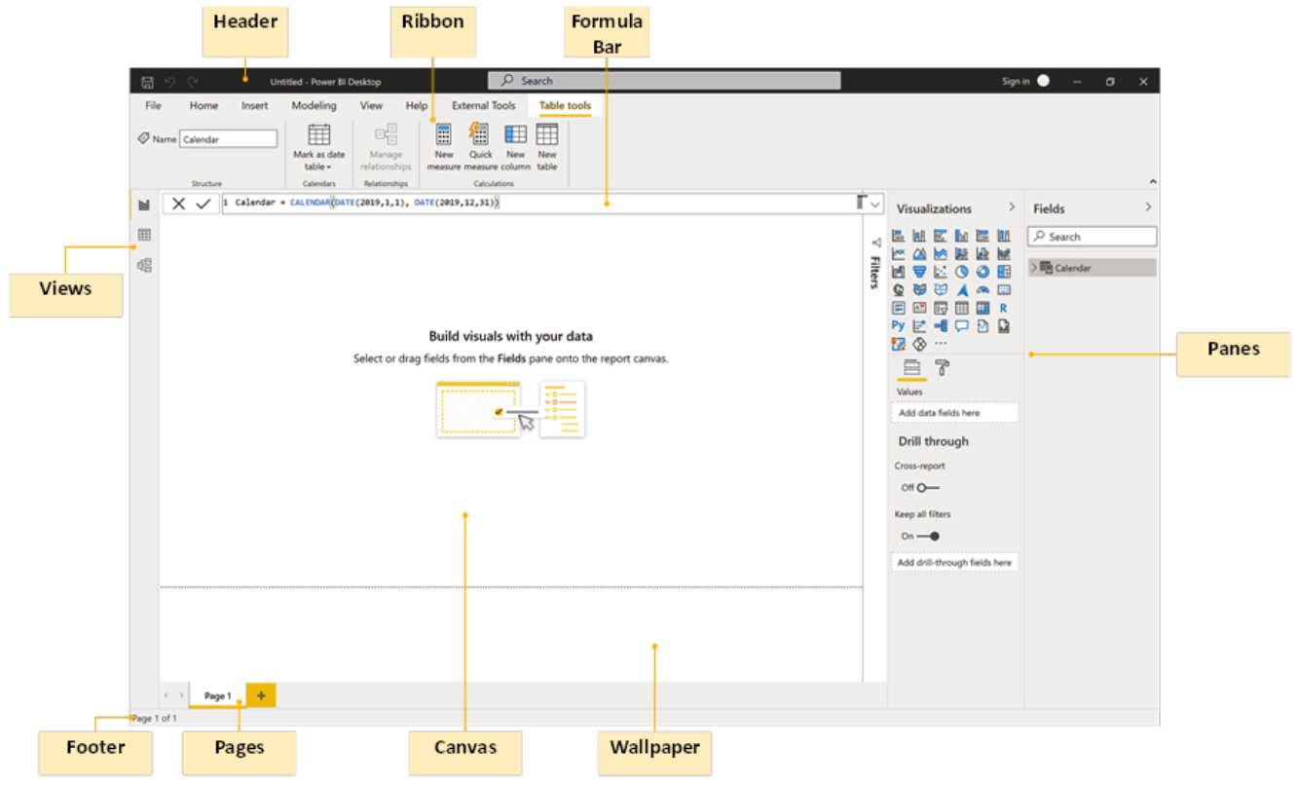
Power BI Desktop interface elements
Source: Deckler (2022)
Notes:
4 Greg Deckler - Learn Power BI_ A comprehensive, step-by-step guide for beginners to learn real-world business intelligence, 2nd Edition-Packt Publishing (2022)

Slide 49
Views
There are three different views available:
Report: The Report view allows for the authoring of reports through the creation of visualizations on one or more pages.
Data: The Data view provides an interface for exploring the data contained within the individual tables of a data model.
Model: The Model view provides an overall look at all of the tables in the data model and how those tables relate to one another.
Source: Deckler (2022)

Slide 50
Panes
• Filters: The Filters pane is available within the Report view and displays a list of filters currently active on reports, pages, and visualizations.
• Visualizations: The Visualizations pane is also available when in the Report view and provides access to the various visualization types available within the report. Sub-panes exist for configuring and formatting visualizations and adding analytics to visualizations, as well as for configuring filters and drill-through capabilities for reports, pages, and visualizations.
• Bookmarks, Selection, Performance Analyzer, and Sync Slicers: These panes are only available while in Report view and provide additional capabilities that we will explore later.
• Properties: The Properties pane is only present in the Model view. This pane provides the ability to associate metadata (data about data) for various fields or columns within the tables of the data model. This includes the ability to specify synonyms and descriptions as well as data types, data categories, and default aggregations or summarizations.
Source: Deckler (2022)

Slide 51
Canvas
The Canvas is the main work area within the desktop. This area is contextual depending upon the view. When in the Report view, this area is the place where visualizations are created in order to build reports. When in the Data view, this area displays the underlying data for a selected table within the data model. Finally, when in the Model view, this area displays all of the tables within the data model and their relationships to one another.
Source: Deckler (2022)

Slide 52
Wallpaper
The Wallpaper area is only available in the Report view. There islittle functionality other than the ability to set a background color or image for a report.
Source: Deckler (2022)

Slide 53
Pages
The Pages area is only available when in the Report view. The Pages area provides the ability to create new pages, rename pages, and reorder pages within a report.
Source: Deckler (2022)

Slide 54
Footer
The Footer area is contextual based upon the current view. In the Report view, the footer provides basic information regarding how many pages are in the report and which page is currently selected by the user. In the Data view, the footer provides basic statistics of a selected table and/or column, including the number of rows in the table and the number of distinct values in a column. Finally, in the Model view, the footer provides various viewing controls, such as the ability to zoom in and out, reset the view, and fit the model to the current display area.
Source: Deckler (2022)

Slide 55
Ribbon
The ribbon consists of three permanent tabs and a number of contextual tabs. The permanent tabs are as follows:
File: The File tab actually displays a fly-out menu when clicked that allows overall file operations, such as opening and saving Power BI Desktop files. Power BI Desktop files have the .pbix file extension. Other operations include importing data, exporting, and publishing.
Home: The Home tab provides a variety of the most common operations, such as copying and pasting, getting data, inserting visuals, creating calculations, and other common actions.
Help: The Help tab includes useful links for getting help with Power BI, including links to the Power BI Community site, documentation, guided learning, and training videos.
Source: Deckler (2022)

Slide 56
Ribbon
Contextual tabs appear in the ribbon depending upon the view selected, what items are selected in the interface, and whether or not additional tools are installed. These tabs include the following:
Insert: The Insert tab only appears in the Report view and has options for adding pages, visuals, and visual elements such as textboxes, images, and buttons.
Modeling: The Modeling tab only appears in the Report view and provides operations common to the data modeling process, including creating calculations, new tables, and new parameters, as well as operations related to security, questions, and answers.
View: The View tab only appears in the Report view and has actions related to themes, page views, and mobile page layout, as well as options related to laying out visual elements on a page, such as gridlines and snap to grid. Finally, the View tab includes options for showing or hiding panes, such as the Filters pane, Bookmarks pane, and Performance Analyzer pane.
Format: The Format tab is all about formatting how visuals interact with one another or are displayed in relation to one another. This tab appears while in Report view when a visual is selected on the canvas.
Drill/Data: The Drill/Data tab provides operations focused on Power BI's ability to drill into data and see the raw data that makes up a visualization. This tab only appears in Report view when a visual is selected on the canvas.
Table tools: The Table tools tab provides options for adjusting the properties of tables as well as creating new tables, measures, and columns. This tab is displayed in the Report and Data views when a table is selected in the Fields pane.
Column tools: The Column tools tab provides options for adjusting the properties of columns in the dataset. This tab is displayed in the Report and Data views when a column is selected in the Fields pane.
Measure tools: The Measure tools tab provides options for adjusting the properties of DAX measures. This tab is displayed in the Report and Data views when a measure is selected in the Fields pane.
External Tools: This tab is displayed in the Report, Data, and Model views when external tools, such as DAX Studio or Tabular Editor, are installed.
Source: Deckler (2022)

Slide 57
The Formula Bar
The formula bar allows the user to enter Data Analysis Expressions (DAX) code in order to create columns, measures, and tables in the data model. DAX is a formula language comprised of functions, operators, and values and is used in Analysis Services (Tabular), Power BI Desktop, and Power Pivot in Excel.
Source: Deckler (2022)

Slide 58
Introducing DAX
While Excel's formula language is optimized for dealing with cells in a spreadsheet, DAX (Data Analysis Expressions) is optimized to deal with tables of data consisting of columns and rows. Hence, unlike Excel, it is not possible to reference an individual cell within a table. Instead, you use DAX to identity a table and a column and then filter down to a single row or rows.
Source: Deckler (2022)

Slide 59
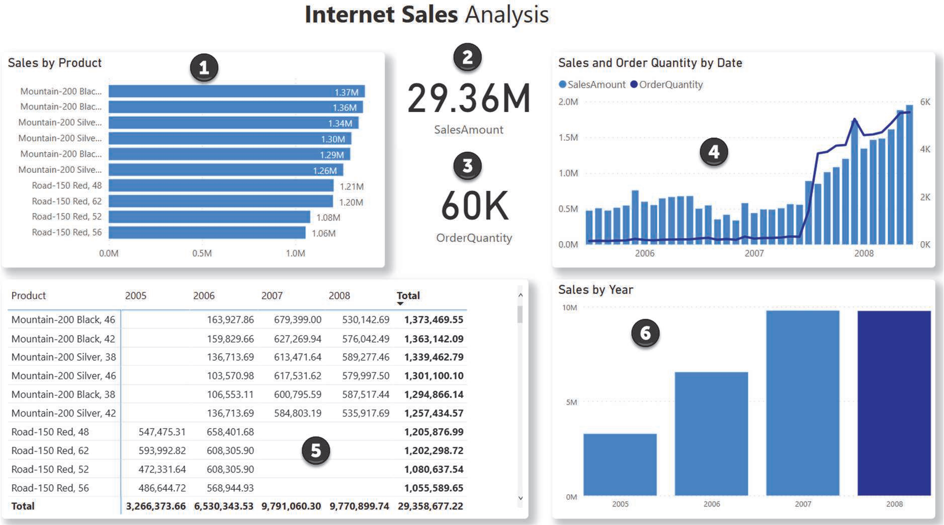

Slide 60
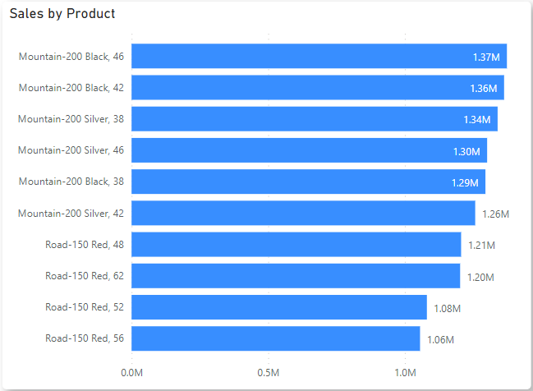
Creating a Bar Chart

Slide 61
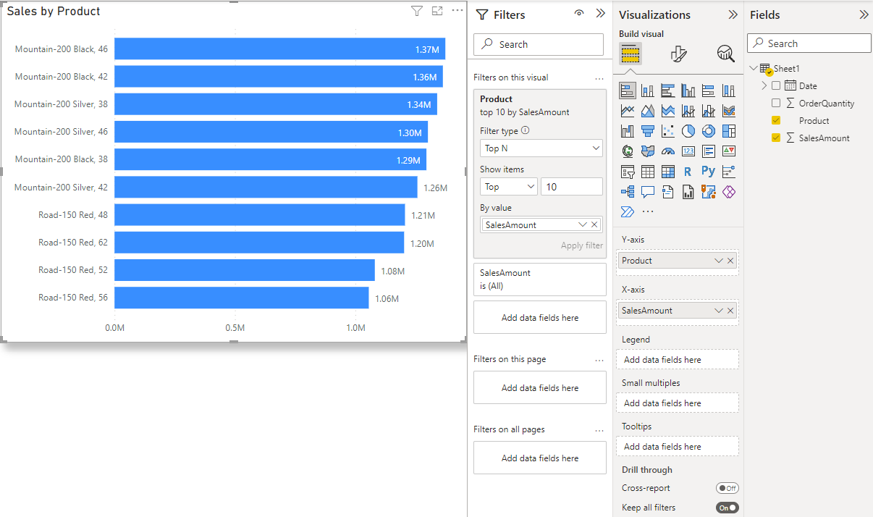
4
3
2
1

Slide 62
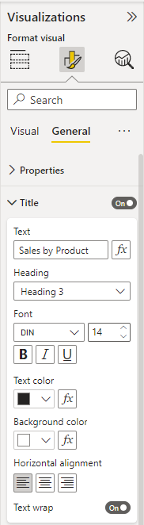
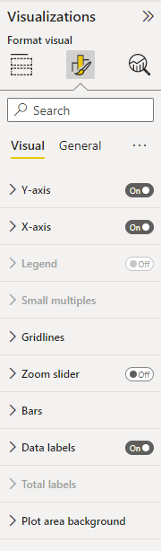
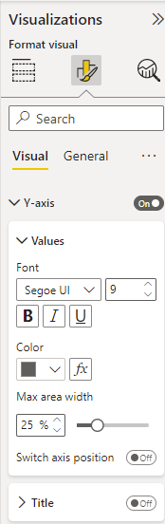
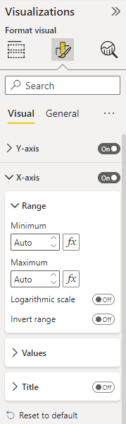
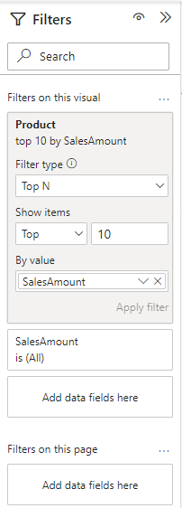
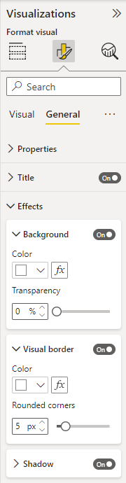
9
10
5
11
6
12
7
8
13
14

Slide 63
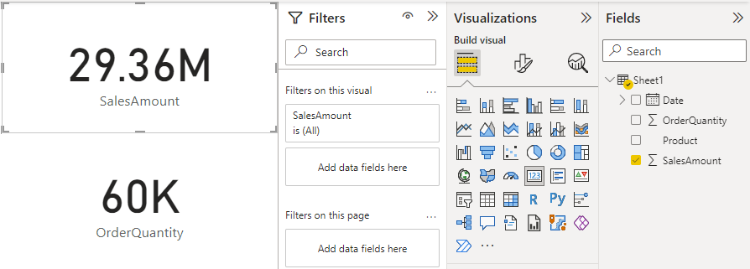
Adding Card visualizations
1
2

Slide 64
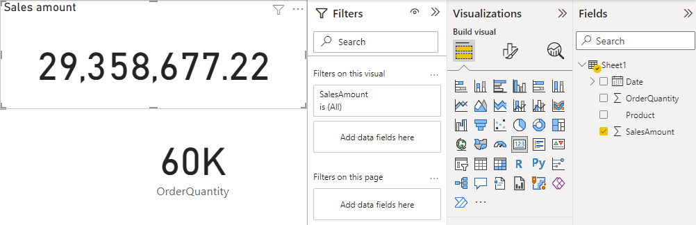
Question: Please edit more to get that

Slide 65
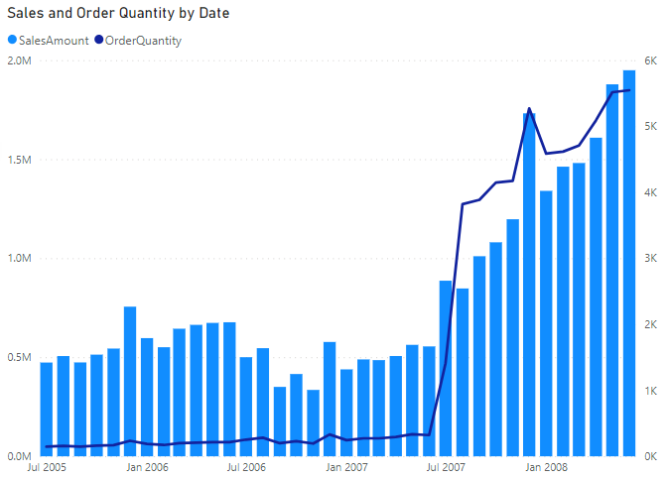
Question: Creating a Combo Chart visualization

Slide 66
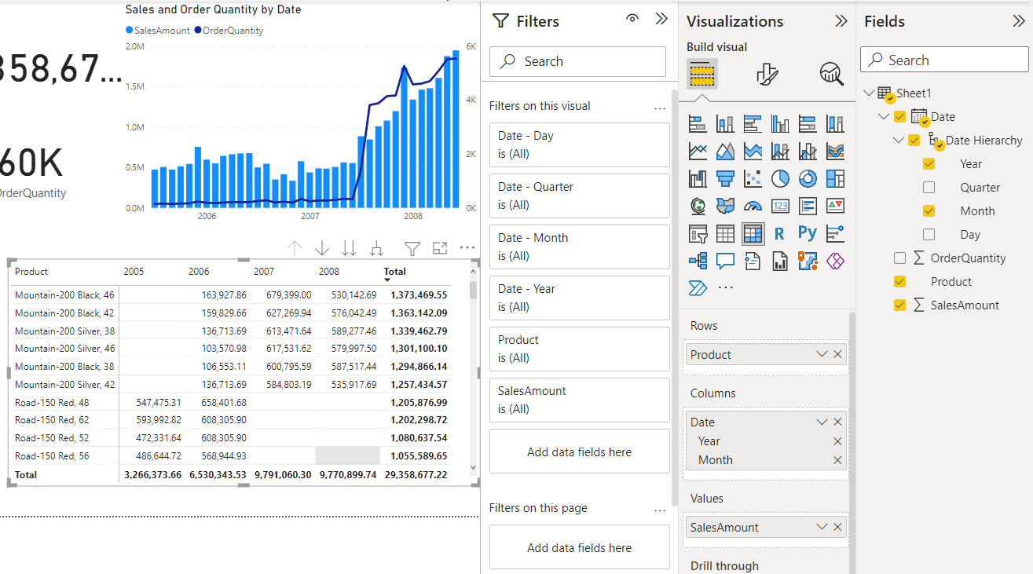
Creating a Matrix visualization
4
2
3
1

Slide 67
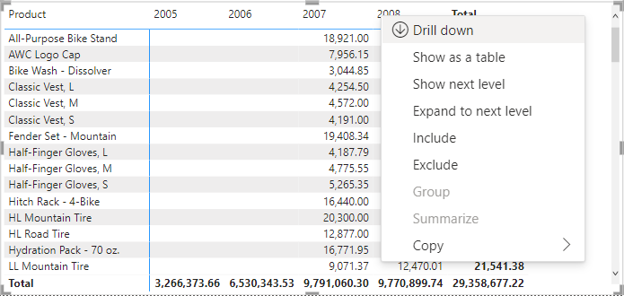
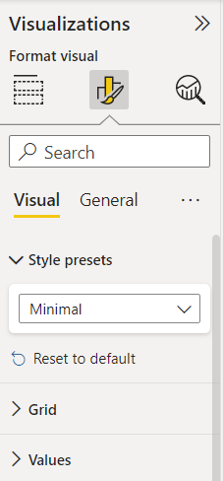
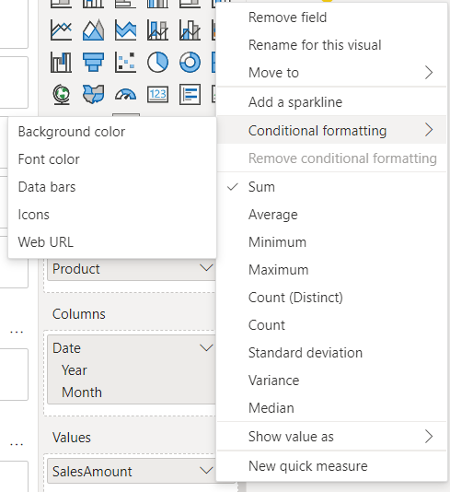

Slide 68
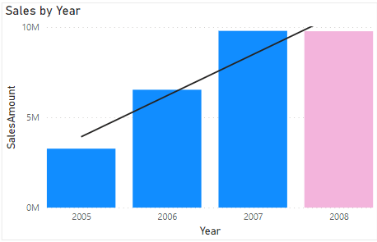
Creating a Column Chart visualization

Slide 69
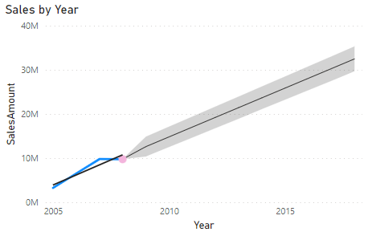
How to get forecasting?

Slide 70
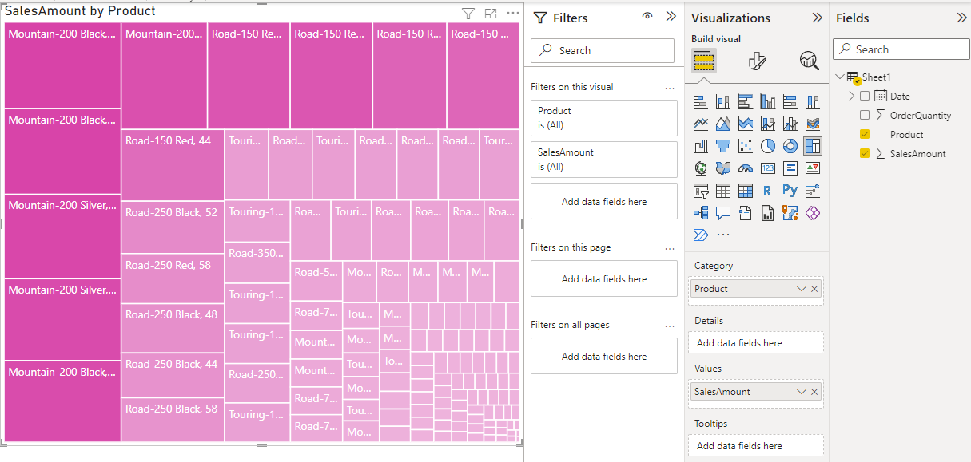
Creating a Treemap
1
2

Slide 71
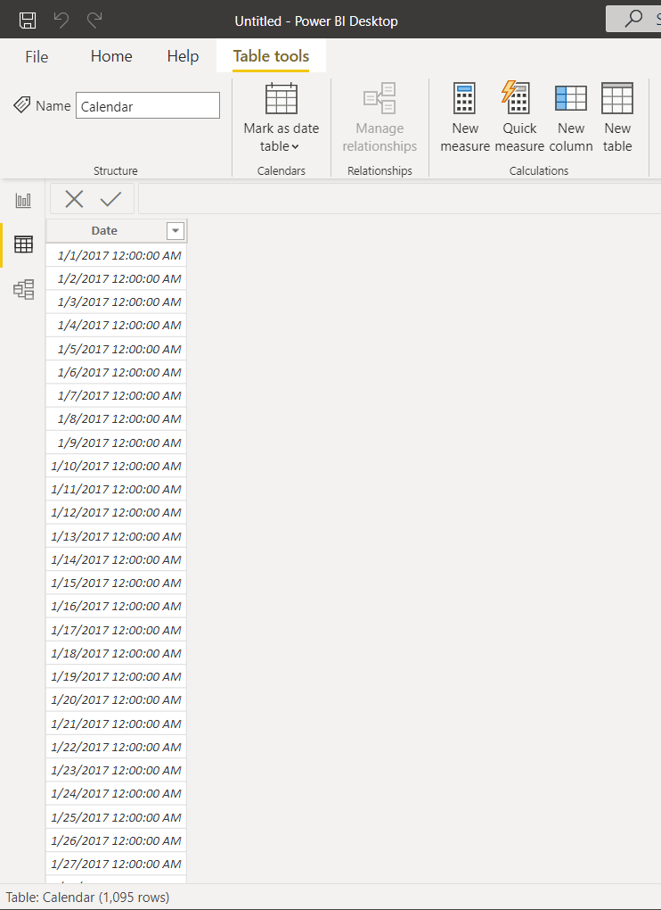
Creating a calculated table
Power BI Desktop is all about connecting to data, modeling that data, and then visualizing that data. Therefore, it makes sense that you cannot really do much within Power BI without data.
Report → Modeling → New Table
Calendar = CALENDAR( DATE(2017 ,1 ,1), DATE(2019 ,12 ,31))
Source: Deckler (2022)

Slide 72

Creating calculated columns
Calendar table, Fields pane, Table tools tab
New Column
Month = FORMAT([Date],"MMMM")
Source: Deckler (2022)

Slide 73

Creating calculated columns
Year = YEAR([Date])
MonthNum = MONTH([Date])
WeekNum = WEEKNUM([Date])
Weekday = FORMAT([Date],"dddd")
WeekdayNum = WEEKDAY([Date],2)
IsWorkDay = IF([WeekdayNum]<=5 ,1, 0)
The IF function works identically to Excel's IF function.
Source: Deckler (2022)

Slide 74

Formatting columns
Date column, Column tools tab
Data type
Format
Source: Deckler (2022)

Slide 75


Slide 76

Creating visualizations
Source: Deckler (2022)

Slide 77

IsWorkDay by Month? Order of month?

Slide 78

2
3
1

Slide 79

Formatting your visualization
Source: Deckler (2022)

Slide 80

Question 1: How to get that?

Slide 81
Adding analytics to your visualization
Ensure that your first visualization is selected in the canvas.
Click on the Analytics sub-pane. Here again, we see several expandable sections.
Expand the Average Line section and then click + Add. Note the dotted line that appears on your visual.
Change the text Average Line 1 to Average Working Days. Underneath this, note that Measure is set to IsWorkDay.
Below Measure, change Color to black and change Position to Behind.
Toggle on the Data label, change Color to black, change Text to Both, and finally, change Horizontal Position to Right.
Source: Deckler (2022)

Slide 82

Your first visualization

Slide 83

Question 2: Try more lines?

Slide 84

Creating and using a slicer
Ensure that your first visual is selected and change to the Fields sub-pane in the Visualizations pane.
Drag the Year column from the Fields pane into the Small multiples field in the Visualizations pane. Your visualization is now divided into four quadrants with each year displayed individually, as shown in the following diagram:
Source: Deckler (2022)

Slide 85

Slicer
Source: Deckler (2022)

Slide 86


Slide 87


Slide 88


Creating more visualizations
Source: Deckler (2022)

Slide 89

Creating more visualizations

Slide 90


Slide 91

2
1

Slide 92
Let's create two additional visuals:
For the first visual, drag the Weekday column in the Fields pane onto a blank area of the canvas. Note that a single-column table of the distinct values for the days of the week appears.
Drag the Date column from the Fields pane into this new visual. Four columns are automatically created for Year, Quarter, Month, and Day. As before, change this from Date Hierarchy to just Date.
Change this visual to Clustered bar chart. That is the third visual over in the top row.
In the Fields sub-pane within the Visualizations pane, drag and drop Date from the Legend field to the Values field. Note that the text changes to Count of Date.
Drag the visual so that the top of the visual lines up with the top of our original column chart visual and then resize it so that this visual extends to the middle of the page horizontally and all of the way to the bottom of the page.
Notice that the weekdays are not in order. Use the ellipsis (...) in the visual to change Sort by to Weekday and Sort ascending.
Click on the Weekday column in the Fields pane and then, from the Column tools tab, choose the Sort by column and then WeekdayNum. This new visual now displays Monday at the top and Sunday at the bottom.
Finally, format this visual to display Data labels.
Click on a blank area of the canvas and select the Card visual. This is the visual in the fourth row from the top and farthest to the right.
Drag Date from the Fields pane into this visual.
In the Fields sub-pane of the Visualizations pane, use the drop-down arrow next to Earliest Date and change this to Count.
Lastly, reposition the Card visual to be in the center of the blank area of the canvas and resize the visual to be just big enough to fully display the Count of Date text.
Source: Deckler (2022)

Slide 93


Slide 94

Editing visual interactions
With Monday selected in the bar chart, hover your mouse over July again, but, this time, hold down the Ctrl key and then click the July column. Note that the Card visual changes to read 5. By using the Ctrl key, we can make values selected within visuals additive with one another.

Slide 95

Editing visual interactions
One icon looks like a column chart with a small funnel, and the other is a circle with a line through it. If you hover over these icons, you will see that the chart icon is called Filter and the circle icon is called None. The icon that is shaded in gray is the currently active interaction mode.
Source: Deckler (2022)

Slide 96

Editing visual interactions
Select the column chart visual in the lower left corner and hover your mouse pointer over the bar chart. Notice that a third icon appears that is simply shaded in the column chart. This is the Highlight icon, which explains the behavior of this chart when we clicked on months within our column chart:
Card visuals cannot filter other visuals.
Source: Deckler (2022)

Slide 97

Still 1095 days. Why?

Slide 98


Slide 99


Slide 100
Assignment: working with specific enterprise
Choose an enterprise you love (e.g. listed/ unlisted companies, SMEs, FDI enterprises, public/ private companies…)
Find out and discuss on key concepts of business intelligence in that enterprise. For example:
Departments of enterprise?
Data sources being pertinent to those departments?
Discuss on how those sources of data give impacts on making decisions (or implications) to improve firm performance?
Collect a piece of data on specific aspect (e.g. sales, human resources, production, finance…) of that enterprise, making visualization, and give some comments.
Package for submission includes:
A report (MS Word file)
Data (MS Excel file)
Visualization (Power BI file)
You could see several attached examples for reference.

Slide 101
Planning Power BI business intelligence projects
Identifying stakeholders, goals, and requirements
Procuring the required resources
Discovering the required data sources
Designing a data model
Planning reports and dashboards
Source: Deckler (2022)
Notes:
4 Greg Deckler - Learn Power BI_ A comprehensive, step-by-step guide for beginners to learn real-world business intelligence, 2nd Edition-Packt Publishing (2022)

Slide 102
Identifying stakeholders, goals, and requirements
Business intelligence projects are most often driven by the business as opposed to IT. This means that one of the business domains, such as sales, marketing, manufacturing/ production, supply chain/operations, research and development, human resources, or accounting/finance, is attempting to answer specific questions about the business or better understand how to make the business more efficient, effective, and profitable. Therefore, it is imperative that any business intelligence project starts with identifying the specific goals or objectives of all interested parties or stakeholders that are championing the business intelligence project as well as any specific requirements in terms of data security, granularity of the data, the amount of historical data, and the availability of data.

Slide 103
Stakeholders
It is not uncommon to have multiple stakeholders for a given business intelligence project, and even stakeholders that span multiple business domains. For example, sales and marketing often share similar interests and desire answers to similar questions. Start by identifying the business domains as stakeholders for the business intelligence project and then identify the specific individuals within those business domains that can provide the goals and requirements for the project.
In most corporate environments, it is often advantageous to identify a single individual as a special kind of stakeholder, a project sponsor. Project sponsors help secure the funding and/or prioritization of resources for the business intelligence project.

Slide 104
Goals
The goal or goals of the business intelligence project should be clearly stated and written down in one or two easily understood sentences (minimal business or technical jargon). The goal or goals should be ever-present in the minds of those implementing the business intelligence project in order to guide the project toward success and avoid increasing the scope of the project unnecessarily or, even worse, failing to fulfill the intended goals.
Goals help determine what data will be required in order to fulfill the purpose of the business intelligence project. For example, in the case of the sales goal stated previously, this helps identify that all corporate sales transactions, as well as online and reseller sales transactions, are required as well as the yearly sales budget. For the marketing scenario, this means that marketing campaign dates, click-through rates, and website data are required. Finally, for the production scenario, the goal statement clearly indicates that both production and inventory data will be necessary.

Slide 105
Requirements
Who will be accessing the reports and dashboards?
Approximately how many individuals will need to access the reports and dashboards?
How frequently will users be checking the reports and dashboards?
Should some individuals or groups only see a subset of the data, reports, and dashboards?
Are there any regulatory concerns regarding the data, such as PCI, HIPAA, or GDPR?
What is the lowest level of data granularity required, such as individual transactions/ orders/records/lines or aggregated hourly, daily, weekly, monthly, or yearly?
How will the data be analyzed, such as by date, customer, department, account, country, region, territory, city, or ZIP code?
How much historical data is required – days, weeks, months, or years?
How current must the data be, such as real-time, near real-time, daily, weekly, or monthly?
What are the core Key Performance Indicators (KPIs) or business metrics required and what are their definitions?
What calendar is used by the business?

Slide 106
Procuring the required resources
Power BI projects require a number of different skill sets and areas of expertise. These skills sets can be broken down into the following roles that must be fulfilled in order to successfully execute a Power BI project:
• Data modeler(s)
• Report author(s)
• Administrator(s)
In smaller organizations, all of these roles may be fulfilled by the same individual, while in larger organizations, or for more complex projects, each role is fulfilled by one or more different individuals. In addition, these roles can be filled either by technical IT resources or business resources.

Slide 107
Data modelers
Power BI projects require connecting to source data systems via queries that load data into structured data tables. These structured data tables and their relationships are called a dataset and it is the job of the data modeler to build these datasets. Data modelers are responsible for creating the queries that connect to the source data systems. In addition, data modelers transform or shape the data as necessary and define the relationships between the tables within the dataset. Data modelers are also responsible for defining the data types within the model (setting columns within data tables to be text or numbers), setting default summarizations such as sum, average, first, and last, and specifying data categories such as country, ZIP code, latitude, longitude, and web URL. Finally, data modelers often create any necessary calculations such as Year-To-Date (YTD) sales or gross margin percentage.
Notes:
Queries and datasets are key components of Power BI solutions. Well-designed queries and datasets are critical to the success of Power BI projects as improperly designed queries and datasets will lead to a poor user experience, complex calculations, and unnecessary consumption of system resources. Key skills for data modelers include a robust knowledge of Power Query (and the associated M coding language), the DAX programming language, and data modeling best practices. In addition, knowledge of source data technologies such as SQL, OData, JSON, and XML is often helpful.

Slide 108
Report authors
Report authors are responsible for data analysis and the creation of visuals that comprise reports and dashboards. Generally, report authors serve as business analysts, gathering reporting requirements and understanding the KPIs and metrics desired by the business as well as how the business wishes to analyze and visualize the data to answer important business questions.
Since the reports and dashboards created by report authors are the most visible product of a Power BI project to the business, it is important that report authors have solid skills in visualization and design best practices. Visualization choices, color choices, font choices, symmetry, and the layout of reports are key aspects of building a good user experience.

Slide 109
Administrators
Administrators are a special role within a Power BI tenant, the Power BI administrator role. Users assigned to this role can access the admin portal within the Power BI service. The admin portal allows administrators to monitor the usage of the Power BI service, as well as enforcing organizational governance policies through the tenant settings. For example, administrators can use the tenant settings to enable or disable certain functionality, such as the use of public embedded codes for reports, the use of R and Python visuals, the exporting of reports, and the creation of workspaces. Administrators are also responsible for setting up enterprise data gateways that facilitate data refresh for datasets, as well as creating and assigning permissions for data connections used by these data gateways. Finally, administrators can restrict the use of custom visuals and configure capacity settings used by Power BI Premium instances.

Slide 110
Discovering the required data sources
Data modelers and report authors will need to collaborate with both IT and the business to discover the required source data repositories. These source data repositories may be transactional systems such as Enterprise Resource Planning (ERP) systems, Customer Relationship Management (CRM) systems, data warehouses, or even individual files maintained by the business, such as in Excel spreadsheets.
An important aspect of this step is ensuring that the required data sources are configured in such a way as to support access and/or data refresh within Power BI. The Power BI reports generated will eventually be published to the cloud in the Power BI service or to an on-premises Power BI Report server. The service or server must be able to access these data sources.

Slide 111
Designing a data model
A data model design includes the following steps:
Identifying facts and dimensions
Creating a bus matrix
Determining a dataset storage mode

Slide 112
Identifying facts and dimensions
Data modelers tend to think in terms of facts and dimensions. Fact tables, or facts, are the tables that contain numeric information about particular business processes such as sales, marketing, production, and inventory. Each row in a fact table represents a particular event associated with that business process, such as a change in inventory or a sale to a customer. Columns in the fact table include such things as the amount of inventory change, the number of units sold, and the unit sale price.
Dimension tables, or dimensions, contain information about people, places, or things involved in the business process. As opposed to storing event information, dimensions store detailed information about people, places, and things. For example, a store dimension table would contain a row for every store in the organization and would include columns such as latitude, longitude, address, country, the date the store opened, and other detailed information that describes each store. Similarly, a product dimension table would include a row for every product sold and might include such columns as color, size, and category.

Slide 113

Creating a bus matrix
The fact tables representing the business processes are on the left and columns describing the grain and important KPIs/measures are included as additional information. The dimension tables describing the people, places, and things associated with the facts are on the right. The Xs indicate which dimensions are associated with the different facts.
Notes:
The bus matrix provides an organized overview of the most important elements comprising the data model and is simple to understand and easily referenced. From the bus matrix, we can quickly understand the granularity of the fact tables, the KPIs and measures most important to those fact tables, and which dimensions are related to which fact tables. For example, it is clear from the bus matrix that the budget fact table has a monthly grain and is broken down by sales territory but not by product.

Slide 114
Determining a dataset storage mode
Deciding on dataset storage is an important design decision that should be addressed early in the planning process. Power BI supports the following three dataset storage modes:
Import: Power BI's default data storage mode is Import. This means that all of the data from source data systems is ingested into a local dataset to the Power BI Desktop file. Import mode allows the full functionality of all DAX functions and supports the extension of the dataset with DAX calculated columns as well as fast performance for DAX measures.
DirectQuery: DirectQuery mode datasets do not ingest any data into the local dataset. This avoids the dataset size limitations and refresh requirements associated with Import mode datasets.
Composite: Composite models allow you to mix DirectQuery and Import sources, or even multiple DirectQuery sources.

Slide 115
Planning reports and dashboards
Power BI lends itself to an agile, iterative development process where feedback from stakeholders is collected on a regular basis and used to inform and adjust the development process. This is especially true when authoring reports and dashboards. That said, it is still useful to include some upfront design work for reports. This often takes the form of one or more whiteboarding sessions with key stakeholders where different layouts for reports are discussed and mock-ups or wireframes of report pages are created. The goal of these design sessions is to understand the key KPIs and metrics the business wants to be displayed on reports, understand whether there will be multiple report pages, and discuss potential interactivity between visual elements and features in the report, such as the use of slicers, drillthrough, and drilldown.

Slide 116
Example scenario: background
A firm recently conducted a yearly employee survey that highlighted a strong employee demand for increased flexibility regarding Personal Time Off (PTO). As a result, human resources have decided to implement unlimited PTO. While time off still needs to be approved, employees no longer have a set amount of days of PTO per year. This is an enormous benefit to employees but, in order to stay profitable, it is now imperative that the organization is able to closely track and report on utilization so that managers can make informed business decisions around requests for time off.

Slide 117
Project objective
Report and analyze % utilization by employee, branch, and division across any date range, including the ability to identify trends and forecasts. The ability to compare revenue against budgets is desirable but not an absolute requirement at this time.

Slide 118

Questions and answers regarding business intelligence

Slide 119
Designing a data model
Hours: Contains reported hours for every employee by day
Budget: Contains a forecasted budget by month for each division and branch
Dimensions for her model:
Date
Branch
Division
Employee
Project

Slide 120

Designing a data model

Slide 121
Planning reports and dashboards
All groups agree that report pages should be kept concise and clean with no more than four or five visuals on a page. The stakeholder groups also agree that there should be simple filtering of the reports by date range, branch, division, and employee type. A person suggests that the reports also include the ability for users to dynamically set the target utilization as different branches and divisions have slightly different utilization targets.
Partners and executive management desire an executive summary page that includes the % utilization for the entire calendar year as well as a visual that displays the % utilization trend by month. Finally, partners and executive management also desire that the % utilization be displayed across branches and divisions.
Division managers want similar information but displayed somewhat differently. Division managers are also interested in the % utilization for the year and % utilization broken down by branch. However, division managers also want visuals that display the total hours and % utilization by project code as well as employee type. Finally, division managers desire the ability to quickly see the total hours broken down by categories such as billable time, PTO, project non-billable time, bench time, and sales support.
Branch managers desire extremely similar information to division managers, with the main difference being that branch managers want to see hours and % utilization by employee rather than by project code.
Finally, all stakeholders feel that it is important to be able to drill down into additional detail pages that display hours and utilization per employee and per project code in order to analyze and determine the cause of utilization issues.

Slide 122
Connecting to and transforming data
Getting data
Transforming data
Merging, copying, and appending queries
Verifying and loading data

Slide 123

Understanding the Power Query Environment
Figure. The Power Query Editor opens in a new window to give you access to the queries defined in the model.
Source: Lachev & Price (2018)

Slide 124
Creating your first query
To determine whether or not Personal Time Off (PTO) should be approved, it is important to understand where the company is concerning budgets and forecasts. Whether or not the company, department, and/or location is on target in terms of its budget can be an important consideration when approving or denying time off.
We will import data into our data model using a query. A query is simply a series of recorded steps for connecting to and transforming data.
Source: Deckler (2022)

Slide 125

Creating your first query
All: This lists all of the available connectors.
File: File connectors, including Excel, text/CSV, XML, JSON, folder, PDF, and SharePoint folders.
Database: The Database section lists sources such as SQL Server, Access, Oracle, IBM DB2, IBM Informix, IBM Netezza, MySQL, PostgreSQL, Sybase, Teradata, SAP, Impala, Google BigQuery, Vertica, Snowflake, Essbase, and AtScale.
Power Platform: Power Platform includes Power BI datasets and dataflows, as well as Dataverse.
Azure: Azure lists many different services, such as Azure SQL Database, Azure Synapse Analytics, Azure Analysis Services, Azure Blob Storage, Azure Table Storage, Azure Cosmos DB, Azure Data Lake Storage, Azure HDInsights (HDFS), Azure HDInsights Spark, Azure Data Explorer (Kusto), Azure Databricks, and Azure Cost Management.
Online Services: There is a substantial collection of online services, including Microsoft technologies such as SharePoint Online, Exchange Online, Dynamics 365, Common Data Service, DevOps, and GitHub, as well as third parties such as Salesforce, Google, Adobe, QuickBooks, Smartsheet, Twilio, Zendesk, and many others.
Other: other connectors include Web, OData, Spark, Hadoop (HDFS), ODBC, R, Python, and OLE DB.
Source: Deckler (2022)

Slide 126

1
2

Slide 127

Getting additional data
1
2

Slide 128

Getting additional data
1
2

Slide 129

Transforming data
Power Query Editor can be launched from the Home tab by choosing Transform data in the Queries section of the Ribbon. Once launched, the following screen will be displayed:

Slide 130
Formula bar
The Formula bar allows the user to view, enter, and modify the Power Query (M) code. The Power Query formula language, commonly called M, is a functional programming language comprised of functions, operators, and values. M is the underlying data connection and transformation technology for Microsoft Power Automate, PowerApps, Power BI Desktop, and Power Query in Excel.
M is the language behind queries in Power BI. As you are building a query in Power Query Editor, behind the scenes, this is building an M script that executes to connect to, transform, and import your data. In reality, each of the applied steps in a query is a line of Power Query M language code. You do not need to worry about that just yet, but we will explore this in the Merging, copying, and appending queries section.
Source: Deckler (2022)

Slide 131

Transforming budget and forecast data
Text (ABC)
Whole number (123)
Text
or number (ABC123)
Decimal (1.2)

Slide 132


Cleaning up extraneous bottom rows

Slide 133

Filtering rows
Note that all of the distinct values that appear in the column are listed, including (null), Charlotte, Cleveland, and Nashville. As datasets become larger, you may see a List may be incomplete warning message. This occurs because Power Query Editor samples the first 1,000 rows of data. If you see this message, you can click on the Load more link to have Power Query Editor analyze all the rows of data.
Source: Deckler (2022)

Slide 134


Unpivoting data

Slide 135

Unpivoting data

Slide 136

Unpivoting data

Slide 137

Using Fill

Slide 138

Changing data types

Slide 139

Changing data types

Slide 140

Transforming People, Tasks, and January data

Slide 141

2
1

Slide 142


Slide 143



Slide 144

Merging queries

Slide 145

Merging queries

Slide 146

2
1
2
3

Slide 147
Join Kind
A fuzzy merge allows similar but not identical items to be matched during a merge. Options include a Similarity threshold, which is optional. The similarity threshold is a number between 0.00 and 1.00. A value of 0.00 causes all values to match, while a value of 1.00 causes only exact values to match. The default is a value of 0.80. Additional options include the ability to Ignore case, as well as the ability to Match by combining text parts. For example, by ignoring case, mIcrOSoft could match Microsoft, and by combining text parts, Micro and soft could be combined to match Microsoft. When performing fuzzy merges, it is possible to have multiple values match. You can use the optional Maximum number of matches setting to control how many matching rows are returned for each input row. This is a number that can range from 1 to 2,147,483,647 (the default). Finally, there is an option to use a Transformation table. This allows you to specify a table of values with From and To columns that can be used during the merge process. For example, the merge table might contain a value in the From column for USA that maps to a To column of United States.
Source: Deckler (2022)

Slide 148
Join Kind
Similarity threshold Can be valued from 0 to 1, where 0 will make all values match each other and 1 will allow exact matches only. The default is 0.8.
Ignore case Lowercase and uppercase letters will be treated as the same.
Match by combining text parts Power Query will try to combine separate words into one to find matches between keys.
Maximum number of matches This option will limit the number of rows from the second table that are matched against the first table, and it can be useful if you expect multiple matches.
Transformation table You can use a column with two columns—From and To—to map values during the matching process. For example, you can map NZ to New Zealand, and the two values will be considered the same for merge purposes.

Slide 149







Join Kind

Slide 150

Expanding tables

Slide 151
Expanding tables
Expand You can select the columns from the joined table that you want to add to the current table. If there is more than one matching row in the joined table, the current table’s rows will be duplicated after expansion.
Aggregate This option aggregates rows and won’t duplicate any rows in the current table. You can apply arithmetic and statistical functions to the columns of the joined table. For example, if it made business sense, you could take the average of State Province Key from the State Province table.

Slide 152
Merge queries
The new column:
Is of type Table
Has Table hyperlinks in each cell
Has a double-arrow button instead of a filter button on its header

Slide 153
Merge queries
Expand You can select the columns from the joined table that you want to add to the current table. If there is more than one matching row in the joined table, the current table’s rows will be duplicated after expansion.
Aggregate This option aggregates rows and won’t duplicate any rows in the current table. You can apply arithmetic and statistical functions to the columns of the joined table. For example, if it made business sense, you could take the average of State Province Key from the State Province table.

Slide 154

Power Query M
M is a case-sensitive language that is behind the Power Query engine.

Slide 155


Disabling queries from being loaded

Slide 156


Copying queries

Slide 157



Slide 158



Slide 159

Changing sources

Slide 160


Slide 161


Slide 162

Another way?

Slide 163

Appending queries

Slide 164

Appending queries

Slide 165

Appending queries

Slide 166

Appending queries
We have used multiple pages in a single Excel workbook for the Hours query. In a production scenario, this would likely involve multiple Excel workbooks, one for each month. In this case, if you have many files in the same format, consider using a Combine Binaries (Folder) query: https://docs.microsoft.com/en-us/power-bi/desktop-combine-binaries.
Source: Deckler (2022)

Slide 167

Verifying and loading data
The Query Dependencies window is useful for understanding how queries are related to one another and how queries are organized.
Source: Deckler (2022)

Slide 168


Organizing queries

Slide 169


Organizing queries

Slide 170

Checking column quality, distribution, and profiles

Slide 171
Checking column quality, distribution, and profiles
The distinct number refers to how many different values there are in a column once duplicates are excluded. The unique number shows how many values occur exactly once. The number of distinct and unique values will be the same only if all values are unique.

Slide 172

Loading the data

Slide 173

Combining Mismatched Tables
Source: Maslyuk and Raviv (2025)

Slide 174

Combining mismatched tables from a folder
Source: Maslyuk and Raviv (2025)

Slide 175

Combining mismatched tables from a folder
Source: Maslyuk and Raviv (2025)

Slide 176

Combining mismatched tables from a folder
Source: Maslyuk and Raviv (2025)

Slide 177

Unpivoting tables with multiple levels of hierarchy
Source: Maslyuk and Raviv (2025)

Slide 178

Creating a data model

Slide 179

Modifying the layout

Slide 180

Creating and understanding relationships
There are actually four different cardinalities for relationships in Power BI, as outlined here:
One-to-one: This means that there are unique values in each table.
Many-to-one: This means that there are unique values in one table that match multiple rows in another table.
One-to-many: This means that there are unique values in one table that match multiple rows in another table.
Many-to-many: This means that neither table has unique values for rows. It is generally good practice to avoid these types of relationships because of their complexity and the amount of processing and resources required.
There is also an arrow icon in the middle of the line that points from People to Hours. This indicates that the People table filters the Hours table, but not vice versa. This is known as the cross filter direction. Cross filter directions can be either Single or Both, meaning that the filtering occurs only one way or bidirectionally. In simple data models, you generally don't have to worry about cross filter direction, but it can become very important if the complexity of the data model increases.
The line that forms the relationship between the tables is solid. A solid line indicates an active relationship. Inactive relationships can be created between tables, and these are represented as a dashed line. In Power BI, there can only be a single active path between tables. In other words, there can only be a single path of a relationship cross-filtering from one table to another. This is the active pathway.
Source: Deckler (2022)

Slide 181
Creating and understanding relationships
Each table can be on the one or the many side during a join. If a table is on the one side, it means the key in the table has a unique value for every row, and it’s also known as the primary key. If a table is on the many side, it means that values in the key column are not necessarily unique for every row and may repeat, and such a key is often called a foreign key.

Slide 182

Edit relationship
Note that since the Hours table is defined first and the People table is defined second, the Cardinality value of our relationship is Many to one (*:1). Also, note that the relationship is active and that the Cross filter direction value is Single.
In many-to-one and one-to-many relationships, a Cross filter direction value of Single means that the one side of the relationship filters the many side. Finally, note that the EmployeeID column in the Hours table and the ID column in the People table are highlighted in gray. This shows us the columns that form a relationship between the two tables. Close the Edit relationship dialog by clicking the Cancel button.
Source: Deckler (2022)

Slide 183

Another relationship

Slide 184


Slide 185


Slide 186

Exploring the data model

Slide 187


Slide 188


Slide 189


Slide 190
Calculated columns
Column = SUM([Hours])
Column 2 = [Hours]/[TotalHours]

Slide 191

Why?

Slide 192
Why?
To understand what is going on here, it is important to understand the concept of evaluation context. Evaluation context is the context in which a DAX formula evaluates a calculation.
There are two types of evaluation contexts in DAX: row and filter contexts. Calculated columns, by default, evaluate within what is called row context. Row context means that when a DAX calculation evaluates, it only considers the current row, and nothing else.
However, certain functions, such as SUM, override this default context. In this case, the SUM function is overriding the row context of the calculated column and imposing a filter context of the entire table. Hence, the output for each of the rows is the sum of all of the hours in the entire table. All of the standard aggregation functions—that is, SUM, AVERAGE, MAXIMUM, MINIMUM, COUNT, and so on—exhibit this behavior.

Slide 193

Why?

Slide 194
Why?
In this calculation, the TotalHours column contains the total number of hours that were reported during the entire reporting period specified by the PeriodStartDate and PeriodEndDate columns. Because no functions have been used that change the evaluation context from row to filter, only the current row is considered during the evaluation of the formula.
Hence, this formula simply divides the Hours column in each row by the TotalHours column in each row. Now, if we click on the drop-down arrow for Column 2, we will see that there are many different values.
Source: Deckler (2022)

Slide 195
Creating calculated columns for utilization
For the purposes of calculating utilization, we want the total hours billed by an employee divided by the total hours reported by an employee.
In order to get the first part of this - that is, the total hours billed - we need to create a third calculated column using the following formula:
Use Shift + Enter and the Tab key to create the correct formatting. Shift + Enter inserts a new line or break, while Tab indents text that's entered.
Column 3 =
SUMX(
FILTER(
ALL('Hours'),
[Category] = "Billable" && [EmployeeID] =
EARLIER([EmployeeID])
),
[Hours]
)
Source: Deckler (2022)

Slide 196
Explanation?
By way of explanation, the SUMX function takes two parameters: a table and a numeric column. These parameters are separated by a comma (,). The SUMX function iterates over the specified table and sums the specified column. Hence, in the preceding formula, the first parameter is the FILTER function (line 3), while the second parameter is simply the Hours column (line 7).
The FILTER function itself takes two parameters. The first parameter is the 'Hours’ table, on line 4, and a filter, on line 5. The ALL function returns an entire table stripped of all of its row and filter contexts. Although technically not required in this context, the ALL function ensures that we are operating against all of the rows in the table. The second parameter is our applied filter. This filter actually contains two parts joined by logical AND criteria, &&. In DAX, && is a logical AND operator, while || is a logical OR operator. Hence, the first part ensures that the table that's returned by the FILTER function only contains rows that have a Category value of Billable. The second part ensures that the table that's returned by the FILTER function also only contains rows for the employee in the current row. To do this, this part of the filter uses the EARLIER function.
Source: Deckler (2022)

Slide 197

Operator

Slide 198
Explanation?
The EARLIER function is perhaps the worst named function in all of DAX. The logic behind the naming of this function makes some amount of sense if you are intimately familiar with the DAX evaluation context but generally makes no sense at all to the common layman. You should think of EARLIER as being the current row value for the column specified. Hence, I like to think of EARLIER as the current value. Another construct that can do the same thing is the use of variables or VAR statements. We will find out more about using DAX variables a little later.
To understand what's going on here, we know that the default context of a calculated column is the row's context. However, because we are using functions such as SUMX and ALL, we have overridden this default row context and imposed a filter context. Hence, to ensure that the table that's returned only includes rows for the employee in our current row, we need to revert to the earlier evaluation context—that is, the row context. This is the purpose of the EARLIER function. Within the EARLIER function, the row context is reestablished, and hence EARLIER([EmployeeID]) returns the value of EmployeeID in the current row.
Source: Deckler (2022)

Slide 199
Explanation for Column 3?
Therefore, the Column 3 formula can be read in the following way:
1. Take the entire table (ALL) and filter this table down so that it only has rows where the Category column has a value of Billable and rows where the EmployeeID column matches the current row value for EmployeeID.
2. Second, sum the Hours column for this table and return the result. Each row for an employee should return the exact same numeric value, which is the total hours that were reported by that employee that were billable hours.
3. For the second part—that is, the total number of hours reported by an employee— we simply need to create another new column with a slight modification to remove the filter for only billable hours. This column can be written with the following formula:
Column 4 =
SUMX(
FILTER(
ALL('Hours'),
[EmployeeID] = EARLIER([EmployeeID])
),
[Hours]
)
Source: Deckler (2022)

Slide 200

Explanation for Column 3?
Finally, to create our utilization calculation, create a new calculated column that utilizes row context, as follows:
Column 5 = DIVIDE([Column 3], [Column 4],0)
While the preceding formula could have been written as Column 5 = [Column 3] / [Column 4], it is a good idea to use the DIVIDE function instead of the divide (/) operator. The DIVIDE function takes a third parameter, which allows for the return of an alternate number instead of an error in the event of an attempt to divide by zero.
We can now select Column 5 by clicking on its header and change its formatting to be a percentage. To change the column to a percentage, we need to go to the Formatting section of the Column tools tab in the ribbon. From here, select the % icon.
Source: Deckler (2022)

Slide 201

Clean up
Right-click the header for Column and choose Delete.
Confirm the deletion of this column in the Delete column dialog box by clicking Delete.
Repeat this procedure for Column 2.
Double-click the TotalHours column and rename this column TotalHoursInPeriod.
Rename Column 3 TotalBillableHours, Column 4 TotalHours, and Column 5 % Utilization.
Source: Deckler (2022)

Slide 202

Visualization
Click on the Report view in the Views bar.
Shrink the existing matrix visualization horizontally to create space on the report canvas.
Click on an empty portion of the report canvas to deselect the existing table.
Click Name from the People table to create a new table visualization on the blank area of the report canvas.
With this new table selected, click on TotalBillableHours, TotalHours, and % Utilization from the Hours table to add these to this second table visualization.
Why?
Source: Deckler (2022)

Slide 203

Visualization
Note that the values that are returned in this second table are really large! This is because the default aggregation for numeric fields is Sum. Since all of the rows for each employee contain our desired number, summing these values doesn't make sense. To correct this, do the following:
In the Values field well of the Visualizations pane, select the drop-down arrow next to TotalBillableHours and choose Average instead of Sum as the aggregation.
Repeat this procedure for TotalHours and % Utilization.
Source: Deckler (2022)

Slide 204
Using calculated columns to resolve data granularity issues
We did not create a relationship for the Budgets and Forecasts table. The main issue here is that the Budgets and Forecasts table has a data granularity of month while our Hours and Calendar tables have a data granularity of day. However, we can resolve this data granularity issue through the use of calculated columns as well as a calculated table.
To resolve the data granularity issue, start by creating the following calculated column in the Budgets and Forecasts table:
MonthYear = [Month] & "2017"
Here, we use DAX's & concatenation operator to concatenate each row's Month column value with the text value 2017 since the Budgets and Forecasts data is for the year 2017.
Notes:
Granularity: độ chi tiết

Slide 205
Using calculated columns to resolve data granularity issues
Similarly, we can create a calculated column in the Calendar table using the following formula:
MonthYear = LEFT([Month], 3) & [Year]
We can now use the MonthYear columns in the Budgets and Forecasts table and the Calendar table to create a relationship between the tables. However, if we do that, we receive a warning when creating the relationship:
“This relationship has cardinality Many-Many. This should only be used if it is expected that neither column (MonthYear and MonthYear) contains unique values, and that the significantly different behavior of Many-many relationships is understood.”
Notes:
The only difference in this formula is that we have used the LEFT function to get the first three letters of the Month column since the Calendar table uses the full name of the month versus an abbreviation, as with the Budgets and Forecasts table.

Slide 206
Using calculated columns to resolve data granularity issues
Since the Budgets and Forecasts table contains a budget for each city for each month, there are multiple rows with duplicate MonthYear values. The same is true for the Calendar table. While relationships with Many-Many cardinality are allowed in Power BI since the July 2018 release of Power BI Desktop, they are often best avoided. To resolve the Many-Many relationship issue, perform the following steps:
Click Cancel to not create the relationship or otherwise delete the Many-Many relationship between the Budgets and Forecast table and Calendar table if already created.
While in the Data view, choose the Table tools tab in the ribbon and then select New table from the Calculations section.
Enter the following formula: MonthYears = DISTINCT('Calendar'[MonthYear])
Switch to the Model view and create a relationship between the MonthYear column in the MonthYears table and the MonthYear column in the Calendar table.
Create a relationship between the MonthYear column in the MonthYears table and the MonthYear column in the Budgets and Forecasts table.
Note that both of the relationships have a Cardinality value of Many-to-one (*:1) with the MonthYears table on the 1 side of the relationships.

Slide 207
Measures
We observed implicit measures when we created our table visualizations in the previous section, Calculated columns. When we placed the TotalBillableHours, TotalHours, and % Utilization columns in our table, the values were calculated via an implicit Sum measure that we changed to Average.
Unlike calculated columns, measures are dynamic in their calculation so that measures are calculated just in time, every time there is an interaction with the end user. Measures are not recalculated during data refresh but rather every time a user views or interacts with a report. This makes measures truly dynamic, and hence they are perfect for a scenario where end users may change the evaluation context on the fly.

Slide 208


Understanding the context for measures
Measure =
SUMX(
FILTER(
'Hours',
'Hours'[Category] = "Billable"
),
'Hours'[Hours]
)
Notes:
It is important to understand that, unlike calculated columns, measures have no implicit row context, only a filter context. This means that when measures refer to a column in a table, that column must be referenced within an explicit aggregation function such as SUM, AVERAGE, MAX, MIN, and so on.

Slide 209


Slide 210



Creating measures for utilization

Slide 211



Creating measures for utilization

Slide 212

Creating measures for utilization
We need to create a measure for the denominator of our utilization calculation—that is, the total potential billable hours available within a period. We know that we cannot simply use the total hours reported, though, and that we must calculate the number of potential billable hours for any period of time in a different way.
To do this, we must have an independent way of calculating the number of hours and thus utilization within any arbitrary period of days.

Slide 213



Creating measures for utilization

Slide 214

Error?

Slide 215

Fixed

Slide 216

Renamed
Problem?

Slide 217



Slide 218


Slide 219



Slide 220

Boundary cases

Slide 221

Boundary cases

Slide 222
Boundary cases

Slide 223

Boundary cases

Slide 224

Boundary cases

Slide 225
Boundary cases

Slide 226

Slicing

Slide 227

Slicing

Slide 228

Slicing

Slide 229

Slicing

Slide 230

Slicing

Slide 231

Slicing

Slide 232

Grouping

Slide 233

Grouping

Slide 234
Unlocking Insights
Segmenting data
Using report navigating features
Advanced analysis techniques

Slide 235
Segmenting data
Power BI provides several mechanisms for segmenting data. These include the ability to use groups, hierarchies, and Row-Level Security (RLS). Segmenting data allows you to partition or group individual rows of data into logical units that make sense to an organization. This helps ensure that business rules are enforced or that metrics can be shown in a manner that is more easily digestible by business users versus looking at individual rows of data.

Slide 236

Creating groups
4
2
1
3
Notes:
After following these steps, we should have an ad hoc grouping of our hours based on the month in which those hours were reported.
However, there is another way to use groups within Power BI. Instead of using ad hoc grouping, we can define groupings of information as part of the data model itself and then use those defined groups within visualizations.

Slide 237


2
1
3

Slide 238



1
2
3

Slide 239
Creating hierarchies
Hierarchies are a powerful feature of Power BI that allows data to be summarized but also allows report viewers to drill down into the data to obtain additional details. Similar to groups, we can create ad hoc hierarchies as well as define hierarchies within our data model. The easiest way to see an ad hoc hierarchy is to use a Matrix visualization.

Slide 240


2
1
3
Notes:
Note that several arrow icons appear above/below our Matrix visualization. In addition, small + icons appear to the left of each row in the matrix. Refer to the following screenshot. If you do not see the + icons, you can turn them on using the Format sub-pane of the Visualizations pane by expanding the Row headers section and then toggling the +/- icons to On.

Slide 241


1
2

Slide 242


Create a hierarchy within the data model
We can also define hierarchies as part of our data model. However, unlike the previous case, where we created an ad hoc hierarchy from columns in separate tables, hierarchies that are created as part of the data model must have all of the columns in the hierarchy come from the same table.
1
1

Slide 243

2
1
3
Notes:
Defining hierarchies within the data model is a convenient way to save time since these reusable hierarchies of information can be created once and then used within multiple visualizations.

Slide 244

Exploring hierarchies
3
1
2
Notes:
The same four arrow icons for expanding/collapsing and drilling down and up through a hierarchy, which appear above or below a visualization that contains a hierarchy, are also available in the Drill actions section of the Data/Drill tab of the ribbon. In the Data/ Drill tab of the ribbon, the forked arrow icon corresponds to Expand next level, while the double arrow icon corresponds to Switch to next level.

Slide 245
Understanding RLS
RLS is used to restrict data access for users viewing reports. Roles are created within Power BI Desktop by using DAX expressions to define filters. These filters restrict the data that's available to that role at the row level of the data. Users are added to roles from within the Power BI Service, but Desktop provides the ability to test role definitions by allowing the report author to view reports as a particular role.

Slide 246
Creating roles
You knows that when she creates and publishes the final report, various job functions within the organization will look at the report. Two of these job functions are branch managers and division managers. You wants to ensure that each of these managers only sees the information that pertains to their area of management, without having to create separate reports for each job function and each user within those job functions. You can do this by creating roles for each using RLS.

Slide 247
Skills cover how to:
Apply conditional formatting
Perform top N analysis
Explore statistical summary
Add a Quick Insights result to a dashboard
Create reference lines by using the Analytics pane
Use the Play Axis feature of a visualization and conduct time-series analysis
Personalize visuals

Slide 248
Apply conditional formatting:
Tables and matrixes
Background color Changes the background color of cells
Font color Changes the font color of values
Data bars Displays bars in cells
Icons Displays icons in cells
Web URL Underlines values and turns cells into hyperlinks; otherwise doesn’t change the appearance of values

Slide 249


Slide 250


Slide 251

Perform top N analysis

Slide 252

Explore statistical summary
Sale Rows = COUNTROWS(Sale)

Slide 253
Create reference lines by using the Analytics pane
Trend line Fitted straight trend line
X-axis constant line Static vertical line
Y-axis constant line Static horizontal line
Min line Dynamic minimum line
Max line Dynamic maximum line
Average line Dynamic average (mean) line
Median line Dynamic median line
Percentile line Dynamic line for which you need to enter the percentile value
Forecast Forecast line of a set length
Symmetry shading Shades the regions across the symmetry line
Ratio line Ratio of total for all points of Y values over X values

Slide 254


Slide 255
Use the Play Axis feature of a visualization and conduct time-series analysis
Total Profit = SUM(Sale[Profit])
Profit % =
DIVIDE(
[Total Profit],
SUM(Sale[Total Excluding Tax])
)
Month Year = EOMONTH('Date'[Date], 0)

Slide 256


Slide 257

Identify outliers

Slide 258


Slide 259

Groupings
West: Far West, Plains, and Rocky Mountain
East: Great Lakes, Mideast, and New England
South: Southeast, Southwest
North: the others

Slide 260

Binnings

Slide 261
Use the Key influencers to explore dimensional variances
Analyze The metric you want to analyze. It can be continuous or categorical.
Explain by The factors you want to check in terms of influence.
Expand by When analyzing a measure or a summarized field, you can increase the detail level without considering these factors as influencers.

Slide 262


Slide 263


Slide 264


Slide 265
Use the Decomposition tree visual to break down a measure
Analyze The measure or aggregated field you want to analyze
Explain by The dimensions you want to analyze by
Tooltips The measures or aggregated fields you want to show when hovering over a bar

Slide 266


Slide 267

Apply AI Insights
Notes:
Key phrase extraction is especially useful for comments and whenever similar phrases are repeated in long text values.

Slide 268
Understanding Reports
Power BI native reports – This report type delivers a highly visual and interactive report that has its roots in Power View. This is the report type I'll mean when I refer to Power BI reports.
Excel reports – Power BI allows you to connect to Excel 2013 (or later) files and view the included table, pivot, and Power View reports.
Paginated (Reporting Services) reports – SSRS is Microsoft's most customizable reporting tool for creating paper-oriented (paginated) reports. As a business user, you can view published paginated reports in Power BI Service.
Source: Lachev & Price (2018)

Slide 269

Understanding Reading View
Figure. Reading View allows you to analyze and interact with the report without changing it.
Source: Lachev & Price (2018)

Slide 270

Understanding the Filters pane
Figure. The Filters pane lets you apply visual and page-level filters and shows the currently active filters.
Source: Lachev & Price (2018)

Slide 271

Interacting with visualizations
Figure. You can see how the visualization is sorted and change or remove the sort.
Source: Lachev & Price (2018)

Slide 272

Adding comments
Figure. You can start or participate in a discussion thread for a given report or visual.
Source: Lachev & Price (2018)

Slide 273

Explain increase/decrease
Figure. The "Explain the increase" feature autogenerates reports to help identify the most likely cause.
Source: Lachev & Price (2018)

Slide 274

Understanding Editing View
Figure. The Editing View menu adds more menus to make changes to the report layout.
Source: Lachev & Price (2018)

Slide 275

Understanding the Visualizations pane
Figure. The Visualizations pane allows you to switch visualizations and to make changes to the active visualization.
Source: Lachev & Price (2018)

Slide 276

Understanding the Fields pane
Figure. The Fields pane shows the dataset tables and fields and allows you to search the model metadata.
Source: Lachev & Price (2018)

Slide 277
Data
We’ve imported six tables into Power BI Desktop as follows:
Winesales – Records our sales transactions.
Wines – Records the names and details of the wines we sell.
Customers – Who we sell our wines to.
SalesPeople – The people making the sales.
Regions – Our customers are grouped into these regions.
DateTable – Records every date, starting from the first day of the month when sales start and ending with the last date in the current financial year, categorizing these dates into year, quarter, and month.

Slide 278

Data model
You will observe that the DateTable, SalesPeople, Customers, and Wines tables are all related to the Winesales table. Notice the “1” and “*” to denote the one side and the many side, respectively. The columns used to create the relationships have the same column names in both tables; for example, WINE ID in the Wines table is related to WINE ID in the Winesales table. The Regions table is the odd one out in that it’s not directly related to the Winesales table but indirectly via the Customers table.
In a Power BI data model, a table should be either one of two types, either a fact table or a dimension as described in the following sections.

Slide 279
Fact Tables
This type of table stores “events.” The term “event” is used loosely here to describe activities such as sales, orders, or survey results. Fact tables answer the question what? That is, what are you analyzing in your report? You can identify the fact table by asking yourself these three questions:
Which table holds the data that you want to analyze in your report?
If you delete this table, will the remaining tables still be related to other tables in the data model?
Which table sits on the many side of all the other relationships?
Notes:
Let’s answer these questions using our data. We want to report on our sales that are recorded in the Winesales table. If we delete the Winesales table, we’ll just have unrelated tables floating around in Model view. The Winesales table sits on the many side of all the other relationships. Clearly, the Winesales table is our fact table.

Slide 280
Dimensions
These tables store the descriptions of the entities in your model. Dimensions answer the question how? That is, how do you want to analyze your data? In our data model, we can analyze our sales by wines, salespeople, customers, regions, and dates using the data in the columns within these tables. The data in dimensions does not necessarily change regularly, and dimensions tend to have fewer rows than fact tables.
There’s no table property that you set to configure the table type as a dimension or a fact table. It’s determined by which side of the relationship the table sits on. Tables that sit on the “one” side are always dimension-type tables, while tables that are only related on the “many” side are fact tables.
The reason it’s so important to distinguish between these two different types of tables is that they support two different types of behavior in the data model, as follows:
Dimension tables support grouping and filtering.
Fact tables support summarization.

Slide 281

The Star Schema
You’ll notice in Model view that we’ve placed the fact table in the middle of the view and arranged our dimensions around the fact table. This arrangement can be described as a star shape, giving a name to the structure, star schema. In a perfect star schema, all dimensions are directly related to the fact table. There is an imperfection in our data model because the Regions table is a dimension related to another dimension.
Dimensions that are not directly related to a fact table but are indirectly related via dimension tables are described as snowflake dimensions. You can imagine that if we had a number of dimensions related to other dimensions in chains outward from the fact table, the schema would more resemble a snowflake.
One thing that Power BI prevents is ambiguity in the data model, where there are multiple paths through which filters can propagate. Therefore, if you attempt to relate a dimension to two or more other dimensions, this will result in an inactive relationship being created, indicated by a dotted line.

Slide 282
Finding Nonmatching Values
A question that is often asked is what happens when there are missing values in the linking columns used to create relationships. There are two different scenarios here, taking the Wines dimension as our example:
You have values in the WINE ID column in the Wines dimension that don’t exist in the WINE ID column in the Winesales fact table.
You have values in the WINE ID column in the Winesales fact table that don’t exist in the WINE ID column of the Wines dimension.
Understanding this situation allows us to answer the following question: Which wines haven’t we sold? When you build a visual that takes a column from a dimension and summarizes a column from the fact table, you will only see items where there’s a match for values in the linking columns. By default, all visuals remove items where there is no value to show.

Slide 283



Identification

Slide 284


Explanation

Slide 285


The “Blank” entry is a result of what we sometimes refer to as “dirty data.” Why are there values in the fact table for which there is no match in the dimension? How are you going to resolve this scenario? This is a question that only the data modeler can answer, and ultimately the solution lies in correcting the data at its source.

Slide 286
DAX Syntax
The formula bar is in effect a code editor and can extend to many lines if the SHIFT + ENTER key combination is pressed.
Also, just like Excel, DAX expressions are case insensitive; it makes no difference in what case you type your DAX code.
However, one of the major differences between DAX and Excel is that in DAX, you can’t reference “cells”.
= COUNTROWS ( Winesales )
The DAX IntelliSense list
Typing spaces is arbitrary as they will be ignored by the DAX editor and can be used wherever you feel they improve the clarity of the expression.

Slide 287
DAX Syntax
To reference a column, you surround the column name with square brackets ( [ ] ) and always precede the column name with the table name. For example, to sum the CASES SOLD column in the Winesales table, this would be the expression:
= SUM ( Winesales[CASES SOLD] )

Slide 288

Comparing Excel formulas and DAX expressions

Slide 289

Contrasting AND and OR in Excel and DAX
Notes:
A single ampersand (&) is used in DAX as the concatenation operator, just as it is in Excel.

Slide 290

DAX Formatting
Comparing unformatted and formatted expressions

Slide 291
DAX Formatting
To add comments to your code, use the following:
-- – Single line comment (double dash)
// – Single line comment (double forward slash)
/* – Start a multiline comment (forward slash and asterisk)
*/ – End a multiline comment (asterisk and forward slash)

Slide 292

Creating Simple Calculated Columns
To create our first DAX expression in a calculated column, let’s take a very simple calculation and multiply the CASES SOLD values in the Winesales table by 10 percent.
10 PC of Cases = Winesales[CASES SOLD] * 0.1

Slide 293

Creating Simple Calculated Columns
Let’s now see how we can use the IF function in DAX in a calculated column. We could, for instance, add a column in the Winesales table that’s populated with either “Team A” or “Team B.” This column will group our salespeople as follows: Salespeople with IDs 1, 3, and 6 are in Team A, and other salespeople are in Team B. We’ll call this new column “Team”.
Team =
IF (
Winesales[SALESPERSON ID] = 1
|| Winesales[SALESPERSON ID] = 3
|| Winesales[SALESPERSON ID] = 6,
"Team A",
"Team B"
)

Slide 294
Creating Simple Calculated Columns
Similarly, you could group the values in the CASES SOLD column into “High” and “Low” volume where high volume is any sales where CASES SOLD is between 50 and 500 by using this DAX expression, noting the use of the double ampersand for “AND” (Question).

Slide 295

Looking at the RELATED Function
This function returns a value from a related table and is similar in purpose to the VLOOKUP function in Excel. However, RELATED will only return values from the one side of the relationship to the many side. For example, if you want to show the customer names related to the CUSTOMER ID’s in the Winesales table, you could use this DAX expression in a calculated column in the Winesales table:
Customer Name from Customers Table = RELATED ( Customers[CUSTOMER NAME] )
Notes:
=VlooKup ( [@CustomEr ID] , Customers, 2, 0)

Slide 296

Looking at the RELATED Function
You can also use RELATED to pull through values from indirectly related tables into the fact table. For example, the Regions table is related to the Customers table that is in turn related to the Winesales table.

Slide 297

Looking at the RELATED Function
REGION NAME = RELATED ( Regions[REGION] )

Slide 298
Looking at the RELATED Function
REGION NAME = RELATED ( Regions[REGION] )

Slide 299
Looking at the RELATED Function
You should understand that you can only use this function in the following two circumstances:
The tables must be related.
Only values from tables on the one side of a relationship can be returned to tables on the many side.

Slide 300
Looking at the RELATED Function
The act of populating values from tables that sit on the one side of a relationship into tables that sit on the many is called denormalization.
There are at least three advantages in doing this:
You now know in which Region each sales transaction was made.
If you need to use the region names in a visual, you can use the calculated column in the Winesales table. Therefore, you no longer need to see the Regions table in Report view. If this is the case, you can hide the Regions table. To hide a table in Report view, right-click the table name in the Fields list in either Data view or Model view, and select Hide in report view.
You can perform a distinct count on the REGION NAME column in the Winesales table to calculate how many different Regions we’ve sold our wines in. We’ll do this calculation later, but because the sales transactions must be directly associated with the regions in which they were made, this would be a difficult expression if we left the REGION values in the Regions table.

Slide 301
Looking at the RELATED Function
Although we have a Winesales table, we have no sales values. However, we can now calculate them. We can multiply the CASES SOLD column in the Winesales table with the PRICE PER CASE column in the Wines table, and because the Winesales table is related to the Wines table in a many-to-one relationship, we can use RELATED to do this.
We’re going to look at two different methods of using RELATED to calculate the Sales revenue values. (Question)
Notes:
PRICE =
RELATED ( Wines[PRICE PER CASE] )
SALES =
Winesales[CASES SOLD] * Winesales[Price]
SALES =
Winesales[CASES SOLD] * RELATED ( Wines[PRICE PER CASE] )

Slide 302

Does this sound a very efficient way of doing this calculation?
Probably not?
Give two reasons?
If you shouldn’t use a calculated column for the sales calculation, what should you use?
Notes:
firstly, the calculated column will be evaluated for every row in the Winesales fact table and recalculated whenever the data is refreshed. That’s a lot of processing if you have millions of rows in your fact table. Secondly, when you put this column into a visual containing items from dimensions, it performs another calculation to sum these values for each item from the dimensions.

Slide 303
DAX Measures
We’re now ready to look at the second type of DAX expression, the measure. There are two types of measures that you can use in visuals: implicit measures and explicit measures.
What’s the difference between implicit and explicit measures?

Slide 304

Implicit Measures
If you’ve created any Power BI visual, you’ve created an implicit measure. Have you ever wondered what the sigma symbol ( ∑ ) beside a numeric column in the Fields list means? It has a more precise purpose than signaling a column containing numbers. The sigma indicates that when you put this column into the Values bucket of a visual, the data in this column will automatically be aggregated. This is what we mean by an implicit measure.
Notes:
1. You may want to rename the implicit measure “Average of CASES SOLD” to something more concise.
2. If you rename the implicit measure, the name of a measure in the visual won’t match the column name in the Fields list.
3. Although you normally want to use the SUM function, you often want to use AVERAGE as well. You would have to keep changing the function to AVERAGE.
4. In some visuals, you might like to format an implicit measure with two decimal places and sometimes with no decimal places.
5. What if you want to calculate 10 percent of the sum of the CASES SOLD values for each wine, or indeed, any calculation on the total values?

Slide 305
Explicit Measures
If you create your own measures rather than relying on implicit measures, these are some of the benefits:
You’ll have more control over the aggregation performed by the measure and be able to name it accordingly.
You’ll be able to use different numeric formatting for different measures.
Explicit measures will become a constituent part of the data model. Your measures will join the Fields list, and you, or people using your data, can use and reuse the measures whenever you need to visualize a particular calculation.
By using DAX, you can go far beyond just simple aggregations of your data. You can perform complex calculations to get to the insights you really need.

Slide 306


Creating a Measures Table

Slide 307



Creating Simple DAX Measures

Slide 308



Slide 309
Creating Simple DAX Measures
Avg Cases = calculate the average cases sold.
No. of Sales = count the number of rows.
Then re-creating the following figures.

Slide 310


Slide 311
Creating Simple DAX Measures
In DAX, we have an aggregate function for this job. Its name is DISTINCTCOUNT, and we can simply reference the column required for the analysis. Let’s discover how many different customers we sold our wines to by authoring this measure:
Distinct Customers = DISTINCTCOUNT ( Winesales[CUSTOMER ID] )
REGION NAME = RELATED ( Regions[REGION] )

Slide 312
Creating Simple DAX Measures
We can use this calculated column to create a measure to calculate in how many different regions we’ve sold our wines:
Distinct Regions = DISTINCTCOUNT ( Winesales[REGION NAME] )

Slide 313


Slide 314

What Exactly Is a Measure?
A measure is a DAX expression that is used in a Power BI visual to return a scalar value and is evaluated in a specific filter context.
In other words, DAX measures filter the rows of tables and typically perform an aggregation on the filtered data to return a scalar value (which is a single value) that is visualized in the report.

Slide 315
What Exactly Is a Measure?
Let’s take a closer look at these three aspects of the measure:
All visuals on the report canvas use measures.
Measures return scalar (single) values.
Measures are calculated where a filter has been placed on the data model. This is known as the filter context.

Slide 316


Slide 317

“A single value for column ‘CASES SOLD’ in table ‘Winesales’ cannot be determined. This can happen when a measure formula refers to a column that contains many values without specifying an aggregation such as min, max, count, or sum to get a single result.”

Slide 318

“A table of multiple values was supplied where a single value was expected.”

Slide 319

The Filter Context
You learned that measures are report-level calculations and that they must return a scalar value. This brings us to the third and most important aspect of the measure, and that is that all DAX measures are evaluated in a specific filter context. To understand what is meant by a “specific filter context,” let’s compare these two different measures:
Total Cases = SUM ( Winesales[CASES SOLD] )
Total Stores = SUM ( Customers[NO. OF STORES] )
Notes:
In our Table visual in Figure 4-1, only factor #1 is relevant (there are no slicers or other filters).

Slide 320
The Filter Context
When a measure is placed into any visual, before the measure is evaluated, the DAX engine in memory places filters on tables in the data model depending on three factors:
The column or columns placed in the visual that group and categorize the data
The columns in slicers that are filtering the data in the visual
Any columns placed in the Filters pane that are filtering the data in the visual

Slide 321
Evaluations Using a Single Filter
The column in the visual that’s grouping the data is the WINE column from the Wines dimension. The first value in this column to be calculated is the total cases for “Bordeaux” wine.
Before the “Total Cases” measure calculates the value for “Bordeaux,” a filter is placed in memory on the Wines dimension to filter “Bordeaux” wines.

Slide 322

Evaluations Using a Single Filter
We can see that the Wines dimension is related to the Winesales fact table in a many-to-one relationship. The arrow tells us that if the Wines dimension is filtered, this filter is propagated onward to the Winesales fact table.
Notes:
Propagated: nhân giống, truyền sang, to spread an idea, a belief or a piece of information among many people

Slide 323

Evaluations Using a Single Filter
Therefore, the Winesales fact table is now cross-filtered to only contain sales for “Bordeaux” wine that has the WINE ID that equals 1. Notice there is no filter in the WINE ID column in the Winesales table because the filter on the Winesales table is a cross-filter that is generated only through filter propagation.
This is the only filter affecting this visual, so the measure now sums the CASES SOLD column for “Bordeaux” wines and returns 54,070.
Every evaluation of the “Total Cases” measure is evaluated in a different filter context.

Slide 324

Evaluations Using a Single Filter
There is a way that we can prove that our Wines dimension, in memory, is filtered to one row on the evaluation of a measure that analyzes each wine. We can create this measure that counts the rows of the Wines dimension:
No. of Wines = COUNTROWS ( Wines )

Slide 325

Calculation in the Total Row
This value is not the sum of the total values for each wine shown in the visual. When the measure is evaluated for the Total row, the filter is removed from the WINE column of the Wines dimension, so the expression is evaluated for all wines. In other words, it’s our expression “= SUM ( Winesales[CASES SOLD] )” calculated in yet another different filter context.

Slide 326


Evaluations Using Multiple Filters
Let’s create some more filters that affect the Table visual. For instance, we could include a slicer using the SALESPERSON column from the SalesPeople dimension and also have the REGION column from the Regions dimension in a page-level filter.

Slide 327


Slide 328

Evaluations Using Multiple Filters
Notice it returns the same value of 1,181 for every wine and also in the Total row. This measure is summing the NO. OF STORES column in the Customers dimension. The Customers dimension has no filter on it when this measure is evaluated. The only filter is on the Wines dimension. Therefore, for the evaluation of every wine, the measure sums the values in the NO. OF STORES column in the Customers table for all the customers.

Slide 329
Evaluations Using Multiple Filters
The filter context underpins all DAX measures and is the reason why it’s so important to distinguish between the two different types of table, dimension tables and fact tables, because they play two different roles in the evaluation of the measure:
The role of dimension tables is to group the data and to propagate filters through the data model into the fact table.
The role of fact tables is to summarize subsets of data that have been cross-filtered from dimensions.
DAX measures typically summarize data in the fact table that’s been cross-filtered by dimension tables.

Slide 330
The Row Context
The filter context is not the only evaluation context that DAX uses. There is another evaluation context called the row context. Row context is applicable in any DAX expression that iterates the rows of a table where the expression is bound to the values in the current row. All calculated columns are evaluated in the row context and this is how they differ from measures, which are always evaluated in the filter context. However, just to make life difficult, some measures will use both the filter context and the row context in their evaluation. Also, there are some calculated columns whose row context can be turned into a filter context.
In an Excel table, the formula is “copied down” where it is calculated for every row in the column. An “@” character is used in the formula to denote using the values in the current row. This is essentially what the row context is in DAX. When using the row context, the DAX expression iterates over every row in the table, and the values used in the expression are the values sitting in the current row.

Slide 331


Slide 332
Iterators
There is a group of functions in DAX that are referred to as iterators, and from their name, we can infer that these functions iterate tables in the evaluation of a DAX expression. Any DAX function that ends in an “X” is an iterator, such as the “X” aggregators: SUMX, AVERAGEX, MAXX, MINX, COUNTAX.
There are also “X” iterating functions that aren’t aggregators such as CONCATENATEX and RANKX.
Just to make life even more confusing, there are iterating functions that don’t end in “X” such as FILTER and ADDCOLUMNS.

Slide 333
Iterators
Aggregating iterators have two arguments: the table to be iterated and the expression that is to be evaluated for each row of the table, the result of which will then be aggregated. These functions create a row context inside the measure by iterating the table referenced by the function, and each row in the table is “visited” in memory by the measure. Remember that the measure will have generated a filter context first, so the table being iterated may have a filter or cross-filter on it.
10 PC Increase Total =
SUMX (Winesales, Winesales[CASES SOLD] * 1.1)
AVERAGEX, MAXX, MINX

Slide 334


Slide 335
The SUMX Function (and Other “X” Functions)
SUMX returns the sum of an expression evaluated for each row in a table and has the following syntax:
= SUMX ( table, expression )
where:
table is the table where you want to perform the calculation.
expression is the calculation you want to be performed for each row in that table.
Here’s an example of the SUMX syntax:
= SUMX ( Winesales, Winesales[CASES SOLD] * 0.1 )

Slide 336
The SUMX Function (and Other “X” Functions)
To illustrate the use of SUMX, let’s start with this rather unrealistic but easy-tounderstand scenario. We have been asked to find any CASES SOLD value that is greater than 100 and increase this value by 20%; otherwise, we only increase the value by 10%. Perhaps this is some strange way of predicting next year’s volume of cases sold, sowe’ll call this calculation “Next Yr Cases”. We then want to see what the “Next Yr Cases” value would be for each of our wines.
Next Yr Cases Measure =
SUMX (
Winesales,
IF ( Winesales[CASES SOLD] > 100,
Winesales[CASES SOLD] * 1.2,
Winesales[CASES SOLD] * 1.1
)
)
Notes:
If we didn’t know how to use SUMX, we would probably do this calculation in a clumsy way using both a calculated column and an implicit measure. We might create this calculated column using the IF function as shown in the following and then use an implicit measure by dragging the calculated column into the Values bucket of a Table visual

Slide 337


Slide 338
The SUMX Function (and Other “X” Functions)
But let’s think this through. We don’t need to first create a calculated column to see the increased value for each row and then in another step sum this value for each wine, using an implicit measure. We can do it all in one go using SUMX. If we do this, the requirement for the calculated column is redundant; we can just use the measure. This is the real benefit because measures are always more efficient than calculated columns.

Slide 339
How does the SUMX measure work?
We know that SUMX sums the expression evaluated for each row in the table. The first argument in SUMX references the table where the calculation will be performed, in our case, Winesales. The second argument is the calculation you want to be done in memory for each row in this table. This is our expression using IF that SUMX calculates in memory by iterating every row. It then sums the results of this calculation, in this case, for each wine (because that’s the current filter context for the evaluation of the measure).

Slide 340

Do you remember we created this column using the RELATED function?
Sales =
Winesales[CASES SOLD] * RELATED ( Wines[PRICE PER CASE] )
Total Sales =
SUMX (
Winesales,
Winesales[CASES SOLD] * RELATED ( Wines[PRICE PER CASE] )
)

Slide 341

How does the SUMX measure work?
This is a much cleaner way to calculate our Total Sales. The SUMX function iterates the Winesales table, and for every row in the current filter context, it multiplies the value in the CASES SOLD column with value in the PRICE PER CASE column of the Wines table (using RELATED to find the price of the wine in the current row context). It then sums the results of these row-level calculations for each wine.
Question: write DAX measures to find the maximum sales and the average sales.

Slide 342

Question
Using AVERAGEX, calculating the average price that our customers have paid for their wines.

Slide 343
Total Row Grief
Total Sales Wrong =
SUM ( Winesales[CASES SOLD] ) * SUM ( Wines[PRICE PER CASE] )
Total Cases =
SUM ( Winesales[CASES SOLD] )
Sum Price =
SUM ( Wines[PRICE PER CASE] )

Slide 344

Total Row Grief

Slide 345


Slide 346


Why You Need CALCULATE
Notes:
It seems that we must find a way to apply different filter contexts for different measures in the same visual. However, as yet, any filters being used by a visual, be they from the visual itself, from slicers, or from filters in the filters pane, apply the same filter to all the measures in the visual. We can’t yet pick and choose which filters affect which measures. At the moment it’s all or nothing. This is where the CALCULATE function can help us.

Slide 347
CALCULATE syntax
CALCULATE evaluates an expression in a modified filter context and has the following syntax:
= CALCULATE ( expression , filter1 , filter2 etc. )
where:
expression is what you want calculated. This can be a DAX expression or a measure that defines an expression.
filter1, filter2, etc. is how you want to filter the expression or measure. You can have multiple filters, and these are combined in an “AND” logical statement.

Slide 348

CALCULATE syntax
Here are two examples of the CALCULATE syntax:
= CALCULATE ( SUM ( Winesales[CASES SOLD] ), Wines[WINE] = "Bordeaux" )
= CALCULATE ( [Total Cases], Wines[WINE] = "Bordeaux" )
The first example uses an expression in the expression argument, and the second uses a measure in the expression argument (highlighted in gray).
Typing a square bracket “ [ ” into the DAX editor, lists all your measures

Slide 349
Using Single Filters
How do we generate a measure to calculate the Total Cases for 2021 while retaining the measure that calculates Total Cases for all years? This is the measure, using CALCULATE that will do the job:
2021 Cases = CALCULATE ( [Total Cases], DateTable[Year] = 2021)

Slide 350

Using Single Filters
Now we can create the final measure that will calculate the percentage that each wine’s total cases for 2021 are of the total for all years and format it as percent:
2021 Percentage = [2021 Cases] / [Total Cases]
OR
2021 Percentage = DIVIDE ( [2021 Cases], [Total Cases] )

Slide 351

How filters propagate for the “2021 Cases” measure
The current filter context filters each WINE in the Wines dimension. This filter is propagated to the Winesales table and cross-filters each wine.
The filter provided by CALCULATE programmatically filters the DateTable for the year “2021”. This filter is also propagated to the Winesales table and so applies a second cross-filter on Winesales.
Question: calculate the total sales where the CASES SOLD value is greater than 350.
1
2

Slide 352
Using Multiple Filters
The following are three more examples of measures that use CALCULATE to modify the filter context. Notice how all the filter arguments to CALCULATE are combined in an “AND”.
Total Cases in May 2021 = CALCULATE ( [Total Cases], DateTable[Year] = 2021, DateTable[Month] = "may" ) | Total Cases for Abel in Argentina = CALCULATE ( [Total Cases], SalesPeople[SALESPERSON] = "abel", Regions[REGION] = "argentina" ) | Average Cases for Black Ltd in 2021 = CALCULATE ( AVERAGE ( Winesales[CASES SOLD] ), DateTable[Year] = 2021, Customers[CUSTOMER NAME] = "black ltd" )

Slide 353


Slide 354
Using Multiple Filters
What if you require a filter that uses “OR”, for example, 2021 OR 2020. Using CALCULATE, filtering using “OR” on the same column is straightforward. Filtering using “OR” on different columns is a little more challenging, and this is where our calculations will get a little trickier. Let’s take the simpler calculations first.
To use “OR” on the same column, you can use the double pipe ( || ) operator within the same filter argument, as in these examples:
Total Cases 2020 or 2021 = CALCULATE ( [Total Cases], DateTable[Year] = 2021 || DateTable[Year] = 2020 ) | Average Cases Argentina or Australia = CALCULATE ( AVERAGE ( Winesales[CASES SOLD] ), Regions[REGION] = "argentina" || Regions[REGION] = "australia" ) | Average Cases Argentina or Australia = CALCULATE ( AVERAGE ( Winesales[CASES SOLD] ), OR ( Regions[REGION] = "argentina", Regions[REGION] = "australia") )

Slide 355

Complex Filters
We may want to find Total Sales for red wines OR French wines using the TYPE and WINECOUNTRY columns in the Wines table, respectively, and use this to analyze our salespeople’s performance of these wines. This would be the expression:
Sales for Red or French #1= CALCULATE ( [Total Sales], Wines[TYPE] = "red" || Wines[WINE COUNTRY] = "France" )

Slide 356
DAX Table Functions
There is yet another aspect of DAX that is hidden from us, and that therefore must be imagined. That is the generation of virtual tables. Much of your DAX code will involve building in-memory tables that are used in the evaluation of the measure. We are going to explore this concept, how we create table expressions through the use of table functions, and their purpose in manipulating the data model. In doing so, we will be focusing on the most ubiquitous of the table functions, and that is the FILTER function.

Slide 357

Types of DAX Functions
https://learn.microsoft.com/en-us/dax/dax-function-reference

Slide 358


Slide 359
Table Functions
Table functions create table expressions and can be used for two purposes:
To generate additional tables in your data model using the New Table button. These are referred to as calculated tables. If this is your requirement, the recommendation is that new tables are generated using Power Query, not DAX.
To generate in-memory virtual tables as part of the evaluation of measures.

Slide 360

Examples of Table Expressions
You need to understand that it’s a table expression being used as the “table” argument or as the “filter” argument inside CALCULATE.

Slide 361
Why Do We Need Table Expressions?
Nested inside any other function other than CALCULATE, table expressions supply the “table” argument and often create subsets of the original table, either subsets of rows or subsets of columns. For example, FILTER nested inside SUMX will normally generate a table with fewer rows for SUMX to iterate. Some table functions are also used to generate “hybrid” tables that comprise combinations of columns from different tables.
On the other hand, as filter arguments inside CALCULATE, table expressions generate virtual tables that are used as filters.

Slide 362
The FILTER Function
The FILTER function returns a table that is a subset of another table and has the following syntax:
= FILTER ( table , filter )
where:
table is the table that you want to filter. The table can also be supplied by another table function.
filter is the filter you want to apply to the table as a Boolean expression, for example, “Wines[TYPE]= "red".
Ex: = COUNTROWS ( FILTER ( Wines, Wines[TYPE]= "red" ) )

Slide 363

1. FILTER Used to Reduce Rows
We could calculate the number of high-volume sales where high volume is any transaction where the CASES SOLD value is greater than 300. To do this, we can use FILTER nested inside COUNTROWS to count the rows of the filtered Winesales table as in the following expression:
No. of High Volume Sales =
COUNTROWS ( FILTER ( Winesales, Winesales[CASES SOLD] > 300 ) )

Slide 364

1. FILTER Used to Reduce Rows
FILTER can also be nested inside SUMX, whereby the number of rows in the table iterated by SUMX will be reduced by FILTER. For example, the “Total Sales” measure could be extended to filter the sales where the volume of cases is greater than 300.
Cases GT 300 =
SUMX (
FILTER ( Winesales, Winesales[CASES SOLD] > 300 ),
Winesales[CASES SOLD] * RELATED (Wines [PRICE PER CASE] ))

Slide 365
2. FILTER as the Filter Argument of CALCULATE
If FILTER is used in a filter argument of CALCULATE, FILTER generates an in-memory table that is used to filter the data model, just as dimensions filter the data model.
Before March 2021, it was a requirement to use the FILTER function inside CALCULATE in the following two situations:
When the filter includes more than one column from the same table
When the filter includes an expression

Slide 366

2. FILTER as the Filter Argument of CALCULATE
However, it is now possible to omit the FILTER function when filtering two or more columns in the same table, but depending on slicer selections, the measure can still fail. It is also now possible to omit FILTER if the expression is a simple Boolean test using an aggregate function, such as AVERAGE, but using any other expression in the filter argument still requires the use of FILTER.
With this in mind, let’s return to our “Sales for Red or French #1” measure we authored when exploring the CALCULATE function. This was the measure:
Sales for Red or French #1 =
CALCULATE (
[Total Sales],
Wines[TYPE] = "red"
|| Wines[WINE COUNTRY] = "France" )

Slide 367

2. FILTER as the Filter Argument of CALCULATE
Omitting FILTER can return incorrect results

Slide 368

2. FILTER as the Filter Argument of CALCULATE
We established that the root of the problem lies in the fact that we’re using two different columns in our filter and indeed in earlier days, we were prevented from authoring such code. To resolve this problem, we need to use the table function FILTER inside CALCULATE. So let’s now get to grips with how we can use FILTER in this context and use it to author the correct version of the measure, “Sales for Red or French #2”:
Sales for Red or French #2=
CALCULATE (
[Total Sales],
FILTER ( Wines, Wines[TYPE] = "red"
|| Wines[WINE COUNTRY] = "France" )
)

Slide 369

Stepping through the “Sales for Red or French #2” measure
The FILTER function iterates the Wines table in memory and filters any rows where TYPE = “red” or WINECOUNTRY = “France”.
FILTER generates an in-memory virtual table containing only those rows where the test is true.
The virtual table generated by FILTER is used as the filter argument to CALCULATE to filter the Winesales table.

Slide 370
2. FILTER as the Filter Argument of CALCULATE
You want to find the number of sales (i.e., the number of rows in the Winesales table) for high profit wines. High profit wines are where wines have a price that is three times the cost price. This test involves two columns in the Wines dimension, PRICE PER CASE and COST PRICE, and therefore, it’s recommended that you use FILTER. These are the measures you can use:
No. of Sales =
COUNTROWS ( Winesales )
No. of Sales of High profit Wines =
CALCULATE (
[No. of Sales],
FILTER ( Wines, Wines[PRICE PER CASE] >= Wines[COST PRICE] * 3 )
)

Slide 371


Slide 372
2. FILTER as the Filter Argument of CALCULATE
You will notice again that FILTER can be omitted here because expressions using different columns from the same table are now valid. However, take note that if you had a filter on either the PRICE PER CASE column or the COST PRICE column, you would not see correct values being returned. Therefore, it is recommended that you use FILTER nested inside CALCULATE whenever more than one column is being referenced.
However, we also need FILTER whenever we need to use an expression in the filter argument in CALCULATE. We’ve set out two examples of this requirement where we are calculating the following:
The number of sales where the total sales values are greater than 20,000. We are using the “Total Sales” measure in the filter test.
The number of sales that are greater than the average sales value. To calculate the average sales, we are using the AVERAGEX expression.

Slide 373
2. FILTER as the Filter Argument of CALCULATE
Sales Greater than 20K Wrong =
CALCULATE ( [No. of Sales], [Total Sales] > 20000 )
Sales Greater than 20K =
CALCULATE ( [No. of Sales],
FILTER ( Winesales, [Total Sales] > 20000 ) )

Slide 374
2. FILTER as the Filter Argument of CALCULATE
Sales Greater than Avg Wrong = CALCULATE ( [No. of Sales], [Total Sales] > AVERAGEX ( Winesales, Winesales[CASES SOLD] * RELATED ( Wines[PRICE PER CASE] ) ) ) | Sales Greater than Avg = CALCULATE ( [No. of Sales], FILTER ( Winesales, [Total Sales] > AVERAGEX ( Winesales, Winesales[CASES SOLD] * RELATED ( Wines[PRICE PER CASE] ) ) ) )

Slide 375
2. FILTER as the Filter Argument of CALCULATE
If the requirement is to calculate the number of sales that are greater than the average cases sold, this expression does not require FILTER because it’s using the simple aggregate function AVERAGE.
Cases GT Avg =
CALCULATE (
[No. of Sales],
Winesales[CASES SOLD] > AVERAGE ( Winesales[CASES SOLD] )
)
Cases GT Avg =
CALCULATE (
[No. of Sales],
FILTER ( Winesales, Winesales[CASES SOLD]
> AVERAGE ( Winesales[CASES SOLD] ) )
)

Slide 376
Column Filters vs. Table Filters
Why do we need to distinguish between table filters and column filters? There are essentially two reasons why this difference is important:
Because the DAX engine has to generate the virtual tables, table filters take longer to process.
Your measure may return a different result depending on the filter type.

Slide 377

Table Filters Are Less Efficient
Cases GT 300 #1 =
CALCULATE ([Total Sales], Winesales[CASES SOLD] > 300 )
Cases GT 300 #2 =
CALCULATE (
[Total Sales],
FILTER ( Winesales, Winesales[CASES SOLD] > 300 )
)

Slide 378


Slide 379


Slide 380
Table Filters Are Less Efficient
If your fact table contains many millions of rows, the FILTER function must iterate these rows to build the virtual table. You pay a heavy processing price if you use table filters rather than column filters.
“A side effect of a table filter is that it requires a large materialization to the storage engine to enable the formula engine to compute the result.”
Cases GT 300 #3 =
SUMX ( FILTER ( Winesales, Winesales[CASES SOLD] > 300 ),
[No. of Sales] )
First, FILTER iterates the fact table to generate a table containing the rows to be considered. Then SUMX iterates the table generated by FILTER. That’s a lot of iterations!

Slide 381

Table Filters Return Different Results
Bordeaux Wines #1 =
CALCULATE (
SUM ( Winesales[CASES SOLD] ),
Wines[WINE] = "Bordeaux" )
Bordeaux Wines #2 =
CALCULATE (
SUM ( Winesales[CASES SOLD] ),
FILTER ( Wines, Wines[WINE] = "Bordeaux" )
)

Slide 382

“Bordeaux Wines #1” measure

Slide 383

“Bordeaux Wines #2” measure

Slide 384

Using the KEEPFILTERS Function
Bordeaux Wines #1 =
CALCULATE (
SUM ( Winesales[CASES SOLD] ),
KEEPFILTERS ( Wines[WINE] = "Bordeaux" )
)
Always use column filters where you can. Only use table filters where necessary.

Slide 385
The ALL Function
The ALL function has the following syntaxes:
= ALL ( table )
where:
table is the table from where you want to clear the filters.
Here is an example of the ALL function syntax, referencing a table:
= ALL ( Winesales )
Or you can reference a column:
= ALL (column 1, column 2, etc.)
where:
column(s) is the column or columns from where you want to clear the filters.
Here is an example of the ALL function syntax referencing a column:
= ALL ( Wines[TYPE] )

Slide 386

1. Applied to the Fact Table
No. of Sales =
COUNTROWS ( Winesales )
Grand Total No. of Sales =
COUNTROWS ( ALL ( Winesales ) )
No. of Sales as Percent of Grand Total =
DIVIDE ( [No. of Sales] , [Grand Total No. of Sales] )

Slide 387


Slide 388

The ALL function passed to the fact table generates a virtual fact table that is used for all evaluations, and any filters from dimensions are ignored

Slide 389

1. Applied to the Fact Table
Total Cases All Winesales =
CALCULATE ( [Total Cases], ALL( Winesales ) )
The ALL function nested inside CALCULATE to find the grand total of cases sold

Slide 390
1. Applied to the Fact Table
Avg Cases All Winesales =
CALCULATE( AVERAGE ( Winesales[CASES SOLD] ), ALL ( Winesales ) )
No. of Sales Where Cases is GT Avg All Wines =
CALCULATE (
[No. of Sales],
FILTER ( Winesales, Winesales[CASES SOLD]
>= [Avg Cases All Winesales] )
)

Slide 391


Slide 392
2. Using ALL on Dimension Tables
No. of Sales All Wines Wrong =
COUNTROWS ( ALL ( Wines ) )
No. of Sales =
COUNTROWS ( Winesales )
No. of Sales All Wines =
CALCULATE ( [No. of Sales], ALL ( Wines ) )
No. of Sales as Percent of Filtered Value =
DIVIDE ( [No. of Sales] , [No. of Sales All Wines] )

Slide 393


Slide 394

The ALL function removes filters from the Wines dimension, but other filters are preserved

Slide 395

3. Using ALL on a Column
ALL that references a table will remove filters from all columns in a table, which may be incorrect

Slide 396
3. Using ALL on a Column
Filters are on both the WINE column and the SUPPLIER column

Slide 397

3. Using ALL on a Column
No. of Sales All Wines #2 =
CALCULATE ( [No. of Sales] , ALL ( Wines[WINE] ) )
Using ALL on a column removes the filter from that column only

Slide 398

3. Using ALL on a Column
No. of Sales as Percent of Filtered Value #2 =
DIVIDE ( [No. of Sales] , [No. of Sales All Wines #2] )
The correct percentage for sales for “Abel” for “Alliance” supplier

Slide 399

3. Using ALL on a Column
All Wines Type =
CALCULATE ( [Total Cases], ALL ( Wines[TYPE] ) )
Percentage of Wine Country =
DIVIDE ( [Total Cases] , [All Wines Type] )
Calculating percentages across grouped data

Slide 400

Stacked column chart showing the percentage breakdown across WINE COUNTRY in the Tooltip

Slide 401

Using ALL on the TYPE column removes the filter from only that column

Slide 402
3. Using ALL on a Column
All Wines Type, Supplier & Wine =
CALCULATE ( [Total Cases],
ALL ( Wines[TYPE], Wines[SUPPLIER], Wines[WINE] )
)
All Except Wine Country =
CALCULATE ( [Total Cases],
ALLEXCEPT ( Wines, Wines[WINE COUNTRY] )
)
Percentage of Wine Country #2=
DIVIDE ( [Total Cases] , [All Except Wine Country] )

Slide 403


Slide 404
The ALLEXCEPT Function
ALLEXCEPT removes all filters in a table except filters that are applied to the columns you specify. This can be used for situations in which you want to remove the filters on many but not all of the columns in a table.
The ALLEXCEPT function has the following syntax:
= ALLEXCEPT ( table, column1, colum2, etc. )
where:
table is the table where you want to clear the filters from except the filters on the columns specified in the next arguments.
column1, column2 are the columns where you want filters preserved.
Here is an example of the ALLEXCEPT syntax:
= ALLEXCEPT ( Wines, Wines[WINE COUNTRY] )

Slide 405

The ALLEXCEPT Function
The “Grand Total No. of Sales” measure is not the total for the selected wines in the slicer
We need to find a function that specifically finds grand totals for the items that have been filtered in the visual. The function we need is called ALLSELECTED.

Slide 406
The ALLSELECTED Function
The syntax for the ALLSELECTED function is the same as for the ALL function:
= ALLSELECTED ( table )
or
= ALLSELECTED ( Column 1, Column 2, etc.)
“ALLSELECTED removes context filters from columns and rows in the current query, while retaining all other context filters or explicit filters. The ALLSELECTED function gets the context that represents all rows and columns in the query, while keeping explicit filters and contexts other than row and column filters. This function can be used to obtain visual totals in queries.” (DAX Function Library)

Slide 407

The ALLSELECTED Function
Grand Total No. of Sales for Selected Wines =
CALCULATE ( [No. of Sales], ALLSELECTED ( Wines[WINE] ) )

Slide 408

The ALLSELECTED function replaces the filter to reflect the slicer selections

Slide 409
The ALLSELECTED Function
Up to now, we’ve been using the ALL function (and its variations) while not considering whether it’s being used as a table function or is being used as a modifier to CALCULATE. The “ALL” functions seem to be doing their job, and we’re thankful for that.
We know that ALL removes filters whether by removing filters from tables and columns or by generating virtual tables containing all the rows. However, we are now going to focus our attention on the difference between ALL as a table function and ALL as a modifier to CALCULATE.

Slide 410

ALL as a Modifier to CALCULATE
No. of Wines #1 =
COUNTROWS ( ALL ( Wines[WINE] ) )
No. of Wines #2 =
CALCULATE ( COUNTROWS ( Wines ), ALL ( Wines[WINE] ) )

Slide 411


ALL as a table function generates a virtual table of distinct values
The ALL function as a CALCULATE modifier removes the filter on the WINE column

Slide 412
ALL as a Modifier to CALCULATE
No. of Sales Where Cases GT 300 #1 = CALCULATE ( [No. of Sales], ALL ( Winesales ), Winesales[CASES SOLD] > 300 ) | No. of Sales Where Cases GT 300 #2 = CALCULATE ( [No. of Sales], FILTER ( ALL ( Winesales ), Winesales[CASES SOLD] > 300 ) )
No. of Sales Where Cases GT 300 #3 = CALCULATE ( [No. of Sales], ALL ( Winesales ), FILTER ( Winesales, Winesales[CASES SOLD] >300 ) )

Slide 413

Similar expressions can return different results

Slide 414

The evaluation of “No. of Sales Where Cases GT 300 #1”

Slide 415

The evaluation of “No. of Sales Where Cases GT 300 #2”

Slide 416

The evaluation of “No. of Sales Where Cases GT 300 #3”

Slide 417
The ALL function
The ALL function as a table function generates a virtual table containing all the rows from a table or all the distinct rows of a column or columns. This virtual table containing all the rows can be refiltered by FILTER, and this will then propagate filters through the model as in measure #2 before.
The ALL function as a modifier to CALCULATE is evaluated first before any filter arguments inside CALCULATE. ALL as a modifier removes any filters from a table or a column and generates an empty filter. Any other filter arguments of CALCULATE are then evaluated and generate the new filter context as in measures #1 and #3 before.
Because ALL has a different behavior when used as a top-level argument to CALCULATE, users believed it should have a different name when used in this context. As a result, in 2019, a new function was introduced into the DAX Function Library, REMOVEFILTERS. This function is synonymous with ALL, but it can be used only as a CALCULATE modifier and not as a table expression like ALL.

Slide 418

Power BI Date Hierarchies
In the absence of a date dimension in your model, if you have columns of a date data type in any tables, for every one of these columns, Power BI will generate an in-memory date table for you that also contains a date hierarchy. We have removed the DateTable dimension from our data model, and so the SALE DATE column is now expressed as a date hierarchy.

Slide 419


Slide 420


Slide 421
Power BI Date Hierarchies
However, there are a number of drawbacks to using these hierarchies:
What if your financial year doesn’t start in January?
What if you want to analyze sales by week granularity? How would you add week numbers?
What if you want to compare sales in 2020 with sales in 2021 in a clustered column chart?
All the preceding problems present a real challenge if you’re using built-in date hierarchies, but if you have a date table dimension in your model, life becomes a lot easier as far as date calculations go. Therefore, the first step is generating your date dimension table and integrating it into your data model.

Slide 422


Creating a Date Table

Slide 423
Using Time Intelligence Functions
Time intelligence functions use a base date from which to perform the required calculation. This base date is supplied by the current filter context. For example, the terms “previous month” and “same period last year” are relative terms, relative, that is, to the date that is in the current filter context. Therefore, with most of these functions, you must have a specific date filtered (a year, a quarter, a month, or a day) either by using slicers, by using the Filters pane, or by having dates in the visual. For example, if you want to find the previous month’s sales, you must have a current month filtered in the visual or in a slicer.

Slide 424

The “base date” is supplied by the filter context which can be through columns in the visual or by year and month slicers

Slide 425

Using Time Intelligence Functions
All time intelligence functions (except LASTNONBLANK and LASTNONBLANKVALUE) have an argument that requires specifying a column of dates to be used in the calculation. In most cases, in this argument, you supply the name of the column in your date table that holds the list of unique dates, for example, the DATEKEY column in our data.
The “Dates” argument normally requires referencing the column that holds the list of unique dates

Slide 426

Time intelligence functions and their return value

Slide 427
Using Time Intelligence Functions
Typically, time intelligence functions generate a virtual one-column table containing filtered dates from the DATEKEY column in the date dimension (or whatever you’ve named this column). This virtual table is used as a table filter inside CALCULATE to filter the dates in the fact table.
However, DAX time intelligence functions either can be table functions that are nested inside CALCULATE as the filter argument or can return scalar values. The reason for this is that if a table function returns a one-column, one-row table, this virtual table is converted into a scalar value by the DAX engine.

Slide 428

Showing “Table” or “Scalar” functions, or both

Slide 429
Example
LastDate Example #1 =
LASTDATE(Winesales[SALE DATE])
LastDate Example #2 =
CALCULATE([Total Sales],LASTDATE(Winesales[SALE DATE]))
LastDate Example #3 =
CALCULATE(LASTDATE(Winesales[SALE DATE]),DateTable[YEAR]=2020)

Slide 430
Previous Month/Year – PREVIOUSMONTH/YEAR
Previous Month Total Cases =
CALCULATE ( [Total Cases],
PREVIOUSMONTH ( DateTable[DATEKEY] )
)
Previous Year Total Cases =
CALCULATE ( [Total Cases],
PREVIOUSYEAR ( DateTable[DATEKEY] )
)

Slide 431
Previous Month/Year – PREVIOUSMONTH/YEAR
The PREVIOUSYEAR function assumes that your financial year ends on December 31. If you use a different financial year, you can use the second argument of this function to define your year-end date. To avoid any date locale issues, use the date format “YYYYMM-DD” (the function ignores the year, so use any year value); for example, if your yearend date is the March 31st, this would be your measure:
Year To Date Cases =
CALCULATE ( [Total Cases] ,
PREVIOUSYEAR ( DateTable[DATEKEY], "2021-03-31"
)
)

Slide 432
Same Period Last Year – SAMEPERIODLASTYEAR
Same Period Last Year Cases =
CALCULATE ( [Total Cases],
SAMEPERIODLASTYEAR ( DateTable[DATEKEY] )
)

Slide 433
Values for Any Time Ago – DATEADD
6 Months Ago Cases =
CALCULATE ( [Total Cases],
DATEADD ( DateTable[DATEKEY], -6, MONTH )
)
30 Days Ago Cases =
CALCULATE ( [Total Cases] ,
DATEADD ( DateTable[DATEKEY], -30, DAY )
)

Slide 434
Year to Date – DATESYTD
Year To Date Cases =
CALCULATE ( [Total Cases] ,
DATESYTD ( DateTable[DATEKEY] )
)
The DATESYTD function, like PREVIOUSYEAR, assumes that your financial year ends in December, and just like PREVIOUSYEAR, you can use the second argument of this function to define your year-end date, using the format “YYYY-MM-DD” to avoid date locale issues, as follows:
Year To Date Cases =
CALCULATE ( [Total Cases] ,
DATESYTD ( DateTable[DATEKEY], "2021-03-31")
)

Slide 435


Slide 436

Total to Date or Cumulative Totals
Cumulative Total =
CALCULATE ( [Total Sales] ,
DATESBETWEEN ( DateTable[DATEKEY], 0 ,
LASTDATE ( DateTable[DATEKEY] )
)
)
Notes:
This expression uses the DATESBETWEEN function that returns a table of dates that fall between a start date and an end date.

Slide 437
Rolling Annual Totals and Averages
Rolling Annual Total Sales =
CALCULATE ( [Total Sales],
DATESINPERIOD ( DateTable[DATEKEY],
LASTDATE ( DateTable[DATEKEY] ) , -1 , YEAR ) )
The LASTDATE function in this measure finds the last date in the current filter context (i.e., the last date of the month sitting in any row of the Table visual, in a slicer, or in the Filters pane). The DATESINPERIOD function calculates the total sales, starting with this last date and going back by 1 year.

Slide 438
Rolling Annual Totals and Averages
Rolling Annual Average Total Sales =
CALCULATE (
[Total Sales] / COUNTROWS ( VALUES ( DateTable[MONTH] ) ),
DATESINPERIOD (
DateTable[DATEKEY],
LASTDATE ( DateTable[DATEKEY] ), -1, YEAR
)
)
The expression for the rolling annual average does much the same as the expression for the rolling annual total. However, we need to find the average monthly total for each rolling year. If we divided the “Total Sales” measure by 12, this would not be correct for the first year because in January, only one month is rolling; in February, only two months are rolling; in March, only three months; etc. This is why we need to use the COUNTROWS and VALUES functions to calculate the correct number of rolling months for the denominator and not simply divide by 12.

Slide 439


Slide 440
Calculating the Last Transaction Date and the Last Transaction Value
Date of Last Transaction =
LASTNONBLANK ( DateTable[DATEKEY], [Total Sales] )
Date of First Transaction =
FIRSTNONBLANK ( DateTable[DATEKEY], [Total Sales] )
Value of First Transaction =
FIRSTNONBLANKVALUE ( DateTable[DATEKEY], [Total Sales] )
Value of Last Transaction =
LASTNONBLANKVALUE ( DateTable[DATEKEY], [Total Sales] )

Slide 441


Slide 442
Example
Previous Sales Date =
CALCULATE (
LASTNONBLANK ( DateTable[DATEKEY],[Total Sales] ),
DateTable[DATEKEY] < MAX (DateTable[DATEKEY] )
)
Previous Sales Value =
CALCULATE (
LASTNONBLANKVALUE ( DateTable[DATEKEY], [Total Sales] ),
DateTable[DATEKEY] < MAX ( DateTable[DATEKEY] )
)
Sales Difference =
[Total Sales] - [Previous Sales Value]

Slide 443


Slide 444
Example
Because we are using the DATEKEY column from the date dimension in the Table visual, the expressions using LASTNONBLANK and LASTNONBLANKVALUE will be evaluated for every date in this column, regardless of whether each date has a transaction in the Winesales table. When you then populate the “Total Sales” measure into the Table visual, you will see blank values for dates where there are no transactions. To resolve this, use a visual-level filter and filter the “Total Sales” measure to exclude blank values.
The important factor in the evaluation of these expressions is the use of CALCULATE to modify the filter context in which the LASTNONBLANK and LASTNONBLANKVALUE are evaluated. The expression “MAX (DateTable[DATEKEY])” returns the date value in the current filter context, for example, 7 January 2017. The MAX function is used to return a scalar value. As there is only a single date in the current filter context, we could equally use MIN or SUM. The filter argument of CALCULATE therefore is saying “find the date in the DATEKEY column of the DateTable that is before the date returned by ‘MAX (DateTable[DATEKEY])’ but only if it has a sales value and is not blank.” The LASTNONBLANK function returns this date, that is, 3 January 2017. The LASTNONBLANKVALUE function returns the sales value associated with this date, $10,560.

Slide 445

Focusing on an evaluation of the LASTNONBLANK and LASTNONBLANKVALUE expressions

Slide 446
Finding the Difference Between Two Dates
Days Difference =
INT ( [Date of Last Transaction] ) - INT ( [Date of First Transaction] )
Months Difference =
DATEDIFF ( [Date of First Transaction], [Date of Last Transaction], MONTH )

Slide 447


Slide 448

The BLANK( ) Function
In DAX, there is a special way to identify null or empty values, and that’s by using a value called “blank.” To return blank values, we can use the BLANK() function as shown in a calculated column created in the Winesales table:
10 Percent =
IF ( Winesales[CASES SOLD] > 100,
Winesales[CASES SOLD] * 0.1, BLANK () )
10 Percent =
IF ( Winesales[CASES SOLD] > 100,
Winesales[CASES SOLD] * 0.1 )

Slide 449

The BLANK( ) Function
Blank? =
IF ( Winesales[CASES SOLD] = BLANK(), "Blank", "Other")
Zero? =
IF ( Winesales[CASES SOLD] = 0, "Zero", "Other")

Slide 450
The ISBLANK Function
Blank or Zero? =
IF (
ISBLANK ( Winesales[CASES SOLD] ),
"Blank",
IF ( Winesales[CASES SOLD] = 0, "Zero", "Other" )
)

Slide 451
Testing for Zero
Zero? =
IF (
NOT ( ISBLANK ( Winesales[CASES SOLD] ) )
&& Winesales[CASES SOLD] = 0,
"Zero",
"Other"
)

Slide 452
Using Measures to Find Blanks and Zero
No. of Customers with No Sales =
COUNTROWS ( FILTER ( Customers, ISBLANK ( [Total Sales] ) ) )
No. of Customers with Zero or No Sales =
COUNTROWS ( FILTER ( Customers, [Total Sales] = 0 ) )
No. of Customers with Zero sales =
COUNTROWS (
FILTER ( Customers, NOT ( ISBLANK ( [Total Sales] ) )
&& [Total Sales] = 0 )
)

Slide 453


Slide 454
Using Measures to Find Blanks and Zero
We can conclude, therefore, that we must be careful using the following expression:
“= IF ( [expression] = 0 )”
because it will include blank values as well as zero values.

Slide 455
Using the COALESCE Function
If Blank Return Zero =
If ( ISBLANK ( [Total Sales] ), 0, [Total Sales] )
If Blank Return Zero =
COALESCE([Total Sales],0)
If Blank Return No Sales =
COALESCE([Total Sales],"No Sales")

Slide 456


Slide 457
Handling Blank with DAX
Checks a condition, and returns one value when it's TRUE, otherwise it returns a second value.
IF(<logical_test>, <value_if_true>[, <value_if_false>])
Return value: Either value_if_true, value_if_false, or BLANK.

Slide 458
Handling Blank with DAX
Returns the first expression that does not evaluate to BLANK. If all expressions evaluate to BLANK, BLANK is returned.
COALESCE(<expression>, <expression>[, <expression>]…)
Return value: A scalar value coming from one of the expressions or BLANK if all expressions evaluate to BLANK.
Examples:
EVALUATE { COALESCE(BLANK(), 10, DATE(2008, 3, 3)) }
= COALESCE(SUM(FactInternetSales[SalesAmount]), 0)

Slide 459
Example

Slide 460
Using variables in DAX expressions
There are three major advantages gained by using variables:
Improved performance
Improved readability
Reduced complexity
To include variables in your code, use the keyword VAR followed by the name of the variable and then the definition of the variable. The keyword RETURN is then used at the end of the code to return the expression to be evaluated:
Example Measure =
VAR MyVariable = SUM (Winesales[CASES SOLD])
RETURN
MyVariable * 1.1

Slide 461
Using variables in DAX expressions
Variables can be used in both measures and calculated columns to harvest the values generated by:
Expressions, for example, SUM ( Winesales[CASES SOLD] )
Measures, for example, [Total Cases]
Tables, for example, FILTER ( Winesales, Winesales[CASES SOLD] >300 )
Values, for example, 0.1, 10, 20

Slide 462
Improved Performance
10 PC or 5 PC =
IF (
SUM ( Winesales[CASES SOLD] ) > 20000,
SUM ( Winesales[CASES SOLD] ) * 0.1,
IF (
SUM ( Winesales[CASES SOLD] ) > 15000,
SUM ( Winesales[CASES SOLD] ) * 0.5,
SUM ( Winesales[CASES SOLD] )
)
)

Slide 463
Improved Performance
The problem with this expression, especially as far as performance goes, is that there are five repetitions of the SUM function, forcing the evaluation of these expressions five times. Also, the use of the nested IF is rather cumbersome. Using the SWITCH function in place of the nested IF is a small improvement:
10 PC or 5 PC #2 =
SWITCH (
TRUE (),
SUM ( Winesales[CASES SOLD] ) > 20000,
SUM ( Winesales[CASES SOLD] ) * 0.1,
SUM ( Winesales[CASES SOLD] ) > 15000,
SUM ( Winesales[CASES SOLD] ) * 0.5,
SUM ( Winesales[CASES SOLD] )
)

Slide 464
Improved Performance
=SWITCH ( expression, value1, result1, value2, result2 etc…else )
Notice that inside SWITCH, the function TRUE() is used as the expression to be evaluated and then Boolean statements are listed, followed by the value to be returned if the statements are true. The final argument is the “else” expression.

Slide 465
Improved Performance
10 PC or 5 PC #3 =
VAR TotalCasesValue =
SUM ( Winesales[CASES SOLD] )
RETURN
SWITCH (
TRUE (),
TotalCasesValue > 20000, TotalCasesValue * 0.1,
TotalCasesValue > 15000, TotalCasesValue * 0.5,
TotalCasesValue
)
Notes:
In this expression, not only do we avoid repeating the SUM function, but also the total cases calculation is performed only once when the variable is declared rather than being recalculated for every test.

Slide 466
Improved Readability
Variables can also help to clarify expressions that use nested measures or nested expressions where the readability of the expressions gets more convoluted. For example, consider the following expression that calculates growth percentage. Notice that the first variable defines a measure and the second variable defines an expression. The use of the variables and the RETURN statement result in the expression much simpler to understand:
Growth % =
VAR CurrentCases = [Total Cases]
VAR LastYrCases =
CALCULATE ( [Total Cases], PREVIOUSYEAR (
DateTable[DateKey] ) )
RETURN
DIVIDE ( CurrentCases - LastYrCases, LastYrCases )

Slide 467
Improved Readability
High-profit Wines =
CALCULATE ( [No. of Sales],
FILTER ( Wines, Wines[PRICE PER CASE] >=
Wines[COST PRICE] * 3 ))

Slide 468
Improved Readability
High-profit Wines #1 =
VAR TableOfWines =
FILTER ( Wines, Wines[PRICE PER CASE] >=
Wines[COST PRICE] * 3 )
RETURN
CALCULATE ( [No. of Sales], TableOfWines )

Slide 469
Improved Readability
We can use variables in calculated columns too, for instance, within the arguments of IF:
Cases Sold Increase =
VAR CasesSold = Winesales[CASES SOLD]
VAR MyValue1 = 1.1
VAR MyValue2 = 1.2
RETURN
IF(CasesSold > 100, CasesSold * MyValue1, CasesSold * MyValue2)

Slide 470
Reduced Complexity
We calculated the number of sales where the value in the CASES SOLD column was above the average cases for all wines. This was the measure:
No. of Sales Where Cases is GT Avg All Wines =
CALCULATE([No. of Sales],
FILTER (Winesales,
Winesales[CASES SOLD] >= [Avg Cases All Winesales] ) )
The problem with this code is that because it nests the measure “Avg Cases All Winesales” within the expression, this measure must already exist in our model, as would any measures we use in this context. We may be required to continually locate such measures in the Fields list in order to edit or debug them, leading to frustration and annoyance.

Slide 471
Reduced Complexity
No. of Sales Where Cases is GT Avg All Wines #2 =
VAR AvgAllWines =
CALCULATE( AVERAGE ( Winesales[CASES SOLD] ) ,ALL ( Winesales ) )
VAR FilterAvgAll =
FILTER ( Winesales, Winesales[CASES SOLD] >= AvgAllWines )
RETURN
CALCULATE ( [No. of Sales], FilterAvgAll )

Slide 472
Variables As Constants
There is one last important point to make regarding variables, and that is the term “variable” can be misleading. Perhaps if we called DAX variables “constants,” this might be a more accurate description because that’s what they really are. Consider the following expression:
Sales for Abel =
VAR MyAmount = [Total Sales]
RETURN
CALCULATE ( MyAmount, SalesPeople[SALESPERSON] = "abel" )

Slide 473

Variables behave as constants and can’t be modified by CALCULATE

Slide 474
Variables As Constants
The reason for this is that the variable “MyAmount” is calculated where it is declared, in this case, before any other code. It then does not and cannot change by using CALCULATE to modify the filter. This is where we must use a measure such as “Total Sales” inside CALCULATE instead.
However, the immutable nature of variables is also their strength. For instance, consider the scenario where you want to identify the months where you’ve had exceptionally high sales. You’ve identified exceptionally high sales as those transactions where the sales value is greater than 5% of the total sales for that month.
No of Sales GT 5% Wrong =
CALCULATE (
[No. of Sales],
FILTER (
Winesales,
[Total Sales] > [Total Sales] * 0.05
)
)

Slide 475

Variables As Constants
However, this measure does not return the correct result. The value of the “Total Sales” measure when used inside an iterator such as the FILTER function calculates the total sales for each row in the Winesales table, not the total sales for each month. Therefore, the measure “Total Sales GT 5% Wrong” calculates the number of sales where the sales value is greater than 5% of the sales value on each row (i.e., each transaction) and so returns the number of sales.
The “No of Sales GT 5% Wrong” measure returns the number of sales

Slide 476
Variables As Constants
The correct expression must calculate the total sales in the current filter context, which is the total sales for each month, that has been lost by the iteration of FILTER. To reapply this filter, CALCULATE can use the filter that is placed on the Winesales table, the code for which would be a challenge even to experienced DAX users:
No of Sales GT 5% Difficult =
CALCULATE (
[No. of Sales],
FILTER (
Winesales,
[Total Sales] > CALCULATE ( [Total Sales], Winesales ) * 0.05
)
)

Slide 477
Variables As Constants
This measure has been labelled as the “difficult” expression because it uses two challenging DAX concepts that we’ve yet to meet: context transition and table expansion. However, you may be relieved to know that you don’t need this advanced knowledge to arrive at the correct calculation. You can use variables instead, and this will render the expression very easy:
No of Sales GT 5% Easy =
VAR PerCentToFind = [Total Sales] * 0.05
RETURN
CALCULATE ( [No. of Sales],
FILTER ( Winesales, [Total Sales] > PerCentToFind ) )
Notes:
The “easy” expression uses a variable to calculate 5% of the “Total Sales” measure, and this is evaluated first and remains constant. This variable is then used to calculate the number of sales in each month that have a total sales value that is greater than the value stored by the variable.

Slide 478
So You Think You Know DAX
https://community.powerbi.com/t5/Data-Stories-Gallery/So-You-Think-You-Know-DAX/td-p/325132

Slide 479
Steps to build an R custom visual in Power BI
Step 1: Configure Power BI
Step 2: Drag the “R custom visual” icon to the Power BI canvas
Step 3: Define the data set
Step 4: Develop the visual in your default R IDE
Step 5: Use the template to develop your visual
Step 6: Make the script functional

Slide 480
Recommended steps to create an R visual using ggplot2
Step 1: Load the required packages that you will need for your script
Step 2: Make any required adjustments to the data set
Step 3: Initiate the creation of the visualization with the ggplot() function
Step 4: Add desired geom(s)
Step 5: Define your titles, subtitles, and caption
Step 6: Make any necessary changes to the x and y axis
Step 7: Apply themes if needed
Step 8: Use the theme( ) function to change any specific non-data elements
Bonus step: Specifying specific colors for your points in your scatter plot

Slide 481
Step 1: Load the required packages that you will need for your script
library(tidyverse)
library(scales)

Slide 482
Step 2: Make any required adjustments to the data set
plot.data <-
diamonds %>%
filter(color == "D") %>%
sample_n(200)

Slide 483

Step 3: Initiate the creation of the visualization with the ggplot() function
ggplot(data = plot.data, aes(x = carat, y = price))

Slide 484

Step 4: Add desired geom(s)
ggplot(data = plot.data, aes(x = carat, y = price)) +
geom_point()

Slide 485

Step 4: Add desired geom(s)
ggplot(data = plot.data, aes(x = carat, y = price)) +
geom_point(aes(color = clarity))

Slide 486

Step 5: Define your titles, subtitles, and caption
ggplot(plot.data, aes(x = carat, y = price)) +
geom_point(aes(color = clarity)) +
labs(
title = "Chart Title",
subtitle = "Chart Subtitle",
caption = "Chart Caption"
)

Slide 487
Step 6: Make any necessary changes to the x and y axis
ggplot(plot.data, aes(x = carat, y = price)) +
geom_point(aes(color = clarity)) +
labs(
title = "Chart Title",
subtitle = "Chart Subtitle",
caption = "Chart Caption"
) +
scale_x_continuous(name = "Size in Carats") +
scale_y_continuous(
name = "Price ($)",
labels = dollar_format()
)

Slide 488


Slide 489
Step 7: Apply themes if needed
ggplot(plot.data, aes(x = carat, y = price)) +
geom_point(aes(color = clarity)) +
labs(
title = "Chart Title",
subtitle = "Chart Subtitle",
caption = "Chart Caption"
) +
scale_x_continuous(name = "Size in Carats") +
scale_y_continuous(
name = "Price ($)",
labels = dollar_format()
) +
theme_minimal()

Slide 490


Slide 491
Step 8: Use the theme( ) function to change any specific non-data elements
ggplot(plot.data, aes(x = carat, y = price)) +
geom_point(aes(color = clarity)) +
labs(
title = "Chart Title",
subtitle = "Chart Subtitle",
caption = "Chart Caption"
) +
scale_x_continuous(name = "Size in Carats") +
scale_y_continuous(
name = "Price ($)",
labels = dollar_format()
) +
theme_minimal() +
theme(
plot.title = element_text(hjust = 0.5),
plot.subtitle = element_text(hjust = 0.5),
plot.caption = element_text(hjust = 1)
)

Slide 492


Slide 493
The element functions with their available options
element_blank()
element_rect(fill = NULL, colour = NULL, size = NULL, linetype = NULL, color = NULL, inherit.blank = FALSE)
element_line(colour = NULL, size = NULL, linetype = NULL, lineend = NULL, color = NULL, arrow = NULL, inherit.blank = FALSE)
element_text(family = NULL, face = NULL, colour = NULL, size = NULL, hjust = NULL, vjust = NULL, angle = NULL, lineheight = NULL, color = NULL, margin = NULL, debug = NULL, inherit.blank = FALSE)
https://ggplot2.tidyverse.org/reference/element.html

Slide 494
Bonus step: Specifying specific colors for your points in your scatter plot
ggplot(plot.data, aes(x = carat, y = price)) +
geom_point(aes(color = “blue”)) +
labs(
title = "Chart Title",
subtitle = "Chart Subtitle",
caption = "Chart Caption"
) +
scale_x_continuous(name = "Size in Carats") +
scale_y_continuous(
name = "Price ($)",
labels = dollar_format()
) +
theme_minimal() +
theme(
plot.title = element_text(hjust = 0.5),
plot.subtitle = element_text(hjust = 0.5),
plot.caption = element_text(hjust = 1)
)

Slide 495


Slide 496
Bonus step: Specifying specific colors for your points in your scatter plot
ggplot(plot.data, aes(x = carat, y = price)) +
geom_point(color = “blue”) +
labs(
title = "Chart Title",
subtitle = "Chart Subtitle",
caption = "Chart Caption"
) +
scale_x_continuous(name = "Size in Carats") +
scale_y_continuous(
name = "Price ($)",
labels = dollar_format()
) +
theme_minimal() +
theme(
plot.title = element_text(hjust = 0.5),
plot.subtitle = element_text(hjust = 0.5),
plot.caption = element_text(hjust = 1)
)

Slide 497


Slide 498
Popular geoms
geom_bar(): column charts and horizontal bar charts.
geom_histogram(): histogram chart.
geom_line(): line charts
geom_point() and geom_smooth(): scatter plot with regression line.

Slide 499

geom_bar()
plot.data <-
data.frame(Titanic) %>%
group_by(Class) %>%
summarize(`Total Freq` = sum(Freq))
ggplot(plot.data, aes(x = Class, y = `Total Freq`)) +
geom_bar(stat = "identity") +
labs(title = "geom_bar") +
theme_minimal()

Slide 500

geom_histogram()

Slide 501
geom_line()
library(tidyverse)
library(lubridate)
players <- c("Kobe Bryant", "Pau Gasol", "Lamar Odom")
plot.data <- lakers %>%
filter(result == "made" & team == "LAL" & player %in% players) %>%
mutate(date = ymd(date)) %>%
group_by(player, date) %>%
summarize(points = sum(points))
ggplot(plot.data, aes(x=date,y=points,color=player)) +
geom_line() +
labs(title = "geom_line") +
theme_minimal()

Slide 502


Slide 503
geom_point() and geom_smooth
library(tidyverse)
set.seed(1)
plot.data <-
diamonds %>%
filter(color == "D") %>%
sample_n(200)
ggplot(plot.data, aes(x=carat, y=price)) +
geom_point() +
geom_smooth(method ="lm") +
labs(title = "geom_point & geom_smooth") +
theme_minimal()

Slide 504


Slide 505


Controlling aesthetics with scales
ggplot(plot.data, aes(x = carat, y = price)) +
geom_point(aes(color = clarity))
ggplot(plot.data, aes(x = carat, y = price)) +
geom_point(aes(color = clarity)) +
scale_x_continuous() +
scale_y_continuous() +
scale_color_discrete()

Slide 506
Themes built into ggplot2
theme_bw(): A variation on theme_gray() that uses a white background and thin gray grid lines
theme_linedraw(): A theme with only black lines of various widths on white backgrounds, reminiscent of a linedrawing
theme_light(): Similar to theme_linedraw() but with light gray lines and axes, to direct more attention toward the data
theme_dark(): The dark cousin of theme_light(), with similar line sizes but a dark background. Useful to make thin colored lines pop out
theme_minimal(): A minimalistic theme with no background annotations
theme_classic(): A classic-looking theme, with x and y axis lines and no gridlines
theme_void(): A completely empty theme

Slide 507
Creating R Custom Visuals in Power BI Using ggplot2
A callout chart with dynamic titles and annotations
A bubble chart with dynamic titles that displays five dimensions of data
A detailed forecast visualization that forecasts the Wikipedia page views for Lamar Jackson and Deshaun Watson
A line chart that displays GDP by Year with a background shade based on the political party in power for the point in time
A map visualization that displays the state selected and colors the counties in that state based on the population quintile the county is in
A quad chart that compares LA Lakers basketball players based on total points scored and rebounds made in the 2008–2009 season
A scatter plot of the average weight by height of US women that is overlaid with a regression line

Slide 508

Callout chart

Slide 509

Step 1: Acquire the necessary data
Import “calloutChartData.csv” data file.

Slide 510

Step 2: Create a slicer based on the year in the Filter pane

Slide 511

Step 3: Configure the R visual in Power BI
Drop the Country, Total Expend %, and Year fields from the calloutChartData table to the Fields pane.

Slide 512

Step 4: Export data to R Studio for development

Slide 513
Step 5: Load the required packages
library(tidyverse)
library(scales)
library(ggthemes)

Slide 514
Step 6: Create the variables needed for the data validation test
currentColumns <- sort(colnames(dataset))
requiredColumns <- c("Country", "Total Expend %", "Year")
columnTest <- isTRUE(all.equal(currentColumns, requiredColumns))
reportYear <- unique(dataset$Year)

Slide 515
Step 7: Create the data validation test
if (length(reportYear) == 1 & columnTest) {
<code to produce visual>
} else {
plot.new()
title("The data supplied did not meet the requirements of the chart.")
}

Slide 516
Step 8: Add additional columns to your data set that is required for the custom R visual
plotdata <-
dataset %>%
mutate(
rank = dense_rank(desc(`Total Expend %`)),
`Country` = fct_reorder(`Country`, rank, .desc = TRUE),
callout = ifelse(rank == 1, TRUE, FALSE)
) %>%
filter(rank <= 7)

Slide 517
Step 9: Create the variables that will be used for the dynamic portions of the chart
countryToAnnotate <- plotdata$`Country`[plotdata$rank == 1]
minExpenditure <- min(plotdata$`Total Expend %`)
maxExpenditure <- max(plotdata$`Total Expend %`)
minCountry <-
plotdata$`Country`[
which(plotdata$`Total Expend %` == minExpenditure)]
minCountry <- paste(minCountry, collapse = " & ")

Slide 518
Step 9: Create the variables that will be used for the dynamic portions of the chart
maxCountry <-
plotdata$`Country`[
which(plotdata$`Total Expend %` == maxExpenditure)]
maxCountry <- paste(maxCountry, collapse = " & ")
mainTitle = "% of Government Expenditure on Education"
subTitle =
paste(
"The top 7 ranked countries in",
reportYear,
sep = " ")
caption = "Source: https://databank.worldbank.org/source/world-development-indicators"

Slide 519
Step 9: Create the variables that will be used for the dynamic portions of the chart
label_val <-
str_wrap(
paste(maxCountry, "spent",
percent((maxExpenditure/minExpenditure-1)),
"more than", minCountry, sep = " "),
width = 25
)

Slide 520
Step 10: Start building the chart by defining the ggplot() function
p <-
ggplot(
data = plotdata,
aes(x = `Country`, y = `Total Expend %`, fill = callout,
label = percent(`Total Expend %`))
) +

Slide 521
Step 11: Add a column chart layer to the R visual
geom_bar(stat="identity", aes(fill = callout)) +

Slide 522
Step 12: Add a text layer to the R visuals
geom_text(nudge_y = -0.05) +

Slide 523
Step 13: Modify the y axis
scale_y_continuous(
limits = c(0,0.75), labels = NULL, breaks = NULL) +

Slide 524
Step 14: Convert chart from a vertical column chart to horizontal bar chart
coord_flip() +

Slide 525
Step 15: Add a dynamic annotation to the R visuals
annotate(
"text",
label = label_val,
x = countryToAnnotate[1],
y = maxExpenditure + 0.1) +

Slide 526
Step 16: Add the dynamic titles and caption to the R visual
labs(
title = mainTitle,
subtitle = subTitle,
caption = caption
) +

Slide 527
Step 17: Remove labels from x axis and y axis
xlab(label = NULL) +
ylab(label = NULL) +

Slide 528
Step 18: Remove legend
guides(fill=FALSE) +

Slide 529
Step 19: Change the look and feel of the visual using theme_few()
theme_few() +

Slide 530
Step 20: Center align titles
theme(
plot.title = element_text(hjust = 0.5),
plot.subtitle = element_text(hjust = 0.5))
p

Slide 531

Step 21: Add code to Power BI

Slide 532


Slide 533
Step 1: Acquire the necessary data
Import “FakeFootballLeagueData.csv” data file.

Slide 534

Step 2: Load the data into Power BI

Slide 535

Step 3: Create a filter slicer based on the year

Slide 536

Step 4: Do the initial R visual configuration

Slide 537

Step 5: Export data to R Studio for development

Slide 538
Step 6: Load the required packages
library(tidyverse)
library(ggrepel)
library(ggthemes)

Slide 539
Step 7: Create the variables needed for the data validation test
currentColumns <- sort(colnames(dataset))
requiredColumns <- c("Conference", "Division", "FN", "Height", "ID", "LN", "Rusing Yards", "Weight", "Year")
columnTest <- isTRUE(all.equal(currentColumns, requiredColumns))
reportYear <- unique(dataset$Year)

Slide 540
Step 8: Create the data validation test
if(length(reportYear) == 1 & columnTest) {
<code to create the visual>
} else{
plot.new()
title("The data supplied did not meet the requirements of the chart.")
}

Slide 541
Step 9: Define the colors for the conferences and conference divisions
divisonColors <- c("East"="#56B4E9", "West"="#33FAFF", "North"="#F0E442", "South"="#8B8D8D")
conferenceColors <- c("USL"="#000000", "AL"="#FC4E07")
https://www.hexcolortool.com/#010328

Slide 542
Step 10: Dynamically define the chart titles
chartTitle <- paste("Runningback Quad Chart for", reportYear, sep = " ")

Slide 543
Step 11: Create the chart’s data set
chartData <-
dataset %>%
mutate(Name = paste0(substring(FN,1,1),". ", LN))

Slide 544
Step 12: Start the chart by defining the ggplot function
p <- ggplot(
chartData,
aes(
x = Weight, y = Height, size = `Rusing Yards`,
color = Conference, fill = Division, stroke = 2,
label = Name
)
) +

Slide 545

Step 13: Add the layer for your bubble chart using the geom_point geom
geom_point(shape = 21) +

Slide 546
Step 14: Add labels to the bubble chart
geom_text_repel(size = 5) +

Slide 547
Step 15: Change the color of the bubble’s border and change the color of the bubble’s fill
scale_color_manual(values = conferenceColors) +
scale_fill_manual(values = divisonColors) +

Slide 548
Step 16: Create the ggtitle
ggtitle(chartTitle) +

Slide 549
Step 17: Set the theme
theme_few()
p

Slide 550

Step 18: Add code to Power BI

Slide 551


Slide 552

Step 1: Acquire the necessary data
Import “input.csv” data file.
Hint: Date.ToText([Date],"yyyyMMdd")

Slide 553

Step 2: Create a slicer based on quarterback

Slide 554

Step 3: Configure the R visual

Slide 555

Step 4: Export data to R Studio for development

Slide 556
Step 5: Load the required packages to the script
library(tidyverse)
library(prophet)
library(ggthemes)
library(gridExtra)
library(lubridate)
library(rlang)

Slide 557
Step 6: Create the variables needed for the data validation test
currentColumns <- sort(colnames(dataset))
requiredColumns <- c("Date", "Page Views", "Page Views (Log10)", "Quarterback")
columnTest <- isTRUE(all.equal(currentColumns, requiredColumns))
qb <- unique(dataset$Quarterback)

Slide 558
Step 7: Create the data validation test
if (length(qb) == 1 & columnTest) {
<code to produce visual>
} else {
plot.new()
title("The data supplied did not meet the requirements of the chart.")
}

Slide 559
Step 8: Create the dynamic chart title
chartTitle <- paste0(qb, "'s Wikipedia page views forecast analysis")

Slide 560
Step 9: Create the data set that is needed to generate the forecast
dfPageViews <-
dataset %>%
mutate(Date = ymd(Date)) %>%
rename(ds = Date, y = `Page Views (Log10)`)

Slide 561
Step 10: Generate the forecast
m <- prophet(dfPageViews, yearly.seasonality=TRUE)
future <- make_future_dataframe(m, periods = 365)
forecast <- predict(m, future)

Slide 562
Step 11: Generate the plot
p1 <- plot(m, forecast) + ggtitle(chartTitle) + theme_few()
p <- prophet_plot_components(m, forecast)
p2 <- p[[1]] + theme_few()
p3 <- p[[2]] + theme_few()
p4 <- p[[3]] + theme_few()
p5 <- grid.arrange(p1, p2, p3, p4, nrow =4)
p5

Slide 563

Step 12: Add code to Power BI

Slide 564


Slide 565
Step 1: Acquire the necessary data
Import “PoliticalInfoWithGDP.csv” data file.
Create two new tables.
= Table.FromRows(Json.Document(Binary.Decompress(Binary.FromText("i45W8sgvLU5VitWJVgpOzUssgTADilKLM1NS80rAPP+y1KLEnByl2FgA", BinaryEncoding.Base64), Compression.Deflate)), let _t = ((type text) meta [Serialized.Text = true]) in type table [#"Political View" = _t])
= Table.FromRows(Json.Document(Binary.Decompress(Binary.FromText("i45WckwuKU3MUXB3CVCK1YlWAtIKqgrOGYl56alKsbEA", BinaryEncoding.Base64), Compression.Deflate)), let _t = ((type text) meta [Serialized.Text = true]) in type table [Stat = _t])

Slide 566

Step 2: Load the data into Power BI

Slide 567

Step 3: Create the report slicers

Slide 568
Step 4: Configure the R visual
GetPoliticalLevel =
SWITCH (
SELECTEDVALUE ( 'Political View'[Political View] ),
"House", MIN ( PoliticalInfoWithGDP[House Majority] ),
"Overall", MIN ( PoliticalInfoWithGDP[Overall Majority] ),
"President", MIN ( PoliticalInfoWithGDP[President's Party] ),
"Senate", MIN ( PoliticalInfoWithGDP[Senate Majority] )
)

Slide 569

Step 4: Configure the R visual
GetPoliticalLevelName = SELECTEDVALUE ( 'Political View'[Political View] )
GetGDPStat =
SWITCH (
SELECTEDVALUE ( 'Stat'[Stat] ),
"Actual GDP", MIN ( PoliticalInfoWithGDP[GDP] ),
"GDP % Change", MIN ( PoliticalInfoWithGDP[% GDP Change] )
)
GetGDPStatName = SELECTEDVALUE ( 'Stat'[Stat] )

Slide 570

Step 5: Export data to R Studio for development

Slide 571
Step 6: Load the required packages to the script
library(tidyverse)
library(ggthemes)
library(scales)

Slide 572
Step 7: Create the variables needed for the data validation test
currentColumns <- sort(colnames(dataset))
requiredColumns <- c("GetGDPStat", "GetGDPStatName", "GetPoliticalLevel", "GetPoliticalLevelName", "Year")
columnTest <- isTRUE(all.equal(currentColumns, requiredColumns))
politicalLevelName <- unique(dataset$GetPoliticalLevelName)
gdpStatName <- unique(dataset$GetGDPStatName)

Slide 573
Step 8: Create the data validation test
if(length(politicalLevelName) == 1 & length(gdpStatName) == 1 & columnTest) {
<code to produce visual>
} else {
plot.new()
title("The data supplied did not meet the requirements of the chart.")
}

Slide 574
Step 9: Create a new data frame based on the dataset data frame
dfPI <- dataset

Slide 575
Step 10: Create the variables that will be used for the dynamic portions of the chart
#Variables for dynamic portions of the chart
politicalLevelName <- unique(dfPI$GetPoliticalLevelName)
gdpStatName <- unique(dfPI$GetGDPStatName)
yAxisName <- paste(gdpStatName, ifelse(gdpStatName == "Actual GDP","(in Billions)",""), sep = " ")
chartTitle <- paste(gdpStatName, "Analysis", sep = " ")
chartSubtitle <- paste(politicalLevelName, "view", sep = " ")

Slide 576
Step 11: Create the data sets needed for background shade
#Get the number of
dfPI$GetPoliticalLevel <- as.character(dfPI$GetPoliticalLevel)
runs <- rle(dfPI$GetPoliticalLevel)
group_id <- rep(seq_along(runs$lengths), runs$lengths)

Slide 577
Step 11: Create the data sets needed for background shade
#Create the data set for shade layer
dfShadeInfo <-
cbind(dfPI, group_id) %>%
transmute(group_id, Year, Party = GetPoliticalLevel) %>%
group_by(group_id, Party) %>%
summarize(start = min(Year), end = max(Year)+0.99) %>%
ungroup()

Slide 578
Step 12: Create the data sets needed for line chart
#Create the data set for line chart layer
dfLineChartInfo <-
dfPI %>%
transmute(Year, GetGDPStat)

Slide 579
Step 13: Create a named character vector that will be used to color the shades
#Define the shade colors
partyColors = c("Republican"="red", "Democrat"="blue", "Tie" = "white")

Slide 580
Step 14: Start the chart by defining the ggplot function
#Create the visualization
p <- ggplot() +

Slide 581
Step 15: Add a layer to create the background shade
geom_rect(
data = dfShadeInfo,
aes(xmin = start, xmax = end, fill = Party),
ymin = -Inf, ymax = Inf, alpha = 0.4, color = NA
) +

Slide 582
Step 16: Add a line chart based on the statistic selected
geom_line(data = dfLineChartInfo, aes(x = Year, y = GetGDPStat)) +

Slide 583
Step 17: Reshade the background using pre-determined colors based on the political party
scale_fill_manual(values=partyColors) +

Slide 584
Step 18: Format the y axis based on the statistic selected
scale_y_continuous(
labels=ifelse(gdpStatName == "Actual GDP", comma_format(),percent_format())
) +

Slide 585
Step 19: Add labels to the x and y axis
ylab(yAxisName) +
xlab("Year") +

Slide 586
Step 20: Add the dynamic titles and caption to the custom R visuals
ggtitle(chartTitle, subtitle = chartSubtitle) +

Slide 587
Step 21: Apply a theme based on The Economists publication
theme_economist()
p

Slide 588
Step 22: Add code to Power BI

Slide 589


Slide 590
Step 1: Acquire the necessary data
Import “chartdata.csv” data file.

Slide 591
Step 2: Load the data into Power BI

Slide 592

Step 3: Create a slicer based on state in the Filter pane

Slide 593

Step 4: Configure the R visual

Slide 594

Step 5: Export data to R Studio for development

Slide 595
Step 6: Load the required packages
library(tidyverse)
library(ggthemes)

Slide 596
Step 7: Create the variables needed for the data validation test
currentColumns <- sort(colnames(dataset))
requiredColumns <- c("County", "Index", "lat", "long", "State", "Total Population")
columnTest <- isTRUE(all.equal(currentColumns, requiredColumns))
state <- str_to_title(unique(dataset$State))

Slide 597
Step 8: Create the data validation test
if (length(state) == 1 & columnTest) {
<code to build visual>
} else {
plot.new()
title("The data supplied did not meet the requirements of the chart.")
}

Slide 598
Step 9: Create the variables for the chart titles
chartTitle <- paste0(state, "'s County Population Analysis")
subTitle <- "(the darker shades the higher the population)"

Slide 599
Step 10: Add the quintile column to the data set
chartdata <-
dataset %>%
mutate(quintile = factor(ntile(`Total Population`, 5)))

Slide 600
Step 11: Define the colors that will be used to shade the map
# http://www.stat.columbia.edu/~tzheng/files/Rcolor.pdf
quintileColors <-
c(
"1" = "dodgerblue",
"2" = "dodgerblue1",
"3" = "dodgerblue2",
"4" = "dodgerblue3",
"5" = "dodgerblue4"
)

Slide 601
Step 12: Define the ggplot() function
ggplot(chartdata, aes(long, lat, group = County, fill = quintile)) +

Slide 602
Step 13: Add the map layer
geom_polygon(show.legend = FALSE, color = "black") +

Slide 603
Step 14: Format the x and y axis
scale_x_continuous(name = NULL, labels = NULL, breaks = NULL) +
scale_y_continuous(name = NULL, labels = NULL, breaks = NULL) +

Slide 604
Step 15: Color the counties based on their quintile
scale_fill_manual(values = quintileColors) +

Slide 605
Step 16: Improve the approximation of the selected state
coord_quickmap() +

Slide 606
Step 17: Add the dynamic titles and caption to the custom R visuals
ggtitle(chartTitle, subtitle = subTitle) +

Slide 607
Step 18: Apply the theme_map( ) theme
theme_map()

Slide 608

Step 19: Add code to Power BI

Slide 609


Slide 610
Step 1: Acquire the necessary data
Import “chartData.csv” data file.

Slide 611

Step 2: Load the data into Power BI

Slide 612
Step 3: Create a slicer for game type and period

Slide 613

Step 4: Configure an R visual on the report canvas

Slide 614

Step 5: Export data to R Studio for development

Slide 615
Step 6: Load the required packages
library(tidyverse)
library(ggrepel)
library(ggthemes)
library(scales)
library(stringi)

Slide 616
Step 7: Create the variables needed for the data validation test
noPlayerDups <- length(unique(dataset$Player)) == length(dataset$Player)
currentColumns <- sort(colnames(dataset))
requiredColumns <- c("Player", "Rebounds", "Total Points")
columnTest <- isTRUE(all.equal(currentColumns, requiredColumns))

Slide 617
Step 8: Create the data validation test
if (noPlayerDups & columnTest) {
<code to produce visual>
} else {
plot.new()
title("The data supplied did not meet the requirements of the chart.")
}

Slide 618
Step 9: Create the chart titles
chart.title <- "LA Lakers player comparison"
chartsubtitle <- "(2008 - 2009 Season)"
chart_source <- "Source: lubridate package"

Slide 619
Step 10: Add additional columns to the data set
graph_data <-
dataset %>%
mutate(
Scaled.Rebounds =
round(rescale(Rebounds, to = c(-10, 10)), 1)
,Scaled.TotalPoints =
round(rescale(`Total Points`, to = c(-10, 10)), 1)
)

Slide 620
Step 11: Start the chart by defining the ggplot function
p <- ggplot(graph_data, aes(x = Scaled.Rebounds, y = Scaled.TotalPoints)) +

Slide 621
Step 12: Use the geom_point() geom to plot the players on the plot
geom_point() +

Slide 622
Step 13: Add the labels for each quadrant
geom_label_repel(aes(label = Player), size = 4, show.legend = FALSE) +

Slide 623
Step 14: Draw vertical and horizontal lines through the x and y axis
geom_hline(yintercept = 0) +
geom_vline(xintercept = 0) +

Slide 624
Step 15: Add quadrant labels to the chart
# quad labels
annotate("text", x = -5, y = -11, label = "Average", alpha = 0.2, size = 6) +
annotate("text", x = -5, y = 11, label = "High Scorer", alpha = 0.2, size = 6) +
annotate("text", x = 5, y = -11, label = "High Rebounder", alpha = 0.2, size = 6) +
annotate("text", x = 5, y = 11, label = "Beast Mode", alpha = 0.2, size = 6) +
# Squares for quad labels
annotate("rect", xmin = -3.5, xmax = -6.5, ymin = -11.5, ymax = -10.5, alpha = .2) +
annotate("rect", xmin = -3.5, xmax = -6.5, ymin = 10.5, ymax = 11.5, alpha = .2) +
annotate("rect", xmin = 3.5, xmax = 6.5, ymin = -11.5, ymax = -10.5, alpha = .2) +
annotate("rect", xmin = 3.5, xmax = 6.5, ymin = 10.5, ymax = 11.5, alpha = .2) +
# Shade lower left quadrant
annotate("rect", xmin = -Inf, xmax = 0.0, ymin = -Inf, ymax = 0, alpha = 0.1, fill = "lightskyblue") +
# Shade upper right quadrant
annotate("rect", xmin = 0.0, xmax = Inf, ymin = 0.0, ymax = Inf, alpha = 0.1, fill = "lightskyblue") +

Slide 625
Step 16: Add labels for the x and y axis
# Titles
xlab(bquote("Reboounding" ~ symbol('\256'))) +
ylab(bquote("Scoring" ~ symbol('\256'))) +

Slide 626
Step 17: Add the dynamic titles and caption to the custom R visual
#ggtitle(chart.title, subtitle = chartsubtitle) +
labs(title = chart.title, subtitle = chartsubtitle, caption = chart_source) +

Slide 627
Step 18: Add a theme
# Prettying things up
theme_tufte() +

Slide 628
Step 19: Perform last minute cleanup
theme(
plot.title = element_text(hjust = 0.5, size = 25)
, plot.subtitle = element_text(hjust = 0.5, size = 20)
, panel.border = element_rect(colour = "black", size = 2, fill = NA)
, axis.title.x = element_text(hjust = 0.1, size = 18)
, axis.title.y = element_text(hjust = 0.1, size = 18)
) +
scale_x_continuous(labels = NULL, breaks = NULL) +
scale_y_continuous(labels = NULL, breaks = NULL)
p

Slide 629

Step 20: Add code to Power BI

Slide 630


Slide 631
Step 1: Acquire the necessary data
Import “women.csv” data file.
library(tidyverse)
data(women)
setwd("<path to folder where the file is located>")
write_csv(women, "women.csv")

Slide 632
Step 2: Load the data into Power BI

Slide 633

Step 3: Configure the R visual

Slide 634

Step 4: Export data to R Studio for development

Slide 635
Step 5: Load the required packages
library(tidyverse)
library(ggthemes)

Slide 636
Step 6: Create the variables needed for the data validation test
currentColumns <- sort(colnames(dataset))
requiredColumns <- c("height", "weight")
columnTest <- isTRUE(all.equal(currentColumns, requiredColumns))

Slide 637
Step 7: Create the data validation test
if (columnTest) {
<code to produce visual>
} else {
plot.new()
title("The data supplied did not meet the requirements of the chart.")
}

Slide 638
Step 8: Start the chart by initializing the ggplot function
chartdata <- dataset
ggplot(chartdata, aes(x = weight, y = height)) +

Slide 639
Step 9: Add a scatter plot layer to the R visual
geom_point() +

Slide 640
Step 10: Add regression line layer to the R visuals
geom_smooth(method='lm') +

Slide 641
Step 11: Add a title to the chart
ggtitle(
"Average Weight by Heights for American Women",
subtitle = "(with added regression line and confidence interval)"
) +

Slide 642
Step 12: Change the chart’s theme
theme_tufte() +

Slide 643
Step 13: Perform some last minute cleanup
theme(
axis.title = element_text(size = 20),
plot.title = element_text(size = 30),
plot.subtitle = element_text(size = 20)
)

Slide 644
Step 14: Add code to Power BI

Slide 645
Vietnam
https://future.ueh.edu.vn/

